Slide 1







SOME HIGHLIGHTS OF RESEARCH
ON HEAVY ION COLLISIONS
BY ALICE AT LHC
G. Feofilov¹ (for ALICE Collaboration)
¹St. Petersburg State University, St. Petersburg, RF
E-mail: g.feofilov@spbu.ru
LXXII International Conference "NUCLEUS–2022: Fundamental problems and applications"
Moscow, Russia, 2022-07-11 - 2022-07-16
Notes:
1

Slide 2




A wealth of ALICE results at major conferences in spring/summer 2022:
Quark Matter 2022 conference
(4-10 April 2022):
• 1 plenary talk
• 35 parallel talks
• 84 posters
Large Hadron Collider Physics
conference (16-21 May 2022):
• 6 plenary talks
• 17 parallel talks
• 10 posters
SQM 2022 conference (13-17 June 2022):
2 plenary, 26 parallel, 9 posters
ICHEP 2022 conference
(06-13 July 2022):
1 plenary, 39 parallel, 13 posters

Slide 3
Layout of this talk
Introduction.
QGP and formation of light (anti) (hyper) nuclei
Jets in QGP medium
Strangeness and charm in collisions of large and small systems
      Strangeness in pp collisions at midrapidity
      Charm in pp, p-Pb and Pb-Pb collisions
      Two-body scattering involving strange and charm hyperons
Flow of identified particles in small systems
ALICE @LHC Schedule

Slide 4
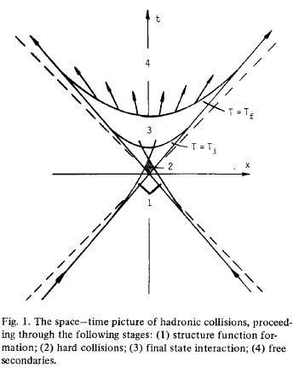
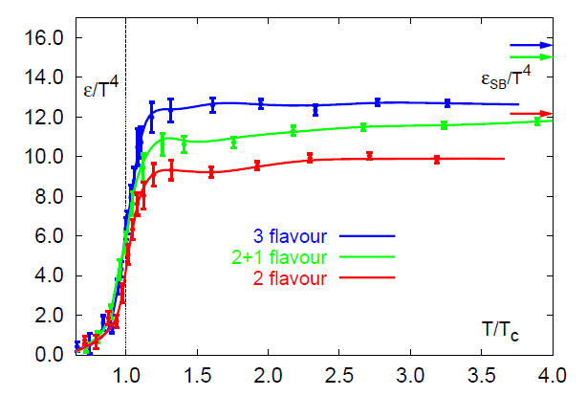
”Relativistic heavy ion physics“- why ?: a bit of history
Cabibbo, N. & Parisi, G. , Exponential hadronic spectrum and quark liberation. Phys. Lett. B 59, 67–69 (1975).
Collins, J. C. & Perry, M. J. Superdense matter: neutrons or asymptotically free quarks? Phys. Rev. Lett.34, 1353–1356 (1975).
E.V.Shuryak, Quark-gluon plasma and hadronic production of leptons, photons and psions, Phys. Lett. B78 (1978) 150.
Lattice QCD results
QGP
Hadron gas
E.V.Shuryak, Phys. Lett. B78 (1978) 150
Early expectations: QGP like an ideal gas of quarks and gluons
4
Notes:
Cabibbo, N. & Parisi. (1975) , “We suggest that the “observed” exponential spectrum is connected to the existence of a different phase of the vacuum in which quarks are not confined.”
“At high enough temperature we expect a transition to a new situation, where the "interior" has fused into a connected region, with isolated ponds and lakes of exterior. Again, in the high temperature state,
quarks can move throughout space. We note that this picture of the quark liberation is very close to that of the droplet model of second order phase transitions”
Collins, J. C. & Perry, M. J. (1975) “We note the following: The quark model implies that superdense matter (found in neutron-star cores, exploding black holes, and the early big-bang universe) consists of quarks rather than of hadrons. Bjorken scaling implies that the quarks interact weakly. An asymptotically free gauge theory allows realistic calculations taking full account of strong interactions.”
E.Shuryak. (1978) : “We assume that in hadronic collisions after some time a local [7] thermal equilibrium is established in the sense that all properties are determined by a single
parameter, the temperature T, depending on time and coordinates. “
….”Collins and Perry noted in 1975 [5] that the reduction of the coupling constant at small distances indicated that the dense nuclear matter at the center of neutron stars would consist of deconfined quarks and
gluons 2 . Their treatment focused on the high-density, low-temperature regime of QCD, but they did note that similar arguments might apply to the high temperatures present in the early universe. An extensive review by Shuryak in 1980 [7] is the first to have examined the high-temperature phase in detail, and is also notable for proposing the phrase “quark-gluon plasma” (QGP) to describe the deconfined state::When the energy density " exceeds some typical hadronic value (∼ 1 GeV/fm3), matter no longer consists of separate hadrons (protons, neutrons, etc.), but s their fundamental constituents, quarks and gluons. Because of the apparent analogy with similar phenomena in atomic physics we may call this phase of matter the QCD (or quark-gluon) plasma.”
….Search for the primordial state of matter may be what the Universe was like in the first instants after the Big Bang
….“We are interested in the final state interaction region, limited by two lines:
T(x, t) = T i, the initial temperature at which the thermodynamical
description becomes reasonable, and T(x, t)
= Tf ~ m~, where the system breaks into secondaries
[4,7]”.
[4] L.D. Landau, Izv. Akad. Nauk Set. Fiz. 17 (1953) 51.
[5] E.V. Shuryak, Zh. Eksp. Teor. Fiz. 74 (1978) 408.
[6] A.M. Polyakov, Trieste preprint IC/77/135.
[7] E.V. Shuryak, Yad. Fiz. 20 (1974) 549.
[8] R. Feynman, Interaction of photons with hadrons
(Benjamin, New York, 1972).
Tcrit~ 170 MeV

Slide 5


Space-time stages of nucleus-nucleus collision
Pre-equilibrium phase
τ_{eq}< 0.5 fm/c
QGP medium
Almost perfect liquid: η/s ~ 0.1
Temperature: ~300 MeV from the photon spectrum inverse slope
Large volume: ~5000 fm³
Mean life time: τ ~ 10 fm/c
Energy density (in central Pb-Pb collisions at 5.02 TeV): ≈20 GeV/fm³ (>>ε_{crit} ≈ 1 GeV/fm³)
Mixed phase
Chemical freeze-out:
particle composition is fixed
at T_{ch} ~ 155 MeV
Thermal freeze-out:
particle p_{T} spectra are fixed
at T_{tfo} ~ 100 MeV
Time
π, K, p, Λ,Ξ,Ω,…d,He3,He4…
“Quark-gluon soup”
z
Colliding
nuclei
Notes:
fast equilibration, within roughly 10^{–24} s,
The resulting deconfined and thermalised medium expands and cools over the next few 10^{–24} s, before the quarks and gluons recombine to form a hadron gas.

Slide 6
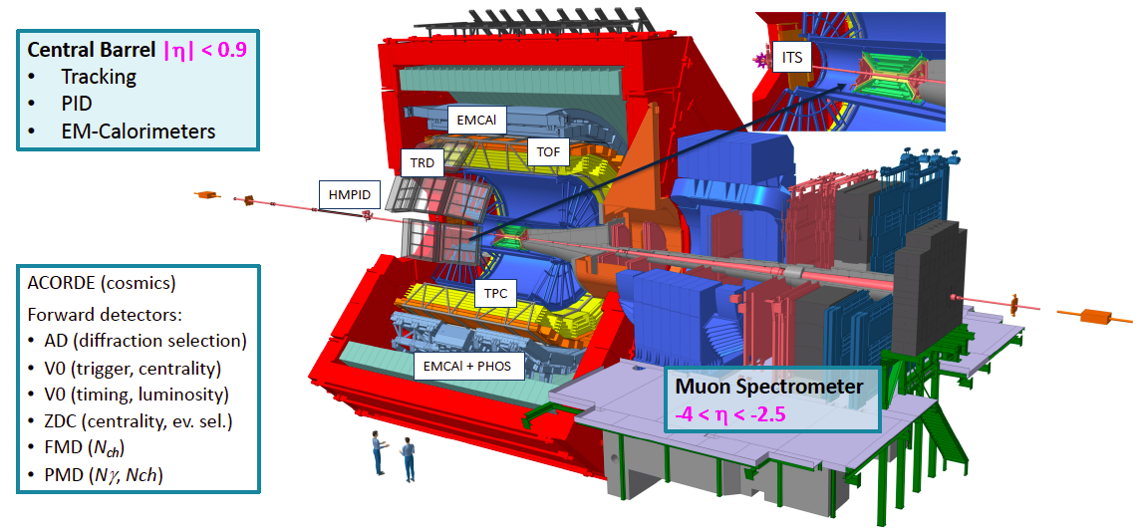
ALICE in Run 1 and Run 2
ALICE is optimized for Heavy-Ion Physics - excellent tracking of low momenta particles
Efficient registration of the hadrons, electrons, muons, and photons.
produced in pp, p-Pb and Pb-Pb collisions at the LHC.

Slide 7
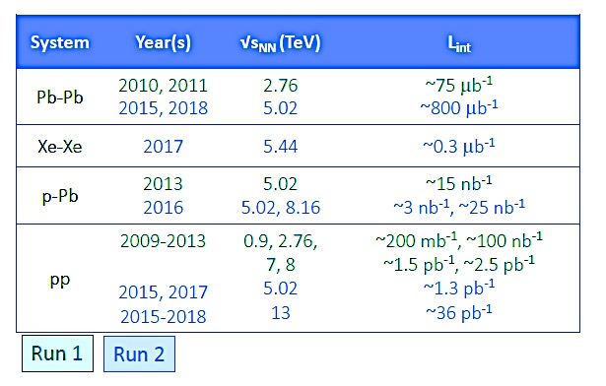
ALICE data in Runs 1,2 in 2=09-2018
ALICE Collaboration: 40 countries, 173 institutes, 2027 members
Publications: total > 390

Slide 8
.
QGP and formation of light (anti) (hyper) nuclei

Slide 9
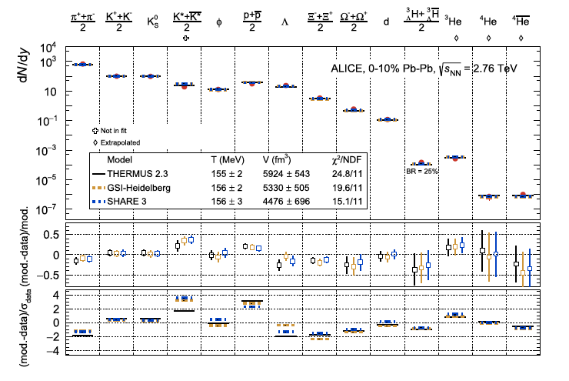
Formation of light (anti) (hyper) nuclei in central Pb-Pb collision at √s_{NN}=2.76 TeV
Pb–Pb collisions
⁴He is the heaviest
antinucleus observed
What is the mechanism of light (anti)nuclei and (anti)hypernuclei production in hadron
collisions?
Statistical hadronisation
model (SHM)[2]
vs. Coalescence?
Thermal-model ﬁts to the p_{T}-integrated yields of many hadron species measured in ALICE[1]
[1] ALICE Collab., Nucl. Phys. A 971 1 (2018) 1-20
[2] NATURE, (2 0 1 8) vol. 561, 321-325
Notes:
Statistical production Thermal-model ﬁts to the p_{T}-integrated yields of many hadron species measured in ALICE show excellent agreement with data. Source: Nucl. Phys. A 971 1
A.Andronic, P.Braun-Munzinger, K.Redlich, Johanna Stachel Statistical hadronisation model (SHM)
NATURE, (2 0 1 8) vol. 561, 321-325

Slide 10
Formation of light (anti) (hyper) nuclei in pp, p--Pb and Pb--Pb collisions: hypertriton
~10fm
n
P
Λ
pp, p-Pb and Pb–Pb collisions
arXiv:2107.10627
The 1st measurement in p–Pb collisions at the LHC of hypertriton, reconstructed via the decay channel ³_{Λ}H → ³He + π⁻
  The lightest hypernucleus (p,n, Λ) (mass ≈ 2.991 GeV/c²)
  The binding energy : B_{Λ} ≈ 130 keV
Fragile but surviving at chemical freeze-out temperature T_{ch} = 156 MeV ?
Important to discriminate between nucleosynthesis mechanisms in dense and hot environments
Results are currently in favour of coalescence
Improved statistics – is expected in the upcoming LHC Run 3 with the upgraded ALICE
Search of Σ⁰–hypernuclei: talk by Alexander Borissov at this conference,12 July 2022, 12:30
Notes:
Production of (anti)(hyper)nuclei was measured earlier in Run 1 and Run 2 at different energies.
Hypertriton/Λ
measurements in p-Pb (in red), pp (in orange) and Pb-Pb collisions (in blue) as a function of mean charged-particle multiplicity. The vertical lines and boxes are the statistical and systematic uncertainties (including the uncertainty on the B.R.), respectively. The expectations for the canonical statistical hadronization and coalescence models are shown.
Reference to the points and models:
- Hypertriton production in p--Pb --> https://arxiv.org/pdf/2107.10627.pdf
- Hypertriton production in Pb--Pb --> ALICE Collaboration (2016). Phys. Lett. B, 754, 360–372.
- Thermal models --> Vovchenko, V., Dönigus, B., & Stoecker, H. (2018). Phys. Lett., B785, 171-174.
Coalescence models --> Sun, K.J., Ko, C., & Dönigus, B. (2019). Phys. Lett. B, 792, 132–137.
³_{Λ}H and ³_{Λ}H are combined
to reduce the statistical
uncertainty.
n the coalescence pictureL nucleons that are close to each other in phase space can form a
nucleus via coalescence [R]N the key concept is the overlap between the nuclear wave function and
the phase space of the constituent nucleons

Slide 11
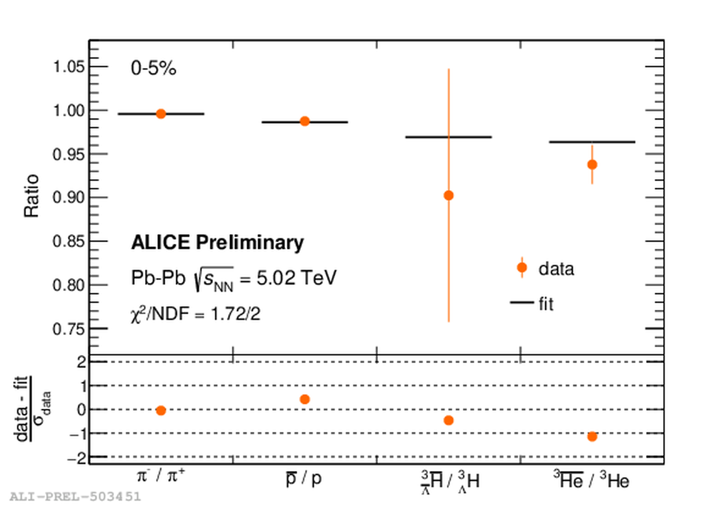
Formation of light (anti) (hyper) nuclei in Pb--Pb collisions: antimatter-over-matter ratios
New!
Antiparticle-to-particle ratios of charged pions, protons, hypertriton (³_{Λ}H) and ³He
Pb–Pb collisions, √s_{NN}=5.02 TeV
T = 156.5 ± 1.5 MeV, fixed from the Statistical Hadronisation Model (SHM) [ A. Andronic et al., Nature 561, (2018) 321]
Measurement of baryon chemical potential 𝜇_{𝐵}
Fit using the relation obtained from SHM.
Notes:
Figure Caption
Fit of the antiparticle-to-particle ratios of charged pions, protons, hypertriton (3ΛH
), 3He, obtained in the 0-5% centrality interval using the relation obtained from the Statistical Hadronisation Model (SHM). The vertical bars represent the sum in quadrature of the statistical and centrality-uncorrelated systematic uncertainties on each measured ratio. The fit values obtained for each particle species are shown as horizontal black lines. The χ2/NDF is also reported. In the bottom panels, the difference between data and fit normalised to the data uncertainty is reported.

Slide 12
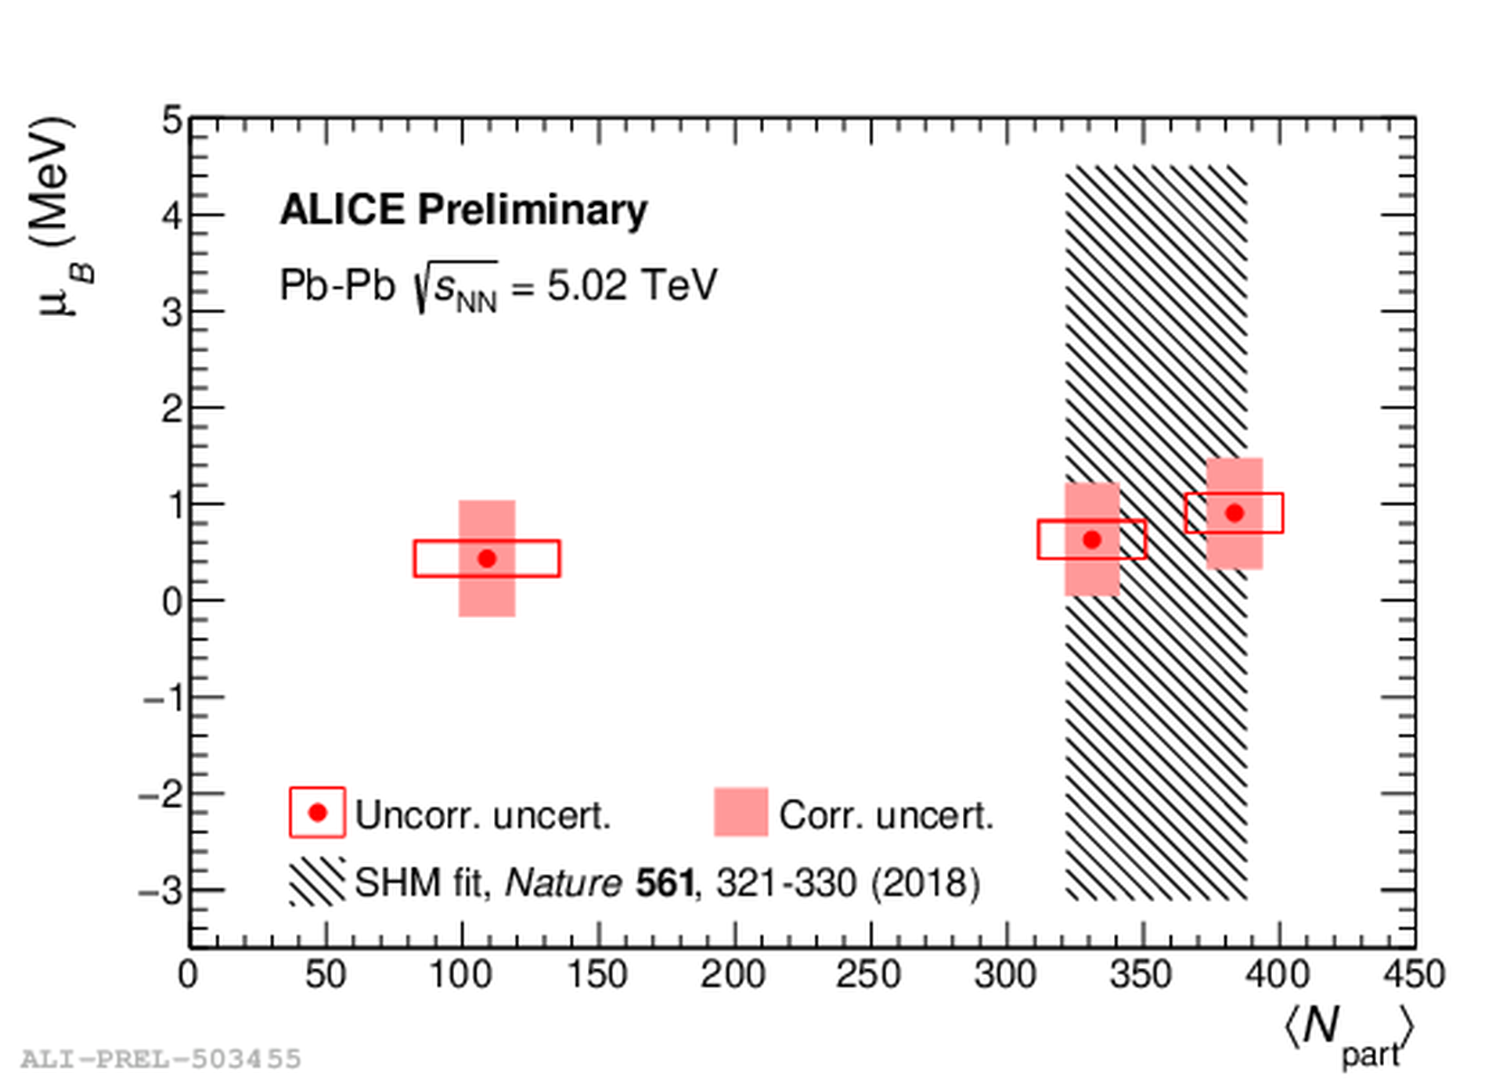
Formation of light (anti) (hyper) nuclei in Pb--Pb collisions: antimatter-over-matter ratios
New!
Pb–Pb collisions, √s_{NN}=5.02 TeV
Most precise measurement
in Pb-Pb at LHC
Small but non-zero μ_{B} at LHC
The analysis will be extended
to antimatter-over-matter ratios for strange baryons, such as Λ, Ξ and Ω
Notes:
Figure Caption
μB
as a function of the average number of participating nucleons ⟨Npart⟩. The empty boxes represent the total centrality-uncorrelated uncertainty on μB and the uncertainty on ⟨Npart⟩, while the filled red areas show the centrality-correlated uncertainty on μB. The shaded black region represents the result obtained in 2018 and published in Nature 561, 321–330 (2018).

Slide 13
.
Jets in QGP medium

Slide 14
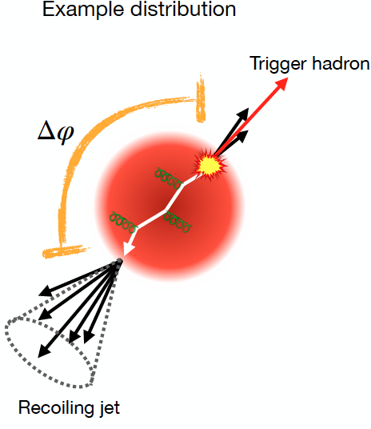
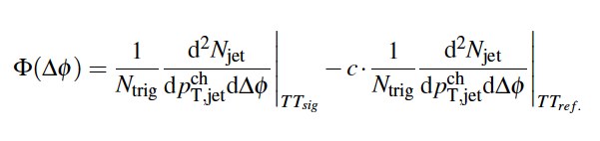
Jets as probes for the study of the deconfined matter
Charged-particle jets recoiling from a high-p_{T} trigger hadron
Observables for recoil jets:
Signal Trigger Track (TT_{sig} ) -- interval 20 to 50 GeV/c
(labeled as TT20,50)
Reference Trigger Track (TT_{ref}) -- interval 5 to 7 GeV/c
(labeled as TT5,7)
Δ_{recoil} (p_{T}, Δφ)- the azimuthal correlation
between the trigger hadron and recoil jet
p_{T}
R.Cruz-Torres QM-2022
Δ_{recoil} (pT, Δφ)
Notes:
Jets as probes for the study of the deconfined matter formed in heavy ion collisions.
Measurements as a function of the charged jet pT, pchT,jet
The trigger hadron, or trigger track (TT) is in a given pT interval pT,trig
The azimuthal correlation between the trigger hadron and recoil jets is studied with a similar observable
100 Φ(Δφ), defined as: Δ_{recoil}
Where c is a scaling factor accounting for conservation of jet density explained in section 4.2.4.

Slide 15
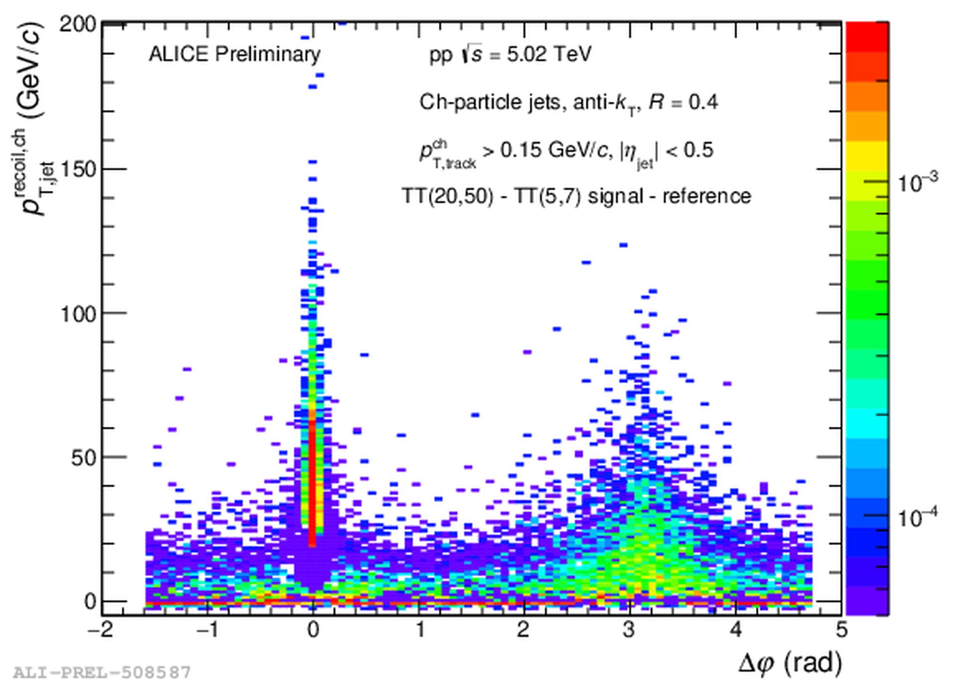
Jets in QGP medium: modification of the angular structure of recoil jets
New!
Measurement of the semi-inclusive hadron+jet distributions
pp and Pb–Pb collisions
R.Cruz-Torres QM-2022
Modification of Δϕ distribution
for recoil jets
Medium-induced gluon radiation vs. multiple-scattering-like intra-jet?
.
Notes:
1001) Measurement of the semi-inclusive hadron+jet distributions in pp and Pb-…

Slide 16
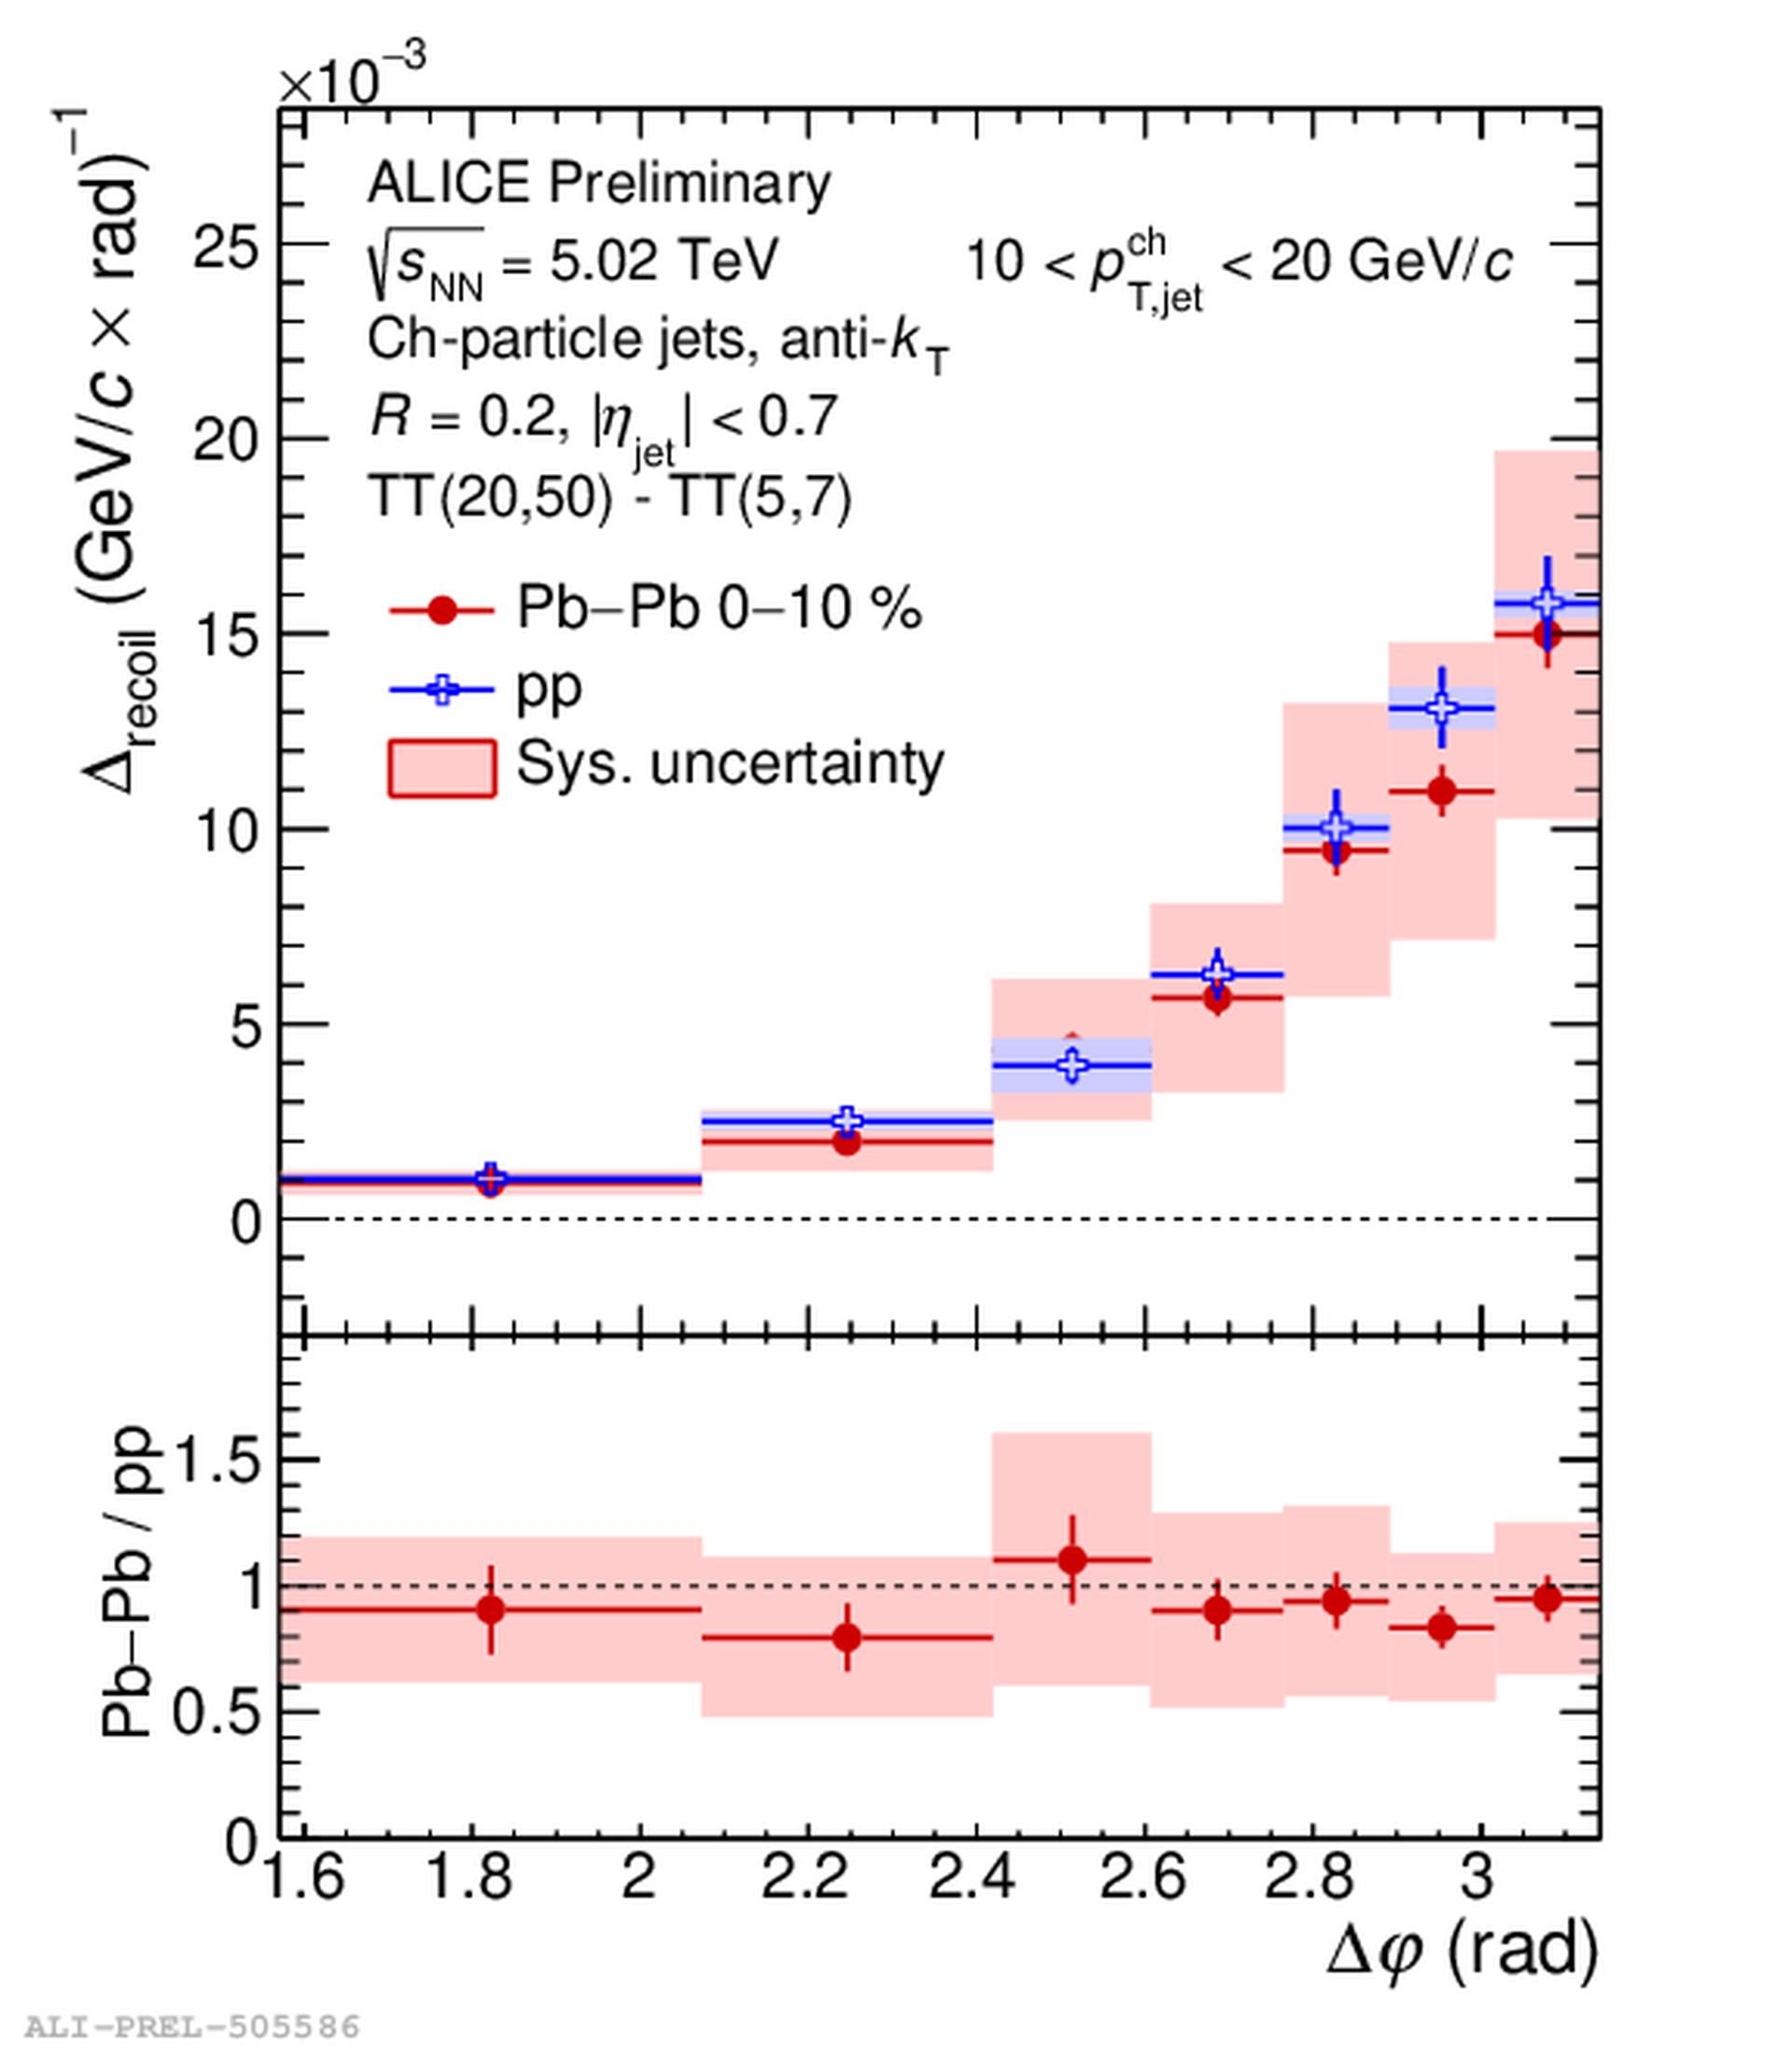
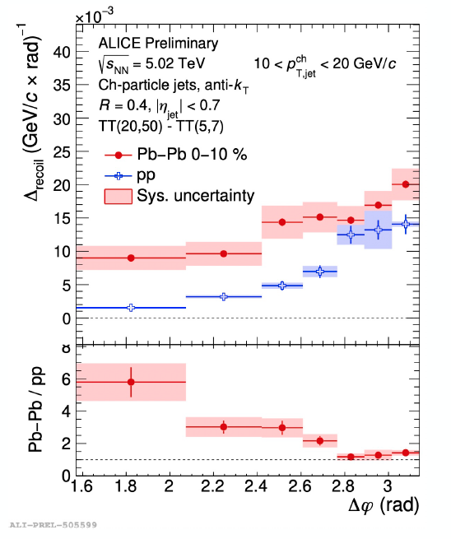
Jets in QGP medium: modification of the angular structure of recoil jets
New!
R=0.2 hadron+jet
R=0.4 hadron+jet
pp and Pb–Pb collisions
R.Cruz-Torres QM-2022
Modification of Δϕ distribution
for recoil jets
At high p_{T} , the Pb–Pb and pp shapes are consistent within uncertainties.
At low p_{T} (R=0.4), a significant azimuthal (in ∆φ) broadening is seen in Pb–Pb collisions with respect to pp collisions.
Notes:
R=0.2 hadron+jet Δϕ distribution for 10<pT,jetch<20GeV/c in 0-10% Pb-Pb collisions and pp collisions at ‾‾‾‾√sNN=5.02TeV
Understand interplay between QGP competing effects -e.g. medium-induced gluon radiation vs. multiple- scattering-like (intra-jet) broadening

Slide 17
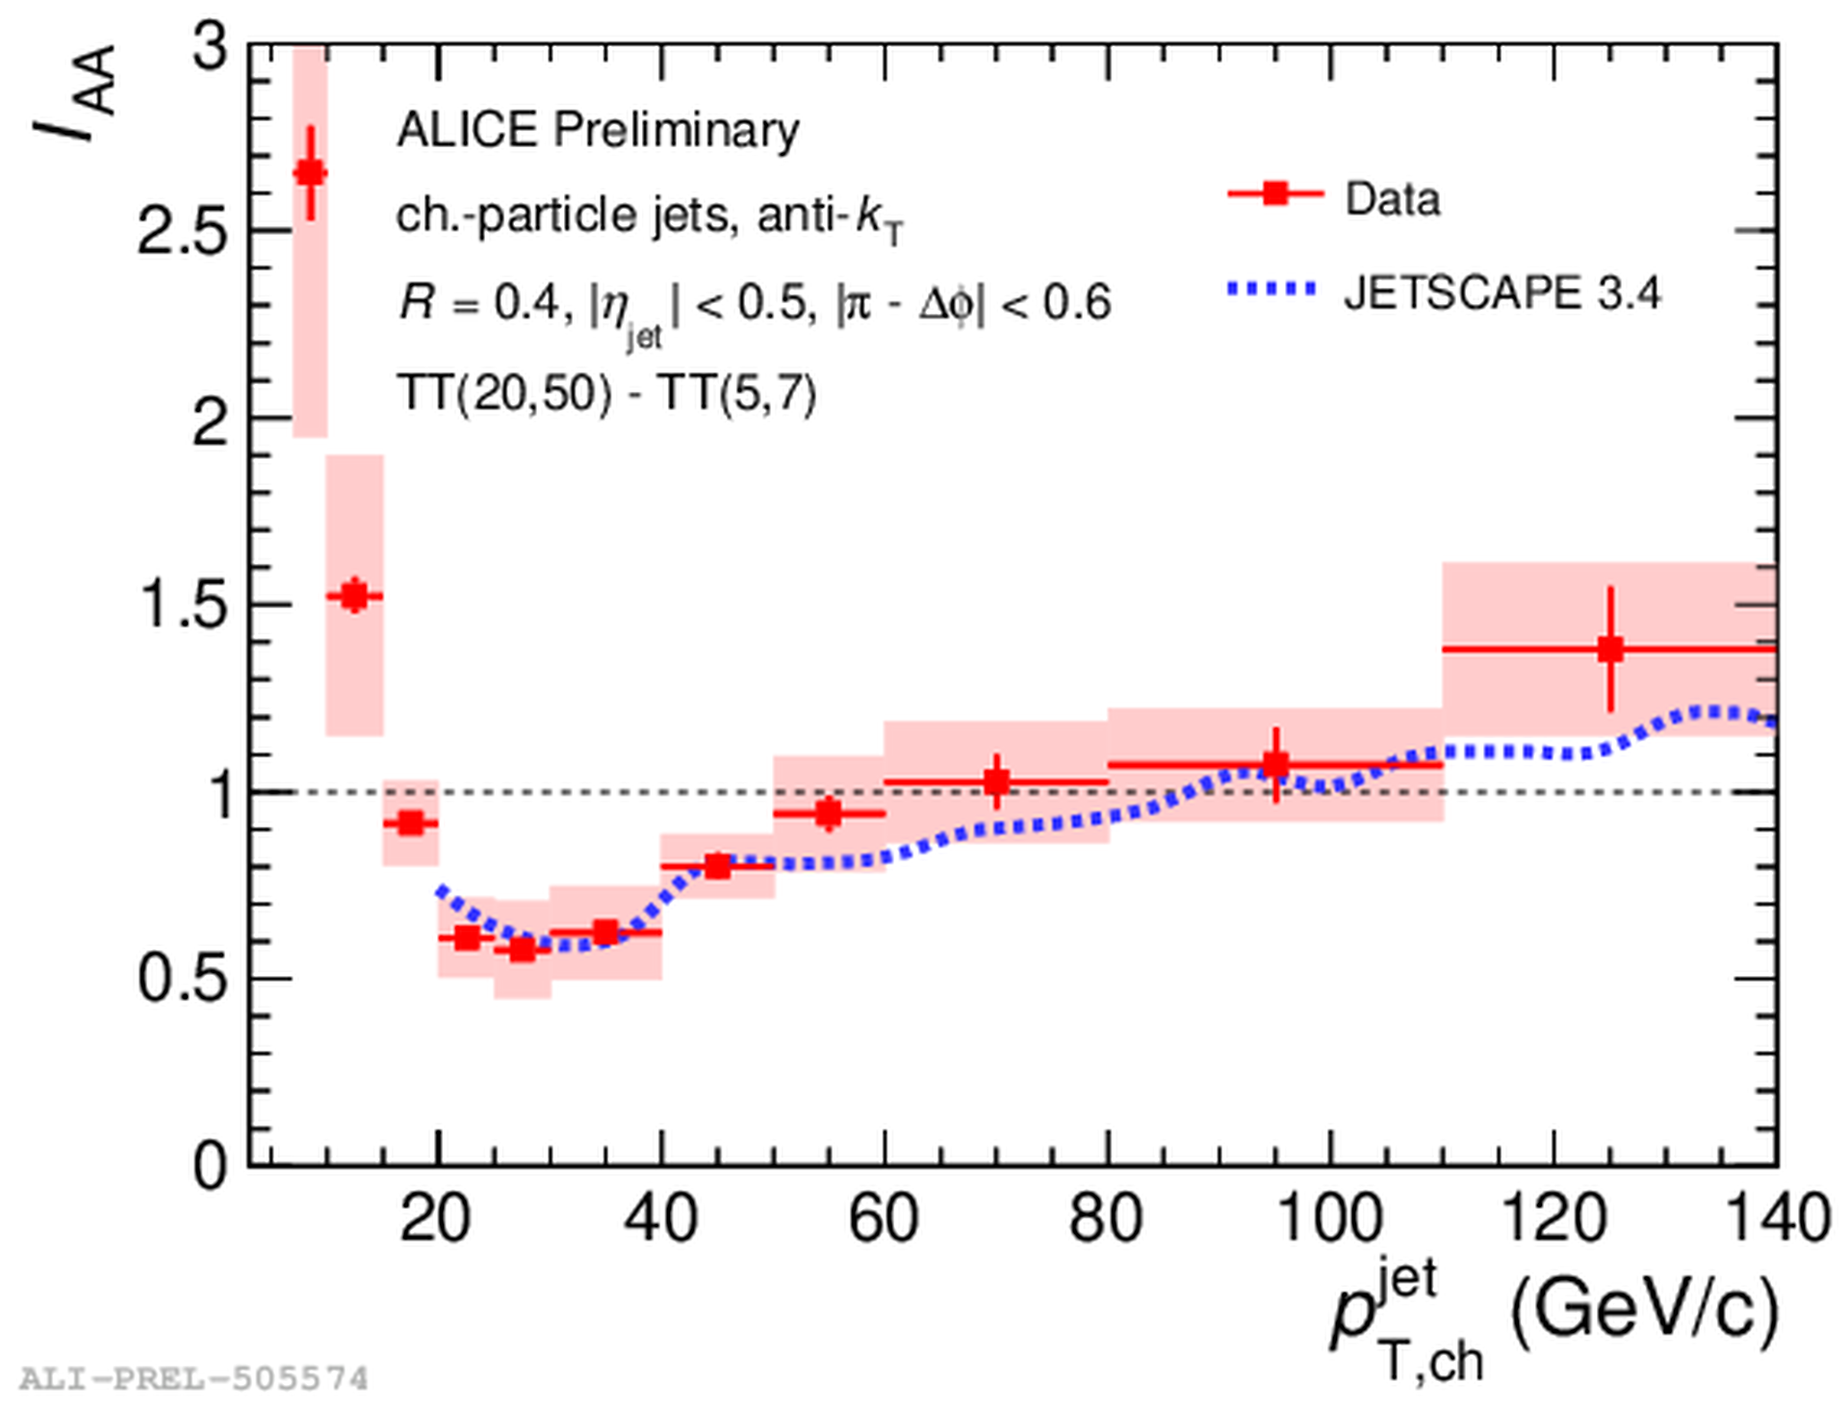

Jets in QGP medium: modification of the angular structure of recoil charge particle jets
New!
pp and Pb–Pb collisions
Jet energy is redistributed in HI collisions?
Low jet momenta region:
energy recovery?
R=0.4 hadron+jet I_{AA} distribution vs. p_{T,ch}^{jet} in 0-10% Pb-Pb collisions over pp collisions
at √s_{NN}=5.02 TeV
Notes:
Δrecoil is defined as the difference between the trigger-normalised recoil jet yields
in two exclusive trigger-track intervals:
TTRef:5<pT,trig<7 GeV/c
and
TTSig:20<pT,trig<50 GeV/c.
The anti-k_t jet clustering algorithm
Matteo Cacciari, Gavin P. Salam, Gregory Soyez > hep-ph > arXiv:0802.1189
Δrecoil is measured
n the back-to-back region of the azimuthal angle between the trigger track and recoil

Slide 18
Strangeness in hadronic collisions

Slide 19
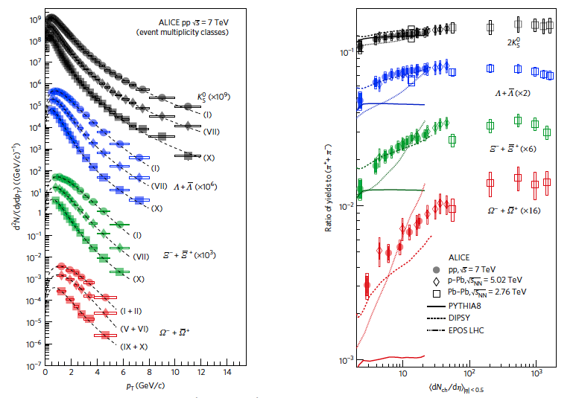
Enhanced production of multi-strange particles in high-multiplicity pp, p─Pb and Pb-Pb collisions
Nature Physics 13,535–539 (2017)
p_{T}-integrated yield ratios to pions (π⁺ + π⁻) as a function of 〈dN_{ch}/dη〉 measured in |y| < 0.5.
p_{T}-differential yields
pp, p-Pb and Pb–Pb collisions
The enhancement is larger
for particles with larger strangeness content
No dependence on
the LHC collision energy
Striking similarities in
strangeness production
for large and small systems
Origin of strangeness
enhancement?
Notes:
Strangeness enhancement, originally proposed as a signature of QGP formation in nuclear collisions⁷, is more pronounced for multi-strange baryons. Several effects typical of heavy-ion phenomenology have been observed in high-multiplicity proton–proton (pp) collisions^{8,9}, but the enhanced production of multi-strange particles has not been reported so far. Here we present the first observation of strangeness enhancement in high-multiplicity proton–proton collisions. We find that the integrated yields of strange and multi-strange particles, relative to pions, increases significantly with the event charged-particle multiplicity.

Slide 20
New!
Strangeness at midrapidity
vs multiplicity and efficient energy
pp collisions, 13 TeV
Λ: (uds)
Ξ: (dss)
Ω: (sss)
Λ, Ξ and Ω production vs midrapidity multiplicity -(left) and vs. energy deposited in ALICE’s Zero Degree Calorimeters (ZDC) –(right)
Yields of multistrange baryons are anticorrelated with the forward energy, measured by ZDC
Correlated with the effective energy available in the event for particle production
Role of the initial stages and number of partonic collisions (MPI) in strangeness production?
.
Notes:
Ξ⁻
dss
Λ0 + π−
Λ (uds) 1116 MeV 2.6·10⁻¹⁰ 1/2⁺(0) → pπ⁻, nπ⁰
Self normalized) ratio of Ξ yields to multiplicity (to INEL>0) vs midrapidity multiplicity (left)
and vs ZDC energy (right).

Slide 21
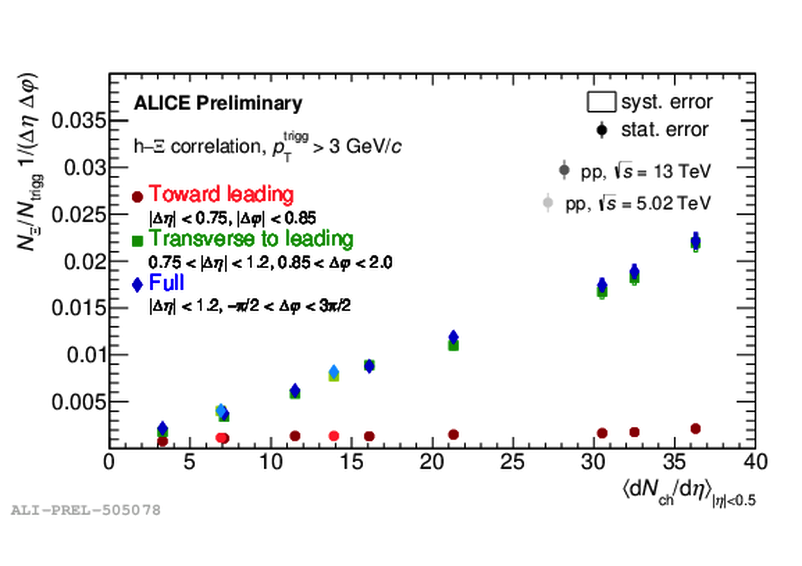
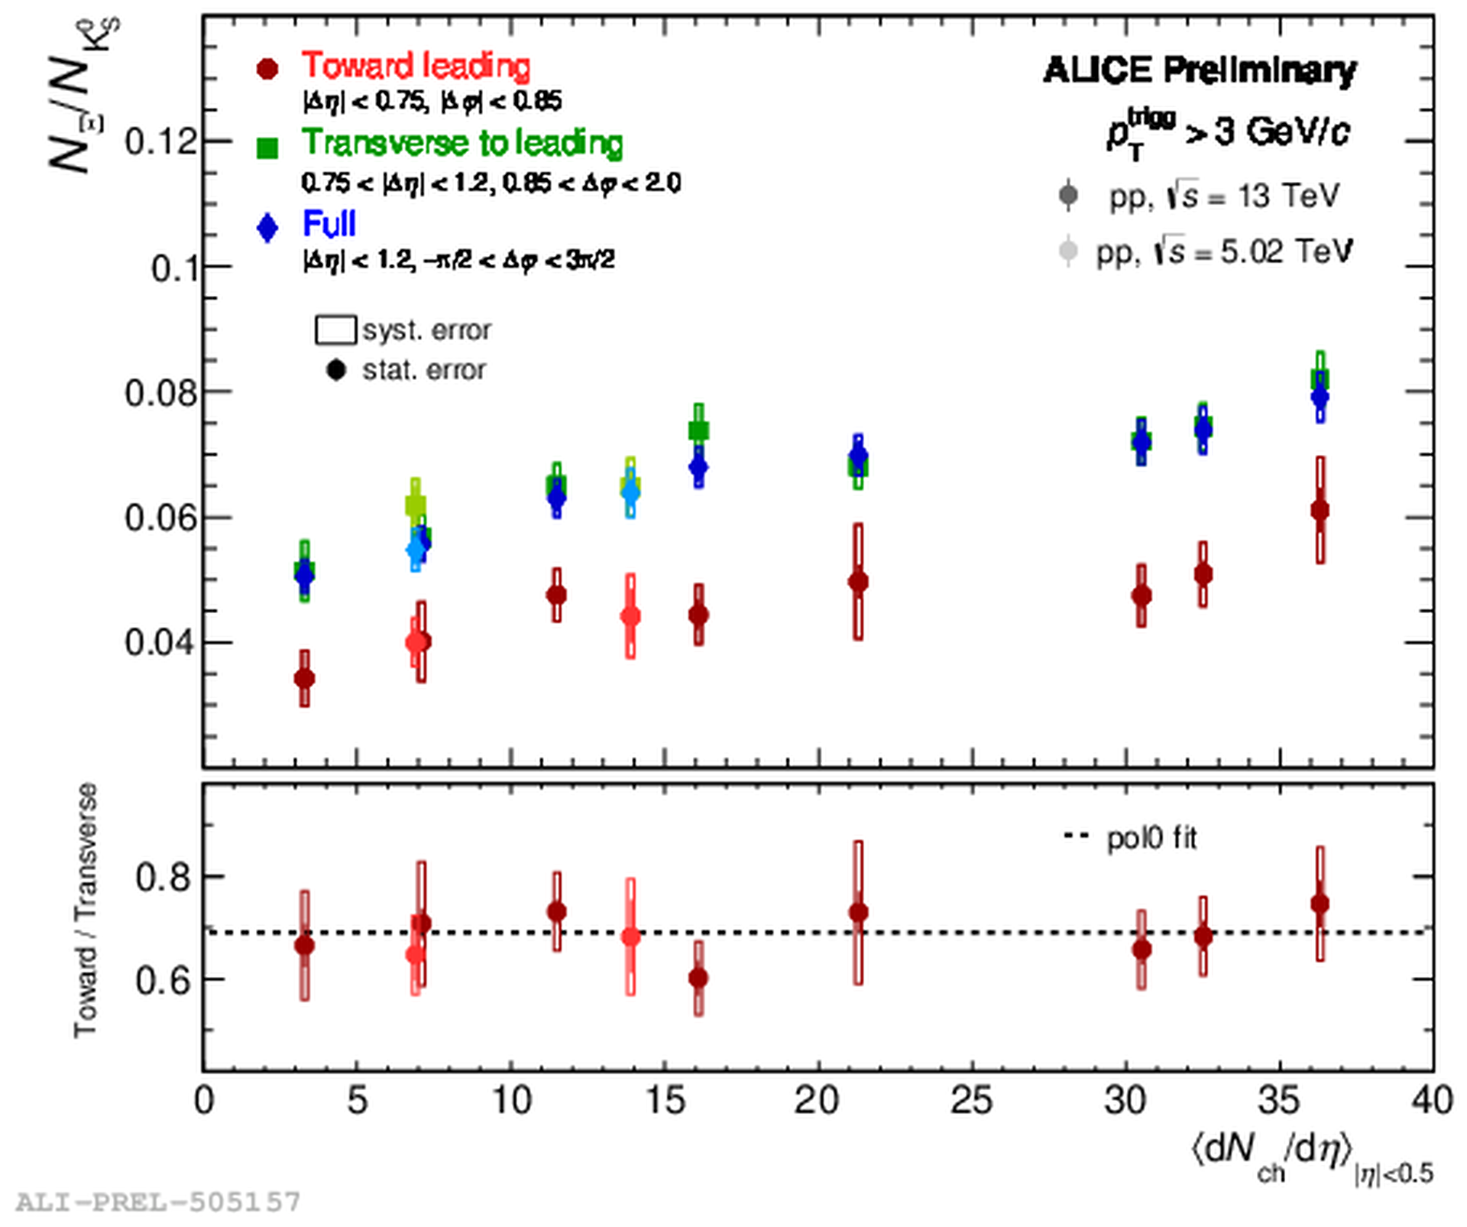
Strangeness production in jets and out of jets
New!
pp collisions at √s=13 TeV and √s =5.02 TeV
Ξ vs. multiplicity
Ξ/K⁰_{s} ratios vs. multiplicity
Near-side jet, out-of-jet and full yield of Ξ vs. multiplicity of charged particles produced at midrapidity
Near-side jet, out-of-jet and inclusive Ξ/K0s yield ratios vs. multiplicity of charged particles
For Ξ mesons the near-side leading jet yield is practically flat with multiplicity
Linear growth of Ξ yield with multiplicity in transverse to leading
.

Slide 22
.
Charm in pp, p-Pb and Pb-Pb collisions

Slide 23
Charm in pp, p-Pb and Pb-Pb collisions
Time
Why open heavy flavour
is interesting?
Production is relevant to early collision stages
Theoretical calculation of production in perturbative QCD
Transport of c-quark through the medium: collisions and radiative e-losses ?
Hadronisation mechanism?
Charm measurements in ALICE:
D⁰ ⟶K⁻⁻π⁺
D⁺⟶K⁻⁻π⁺ π⁺
D_{s}⁺⟶ ϕ π⁺ ⟶ K ⁺ K⁻⁻π⁺
D*⁺ ⟶D⁰π⁺ ⟶K⁻⁻π⁺ π⁺
Λ_{c}⁺⟶ K_{s}⁰ p ⟶ π⁺ π – p
c ⟶ μ± 𝑋 (with muon spectrometer)
π, K, p, Λ,Ξ,Ω,…d,He3,He4…
D
B
C-quark
B-quark
z
Colliding
nuclei
Notes:
fast equilibration, within roughly 10^{–24} s,
The resulting deconfined and thermalised medium expands and cools over the next few 10^{–24} s, before the quarks and gluons recombine to form a hadron gas.
Heavy quarks are mainly produced in hard-scattering processes and hence in shorter timescales compared to the QGP.
Charm azimuthal correlations (DD azimuthal correlations)
Heavy flavour transport
Interactions with the plasma generate azimuthal anisotropy v2:

Slide 24
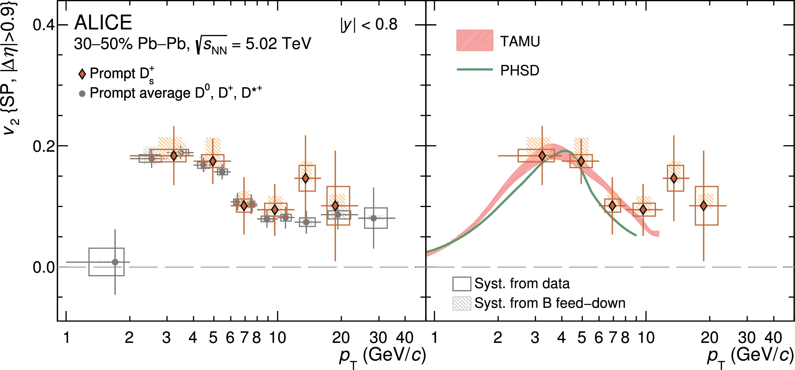
Flow of prompt D_{s}⁺-mesons in Pb-Pb collisions
New!
c
s
Physics Letters B 827 (2022)
Pb–Pb collisions
.
For prompt D⁺_{s} mesons v₂ is compatible with that of non-strange D mesons
Charm participates in collective expansion/motion: noticeable elliptic flow is in line with TAMU and PHSD models with charm-quark coalescence
Future data samples will be collected in Run 3 extended to lower p_{T} with the upgraded ALICE detector
Notes:
The most precise measurements of prompt D+s -meson production in heavy-ion collisions at LHC energies to date
The measured D+s - meson v2 is compatible within uncertainties with the predictions
of the TAMU and PHSD models, which include charm-quark coalescence with flowing strange quarks in the medium
Elliptic flow coefficient v2 of prompt D⁺_{s} mesons in the 30–50% centrality interval in Pb–Pb collisions at √sNN = 5.02 TeV compared with that of non-strange D mesons [26] (left panel) and with theoretical calculations based on the charm-quark transport in a hydrodynamically expanding QGP (right panel)

Slide 25
Constraining hadronization mechanisms with Λ⁺_{c} /D⁰ production ratios
New!
pp and Pb–Pb collisions
c
Prompt Λ⁺_{c}
Λ⁺_{c} /D⁰
u
d
u
c
The p_{T}-differential production yields of prompt Λ⁺_{c} in central (0–10%) and mid-central (30–50%) Pb–Pb collisions at √sNN = 5.02 TeV.
The Λ⁺_{c} /D⁰ ratio in central and mid-central Pb–Pb collisions at
√sNN = 5.02 TeV compared with the results obtained from pp collisions [10, 11]
Λ⁺_{c} /D⁰ - ratio is sensitive to hadronisation mechanism

Slide 26
Constraining hadronization mechanisms with Λ⁺_{c} /D⁰ production ratios
New!
pp and Pb–Pb collisions
Different theoretical
calculations:
The Λ⁺_{c} /D⁰ ratio is enhanced in central Pb-Pb collisions with respect to the pp measurement for 4 <p_{T} < 8 GeV/c
It is described by theoretical calculations that include hadronisation via both coalescence and charm quark fragmentation mechanisms.
  However, no enhancement with multiplicity for p_{T} integrated Λc /D. Is it due to radial flow? arXiv:2112.08156 and arXiv:2111.11948
TAMU, PRL 124, 042301 (2020)
arXiv:1905.0921
Catania, PRC 96, 044905 (2017)
arXiv:1712.00730.
SHMc, HEP 07 (2021) 035
arXiv:2104.12754
Notes:
The pT-differential Λ+
c /D0 ratio was interpolated using the shape predicted by
TAMU [8], Catania [7] (not available for 30–50%), SHMc [9], and blast-wave [62] calculations, leaving the normalization as a free parameter
arXiv:2112.08156
arXiv:2111.11948
Catania model
o Thermalised system of u,d,s and gluons assumed
o Mixed hadron formation
a. Fragmentation
b. Coalescence → imposed to be the only mechanism for 𝑝 → 0
Luuk Vermunt | Quark Matter 2022 | 07/04/2022
“What did we learn so far?
→ Charm quarks interact with medium via collisional and radiative processes → Charm quarks participate in the collective motion, i.e. are thermalised
→ Charm quarks hadronise via recombination (in addition to fragmentation) „
Statistical Hadronization Model and Relativistic Quark
Model (SHM + RQM)
o Hadronization driven by statistical weights
governed by hadron masses (𝑛𝑖 ∼ 𝑚𝑖
2𝑇H𝐾2(𝑚𝑖/𝑇H))
at a hadronization temperature 𝑇H
o Strong feed-down from an augmented set of excited
charm baryons
→ PDG: 5 Λc, 3 Σc, 8 Ξc, 2 Ωc
→ RQM: additional 18 Λc, 42 Σc, 62 Ξc, 34 Ωc (not yet
measured

Slide 27
.
Two-body scattering involving strange and charm hyperons

Slide 28
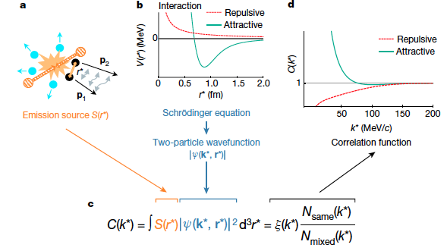
Two-body scattering and study of strong interaction involving strange hyperons
Nature 588, 232–238 (2020)
Absence of interaction C(k*) = 1
Attractive potential C(k*) > 1
Repulsive potential C(k*) < 1
Bound-state formation C(k*) <> 1
Notes:
he situation has drastically changed in recent years,
thanks to the novel employment of the femtoscopy technique [37] in pp and p–Pb collisions at the LHC
applied to almost all combinations of protons and strange hadrons [38]. The ALICE Collaboration could
precisely study the following interactions: pp, pK±, pΛ, pΛ, pΣ0, ΛΛ, ΛΛ, pΞ−, pΩ− and pφ [38–46].
Since conventional scattering experiments cannot be performed with D mesons and charm nuclei [47]
have not been discovered yet (searches for charm nuclear states are included in the scientific program
of the Japan Proton Accelerator Research Complex [48]), the femtoscopy technique can be employed
to study the ND and ND interactions. In this Letter, the first measurement of the strong interaction
between a D− meson and a proton is reported. This pioneering analysis employs D− instead of the more
abundantly produced D0 mesons because of the smaller contribution from decays of excited charm states
and the possibility to separate particles and antiparticles without ambiguity
Absence of interaction C(k*) = 1
➡ Attractive potential C(k*) > 1
➡ Repulsive potential C(k*) < 1
➡ Bound-state formation C(k*) <> 1

Slide 29
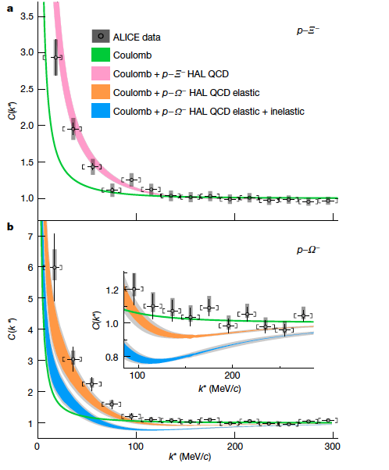
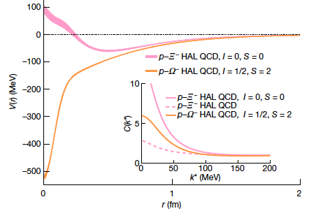

Two-body scattering and study of strong interaction involving strange hyperons
Nature 588, 232–238 (2020)
Potentials for the p-Ξ⁻⁻ and p-Ω— interactions
predicted by the HAL QCD collaboration.
[Phys.Lett. B 792, 284–289 (2019);
Nucl.Phys. A 998, 121737 (2020)].
Important input for the equation of state of neutron stars
.
Notes:
he situation has drastically changed in recent years,
thanks to the novel employment of the femtoscopy technique [37] in pp and p–Pb collisions at the LHC
applied to almost all combinations of protons and strange hadrons [38]. The ALICE Collaboration could
precisely study the following interactions: pp, pK±, pΛ, pΛ, pΣ0, ΛΛ, ΛΛ, pΞ−, pΩ− and pφ [38–46].
Since conventional scattering experiments cannot be performed with D mesons and charm nuclei [47]
have not been discovered yet (searches for charm nuclear states are included in the scientific program
of the Japan Proton Accelerator Research Complex [48]), the femtoscopy technique can be employed
to study the ND and ND interactions. In this Letter, the first measurement of the strong interaction
between a D− meson and a proton is reported. This pioneering analysis employs D− instead of the more
abundantly produced D0 mesons because of the smaller contribution from decays of excited charm states
and the possibility to separate particles and antiparticles without ambiguity
Absence of interaction C(k*) = 1
➡ Attractive potential C(k*) > 1
➡ Repulsive potential C(k*) < 1
➡ Bound-state formation C(k*) <> 1

Slide 30
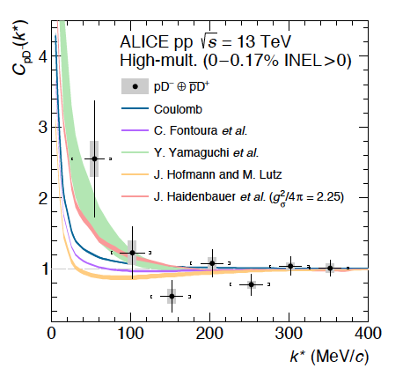
Two-body scattering involving charm hadrons
New!
Time
pp collisions
arxiv:2201.05352
π
D-meson
Coulomb
C-quark gluon
The data are compatible with the Coulomb-only interaction hypothesis within ( 1.1–1.5) σ.
The scattering parameters of charm hadrons with non-charm hadrons are important for models based on charm-quark transport in the expanding QGP
Precision studies during the LHC Runs 3 and 4 are planned with 10 times increased statistics
Notes:
he situation has drastically changed in recent years,
thanks to the novel employment of the femtoscopy technique [37] in pp and p–Pb collisions at the LHC
applied to almost all combinations of protons and strange hadrons [38]. The ALICE Collaboration could
precisely study the following interactions: pp, pK±, pΛ, pΛ, pΣ0, ΛΛ, ΛΛ, pΞ−, pΩ− and pφ [38–46].
Since conventional scattering experiments cannot be performed with D mesons and charm nuclei [47]
have not been discovered yet (searches for charm nuclear states are included in the scientific program
of the Japan Proton Accelerator Research Complex [48]), the femtoscopy technique can be employed
to study the ND and ND interactions. In this Letter, the first measurement of the strong interaction
between a D− meson and a proton is reported. This pioneering analysis employs D− instead of the more
abundantly produced D0 mesons because of the smaller contribution from decays of excited charm states
and the possibility to separate particles and antiparticles without ambiguity
The strong interaction among D mesons and light-flavor hadrons was completely out of experimental reach until recently. The scattering parameters governing elastic and inelastic D-pion/kaon/proton collisions are completely unknown. This poses strong limitations not only to the search of molecular states composed of charm and non-charm hadrons, but also to the study of the rescattering of charm mesons following their formation in ultrarelativistic heavy-ion collisions. In such collisions a colour-deconfined medium, called quark-gluon plasma (QGP), is formed. The system experiences a hydrodynamic expansion cooling down up to the chemical freeze-out, which is followed by a hadronic phase. The knowledge of the scattering parameters of charm hadrons with non-charm hadrons would be a crucial ingredient for models based on charm-quark transport in a hydrodynamically expanding QGP to describe the typical observables of heavy-ion collisions.
In this talk we will report on the first estimation of the scattering parameters governing the strong interaction of the D-proton channel measured by the ALICE Collaboration in high-multiplicity pp collision at 𝑠√= 13 TeV at the LHC. The strong interaction is studied by means of correlation in momentum space and the analysis is extended to D-kaon and D-pion combinations. It is demonstrated that all the relevant scattering parameters for the interaction of D mesons with light-flavor hadrons will be experimentally determined thanks to the upgrades of the ALICE experimental apparatus planned for the LHC Run 4 and 5 data taking periods.
This Letter presents the first measurement of the interaction between charm hadrons and nucleons.
The two-particle momentum correlations of pD− and pD+ pairs are measured by the ALICE Collaboration
in high-multiplicity pp collisions at √s = 13 TeV. The data are compatible with the
Coulomb-only interaction hypothesis within ( 1. 1–1. 5)s . Considering an attractive nucleon(N)D
strong interaction, in contrast to most model predictions which suggest an overall repulsive interaction,
slightly improves the level of agreement. This measurement allows for the first time an
estimation of the 68% confidence level interval for the isospin I = 0 inverse scattering length of the
ND state f−1
0, I=0 ∈ [− 0. 4, 0. 9] fm−1 , assuming negligible interaction for the isospin I = 1 channel.
The analysis was performed using a sample of high-multiplicity pp collisions at √s = 13 TeV collected
by ALICE [49, 50] during the LHC
The data are compatible with the Coulomb-only interaction hypothesis within ( 1. 1–1. 5)sigma .

Slide 31
Two-body scattering involving charm hadrons
New!
π⁺D⁺ π⁻D⁻
π⁺D⁻ π⁻D⁺
⁺
⁺
pp collisions
Coulomb
D-π femtoscopy in high multiplicity pp collisions at √s=13 TeV
The first studies of residual strong interaction between charm and light hadrons performed with Run 2 data
Some deviation from the Coulomb baseline, indication on a shallow repulsive potential (left)
Significant improvement is foreseen with Run 3 data
Notes:
Genuine πD correlation functions fitted in parallel with the Lendicky-Lyuboshits approach[1] in order to extract the scattering length of the strong interaction.
[1] R. Lednický and V. L. Lyuboshits, “Final State Interaction Effect on Pairing Correlations Between Particles with Small Relative Momenta”, Sov. J. Nucl. Phys. 35 (1982) 770.

Slide 32
.
Flow of identified particles
in pp and p-Pb collisions

Slide 33
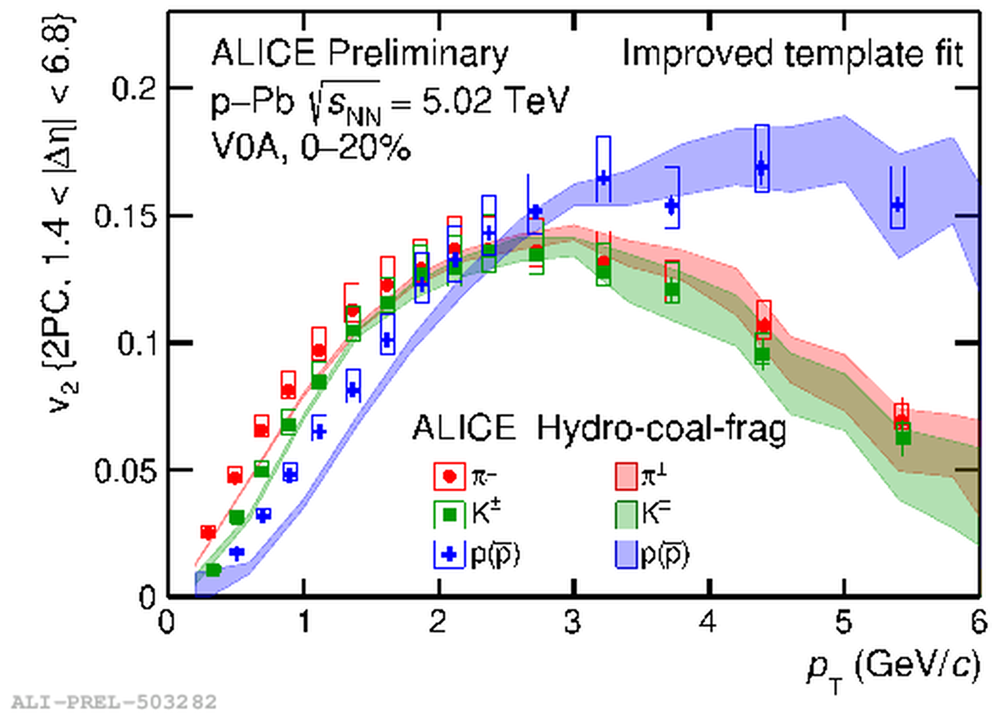
Flow of identified particles in pp and p-Pb collisions
New!
pp and p-Pb collisions
v₂ in High Multiplicity pp collisions with h, pi, K, p
Collective effects in small systems
Baryon-meson splitting - both in High Multiplicity pp and in p-Pb collisions
Partonic flow + coalescence + fragmenation?
Hydro-coal-frag model
from Phys. Rev. Lett. 125, 072301 (2020)

Slide 34
.
ALICE LS2 Upgrade

Slide 35
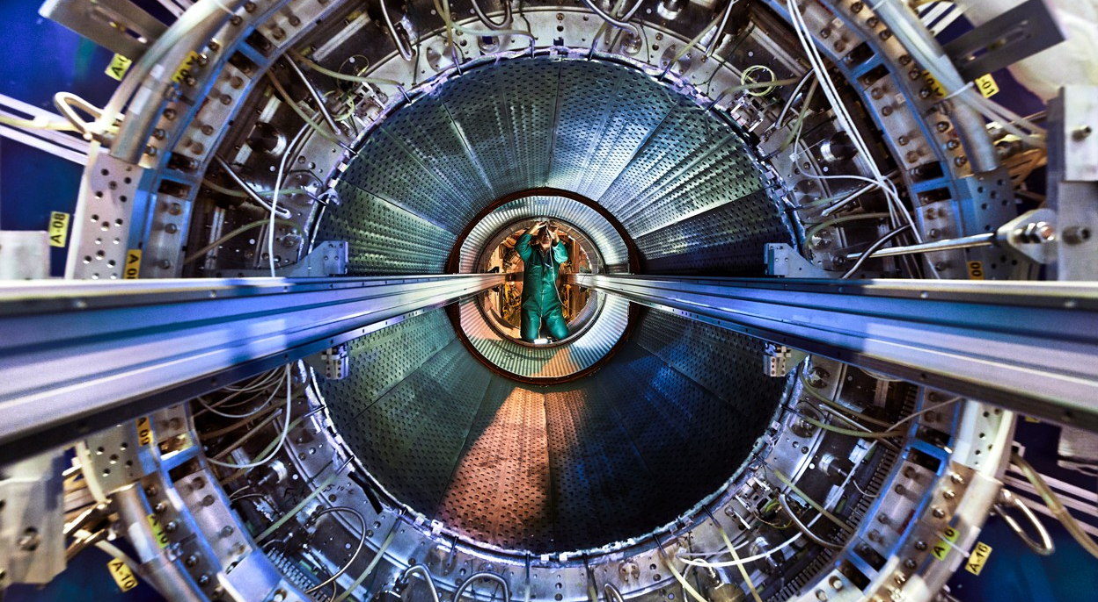
ALICE LS2 Upgrade is completed
Credit: Maximilien Brice, Julien Marius Ordan/CERN

Slide 36
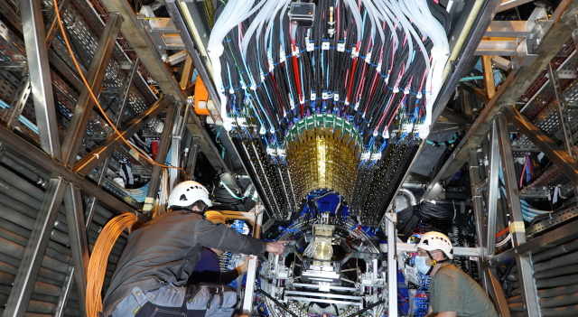
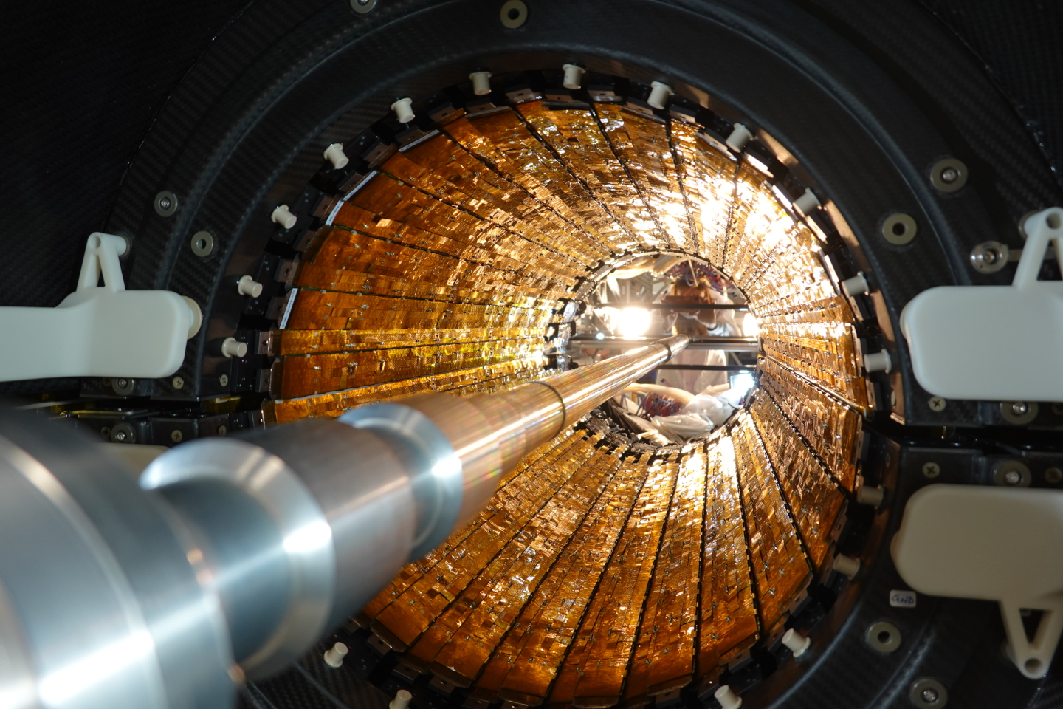
ALICE upgrade:
Inner Tracking System (ITS2) for Run 3
26 May, 2021
ITS2 in the process of installation
ALICE, the new Inner Tracking System
Installation of the Outer Barrel of the new ITS. (Image: CERN)
The new ITS is the largest pixel detector ever built in CMOS Monolithic Active Pixel Sensor (MAPS) technology: 12,5 Gpixel camera of ~10 m² of active silicon area.
High tracking precision and vertex resolution, fast readout
Closer to the IP: first layer at ≈22 mm
Smaller pixels: 28 x 29 μm²
Lower material budget of the Inner Barrel: 0.35% X₀

Slide 37
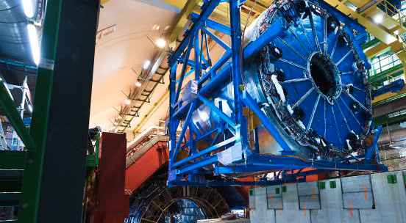
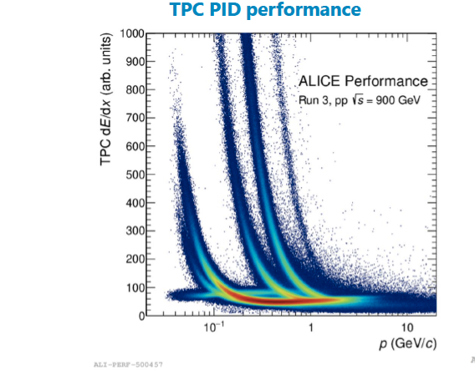
GEM TPC in the pilot beam in October 2021
Photo: Installation of the TPC
TPC with new Gas Electron Multiplier
(GEM) technology
New electronics (SAMPA),
continuous readout

Slide 38
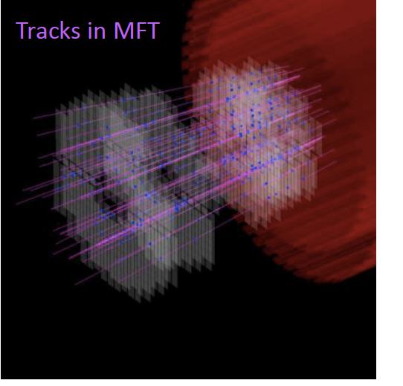
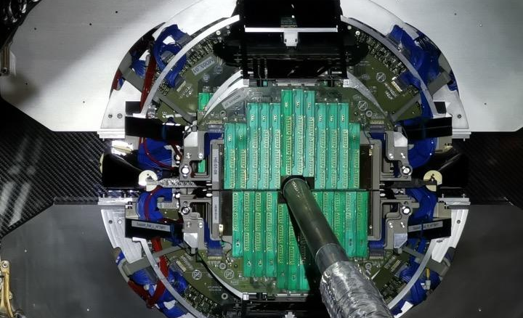
Pixel Muon Forward Tracker (MFT) in the pilot beam in October 2021
. Good performance of the new MFT in the pilot beam
The new Muon Forward Tracker, one of ALICE’s main subdetectors, was installed in the cavern in December 2020
Substantial increase in pseudorapidity coverage for ALICE
High pointing resolution for muon tracking

Slide 39
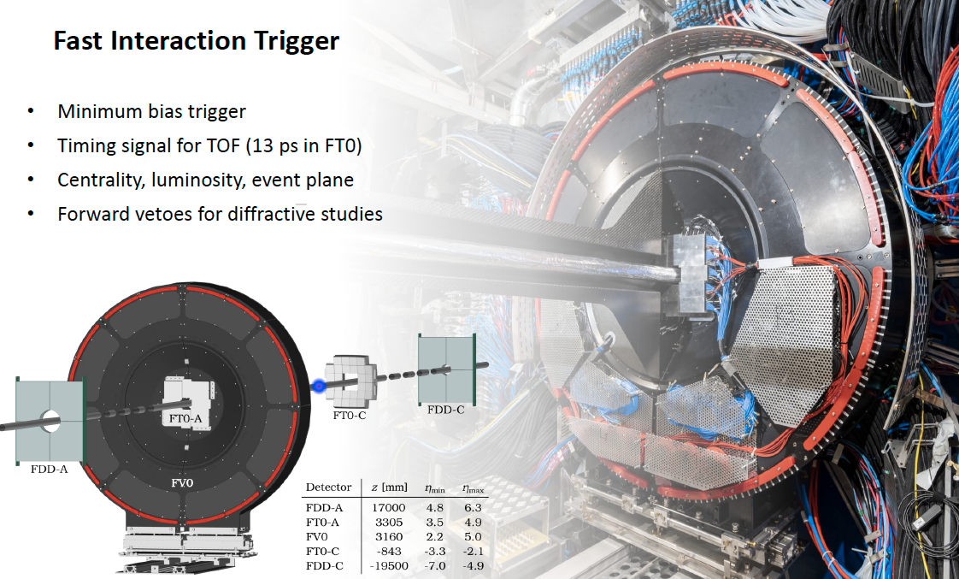
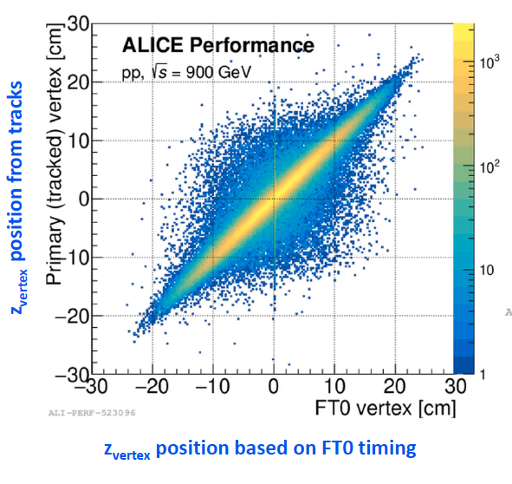
Fast Interaction Trigger (FIT) in October 2021 run

Slide 40
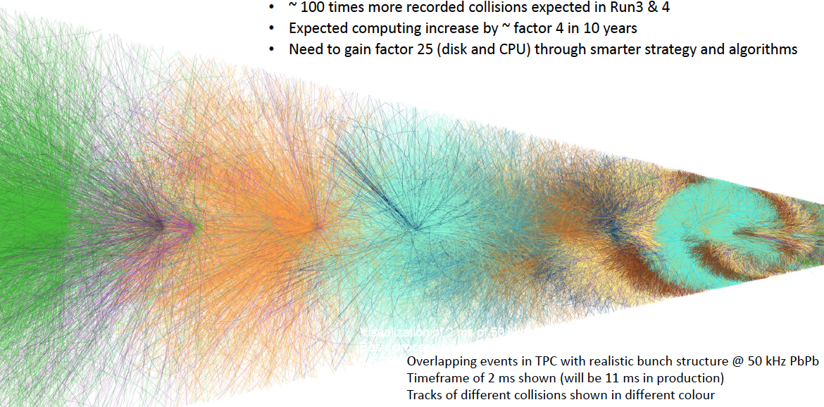
ALICE upgrade for Runs 3 and 4:
Integrated Online-Offline System (O²)
Goal: record Pb-Pb collisions at 50 kHz (vs. 1 kHz in Runs 1 & 2)
Collect 13 /nb in Runs 3&4 – gain factor 100 in statistics!
Continuous readout

Slide 41
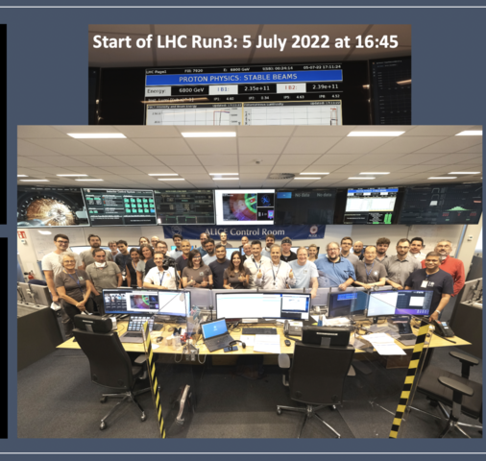
The 5th of July 2022: pp collisions at √s=13.6 TeV for the first time !
Notes:
You may want to include the event display, sent around by Luciano two days ago. (Containing tracks from one time frame, 10 ms, about 100 pp interactions.)

Slide 42
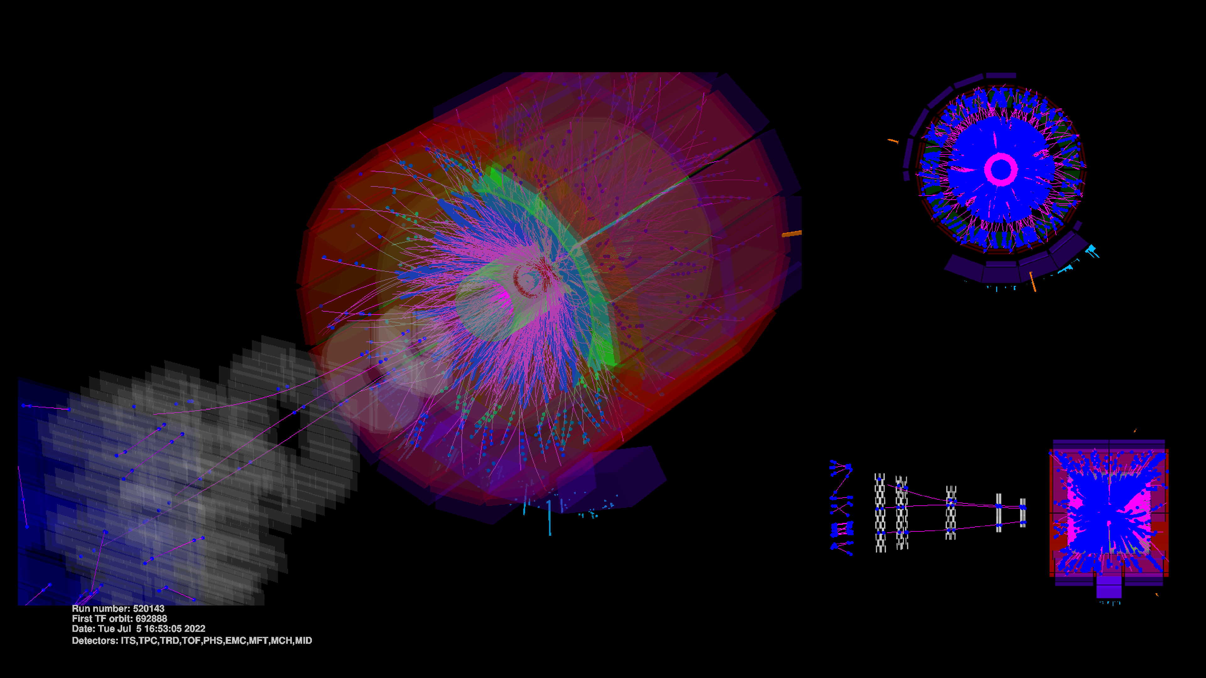
The 5th of July 2022, event display
Tracks from one time frame, 10 ms, about 100 pp interactions
Notes:
You may want to include the event display, sent around by Luciano two days ago. (Containing tracks from one time frame, 10 ms, about 100 pp interactions.)

Slide 43
.
ALICE @LHC Schedule

Slide 44
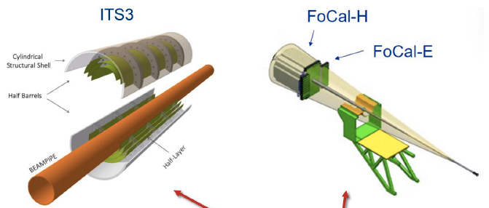
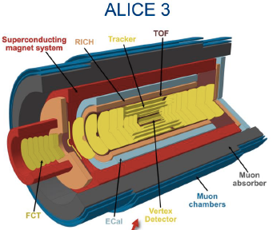
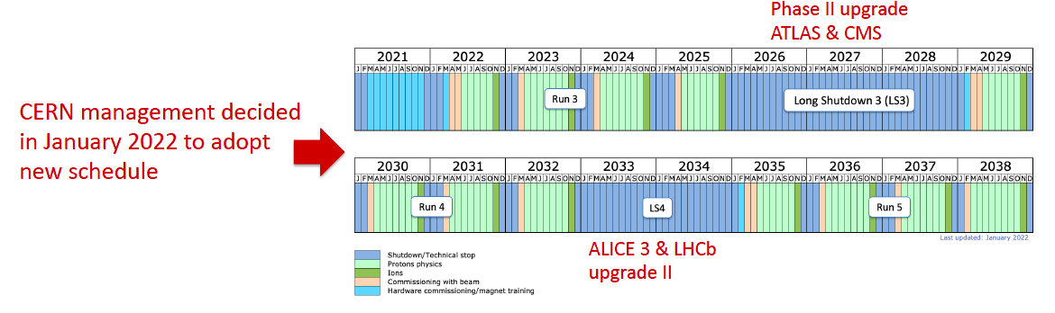
ALICE @LHC Schedule
ALICE LS3 Upgrade
ALICE LS4 Upgrade ALICE 3
ALICE LS2 Upgrade
finished
Today

Slide 45
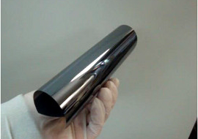
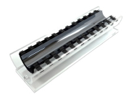
ALICE upgrade in 2026-2028: is under preparations
ITS3
Ultra-light,
a truly-cylindrical
Inner Barrel
x3 less material
Improves measurement of low p_{T}
charm and beauty hadrons
and low-mass dielectrons .
Forward Calorimeter
high-granularity readout
for direct photons at 3.2 < η < 5.8
to probe gluon density
down to x ~ 5x10⁻⁶
Large area,
thin bent
Si pixel MAPS sensors
[LoI: CERN-LHCC-2019-018]

Slide 46
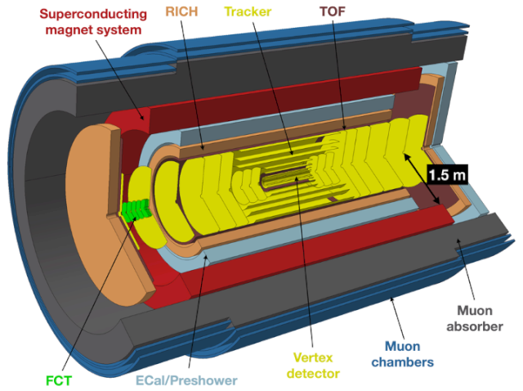
ALICE 3 in Run 5 expected > 2031–?
ALICE 3 -- a completely new experiment, fast with precise tracking and timing.
A large-acceptance, ultra-low material budget, all-pixel silicon tracking system
Future HI programme
at the LHC:
Low-mass dileptons and soft hadrons (<50 MeV)
Evolution of QGP and chiral symmetry restoration
Exotic (multi-)heavy-flavoured hadrons, hadronisation mechanisms
Hadron correlations and interaction potentials
searches beyond-the-Standard-Model
see also talk at this conference by Yury Kharlov
Letter of Intent for ALICE 3 was reviewed
by the LHCC in March 2022
Notes:
While the heavy-ion physics programme in Runs 3 and 4 will provide deep insights into the rich field of QCD phenomenology, open questions will remain that can only be addressed with further advancements in detector performance and with the significant increase in heavy-ion luminosity anticipated in Run 5 (expected in 2035–2038). This extension of the LHC heavy-ion programme through the 2030s has been supported by the 2020 update of the European strategy for particle physics,
TOF ~ 25ps

Slide 47
ALICE results at this conference "NUCLEUS–2022" :
THANK YOU FOR ATTENTION!
who | talk | when
Sergey Kiselev | Hadronic resonance production with ALICE at the LHC | 13 July 2022, 15:40
Gleb Romanenko | Femtoscopic analysis of identical charged kaons in Pb–Pb collisions at 5.02 TeV with ALICE – | 13 July 2022, 15:20
Dmitry Blau | Direct photon and neutral meson production results from ALICE experiment | 12 July 2022, 12:10
Dmitri Peresunko | Performance of the precise electromagnetic calorimeter ALICE/PHOS and upgrade plans | 12 July 2022, 13:30
Alexander Borissov | Production of Sigma0 hyperon and search of Sigma0-hypernuclei at LHC with ALICE | 12 July 2022, 12:30
Yury Kharlov | Probing the hot QCD matter via quarkonia at the next-generation heavy-ion experiment at LHC | 12 July 2022, 13:10

