Slide 1
Joint Institute for Nuclear Research
Frank Laboratory of Neutron Physics
Using the tagged neutron method for determining the concentration of carbon in soil
Yuri Kopatch
for the TANGRA collaboration
Nucleus-2022: Fundamental problems and applications"
Moscow, July 11-16, 2022.

Slide 2
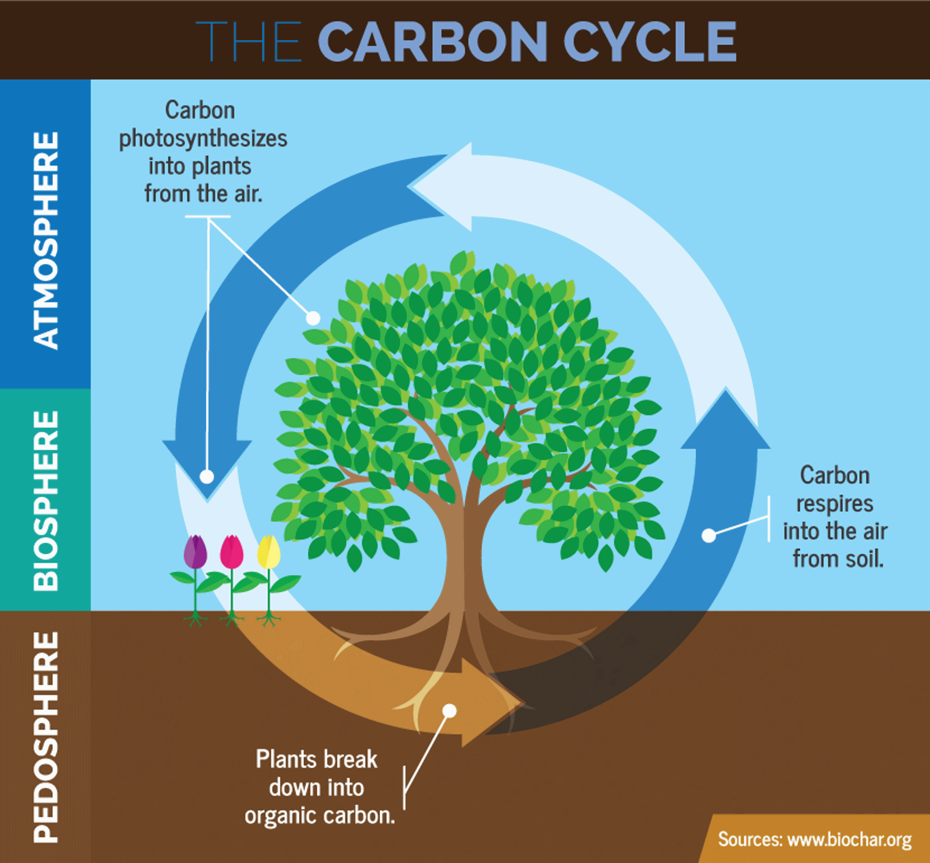
Soil carbon: why is it so important?
The Food and Agriculture Organization (FAO):
“The role of soils and of soil organic carbon (SOC) in the climate system and climate change adaptation and mitigation has been recognized widely and validated in various studies, both experimentally and through modelling.
Maintaining and increasing SOC stocks is not only crucial for reducing greenhouse gases emissions and removing CO₂ from the atmosphere, but also for harnessing the benefits of increased SOC (and SOM, soil organic matter) for soil health and fertility by improving water storage and thereby increasing the access of plants to water, food production potential and resilience to drought.”
2

Slide 3
Soil carbon: the need for new monitoring technologies
The traditional methods of soil carbon monitoring are rather time-consuming and not very accurate.
New methods should satisfy the following requirements:
Reduced sample preparation, ideally the ability to obtain data without sampling,
Simplification of logistics "Sampling - Transportation - Laboratory", creation of field/mobile devices/laboratories)
Automation of analysis, the ability to determine several characteristics at once in one measurement.
The possibilities of new technologies and methods of their application should be able to successfully compete with traditional methods that allow for a familiar and transparent interpretation of the results.
3

Slide 4
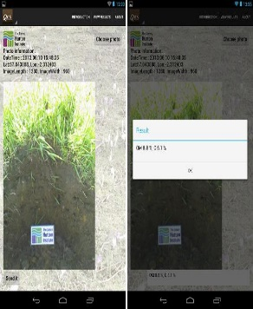
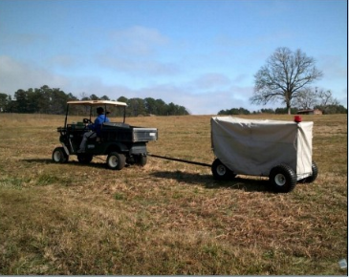
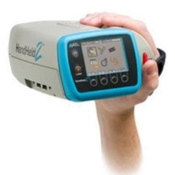
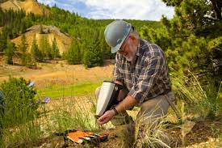
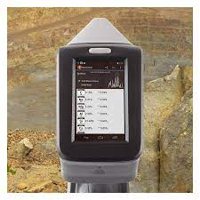
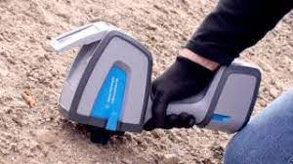
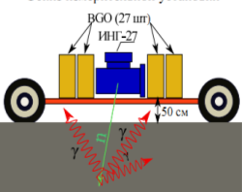
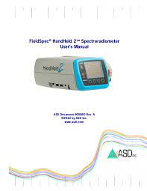
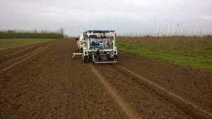
Comparison of proximal methods for determining soil carbon.
J. R. England and R. A. Viscarra Rossel, Proximal sensing for soil carbon accounting, SOIL, 4, 101–122, (2018)
$ –0–40 000; $$ –40 000–100 000; $$$ –100 000+;
A. Kavetskiy, G. Yakubova et al., 236th Electrochemical society meeting,2019, Atlanta, GA, US
https://doi.org/10.1007/978-3-319-28295-4_7
RGB smartphone camra
+ mobile application
Vis-NIR
INS
4
mid-IR
LIBS

Slide 5
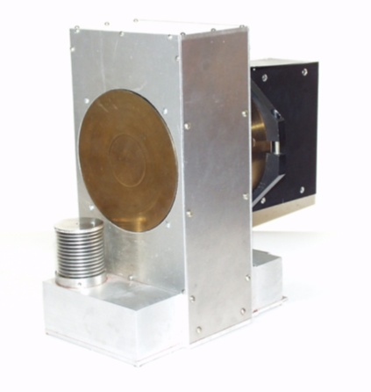
The Tagged Neutron Method (TNM)
Deuteron ~100 кeV
D + T → ⁴He (3.5МeV) + n (14.1МeV)
α-particle 3,5 МeV
Triton
Neutron 14.1 МeV
Neutron generator ING-27
Main advantages of the TNM:
neutrons with an energy of 14.1 MeV are used, which have a high penetrating power;
the ability to determine the spatial distribution of elements in the object under study;
the possibility of creating portable installations;
improvement of the effect/background ratio due to neutron tagging;
induced activity and absorbed dose are negligible.
5

Slide 6
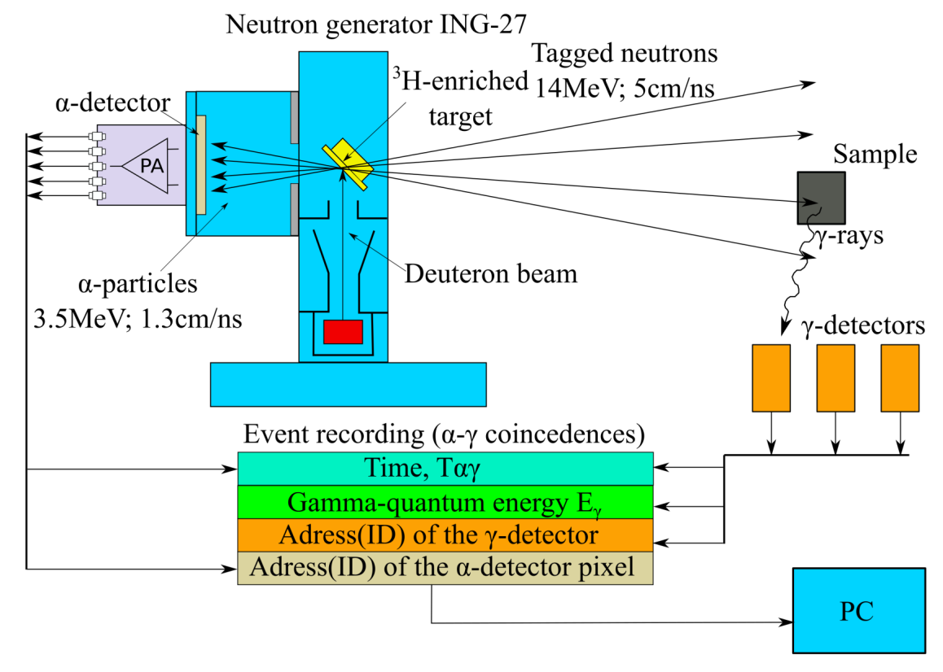
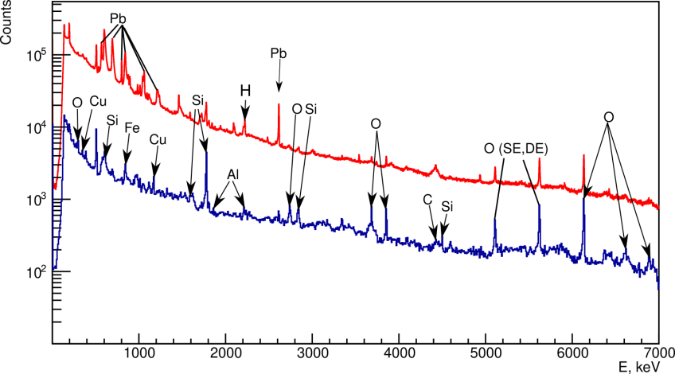
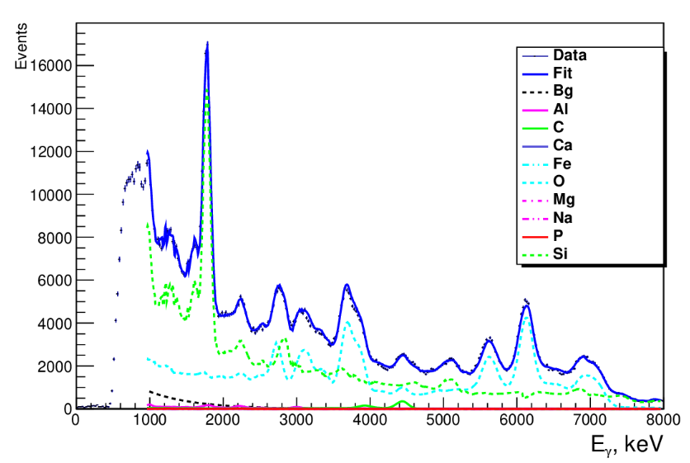
Elemental analysis using fast neutrons
C
Elements can be identified by their characteristic spectra.
The spectrum of carbon consists of a single line with the energy of 4438 keV.
6

Slide 7
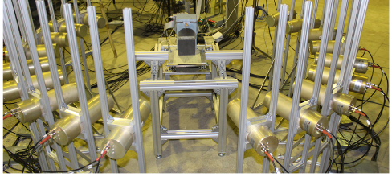
The TANGRA project at JINR
The TANGRA project (TAGGED NEUTRONS & GAMMA RAYS) is being implemented at JINR with the participation of Russian and foreign institutes.
The project uses an installation that includes the ING-27 neutron generator (manufactured by the VNIIA, Moscow), gamma detectors and Russian-made electronics.
The project participants have experience in applying this technique to create devices for detecting drugs and explosives, as well as for elemental analysis of rocks and ores.
Neutron generator ING-27
Experimental facility TANGRA at JINR
7

Slide 8
Investigation of the possibility of determining the carbon concentration in soil using the TNM
Choosing the right type of detectors
Determination of the carbon detection threshold and of the sensitivity of the method
Determination of the repeatability of the method
Monte Carlo simulations of the possibility to determine the depth profile of carbon in soil
8

Slide 9
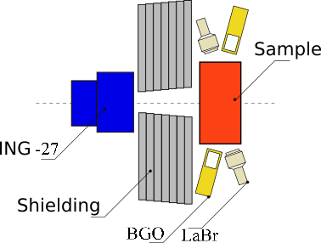
Testing the performance of different gamma detectors
Test setup
includes 6 BGO and
2 LaBr γ detectors
Sample: a mixture of sand and coal with known C concentration in a wooden box 30 x 30 x 20 cm.
Irradiation time: 2 hours
Intensity:
10⁶ neutrons/sec
(~2 × 10⁴ tagged neutrons/sec)
9

Slide 10
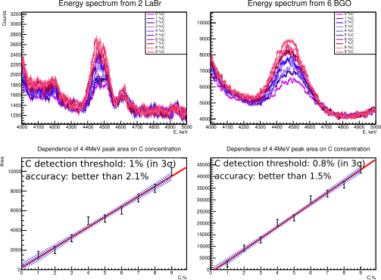
Carbon detection threshold and sensitivity
2 x LaBr₃ 6 x BGO
Dependence of 4.44 peak area on C concentration
10

Slide 11
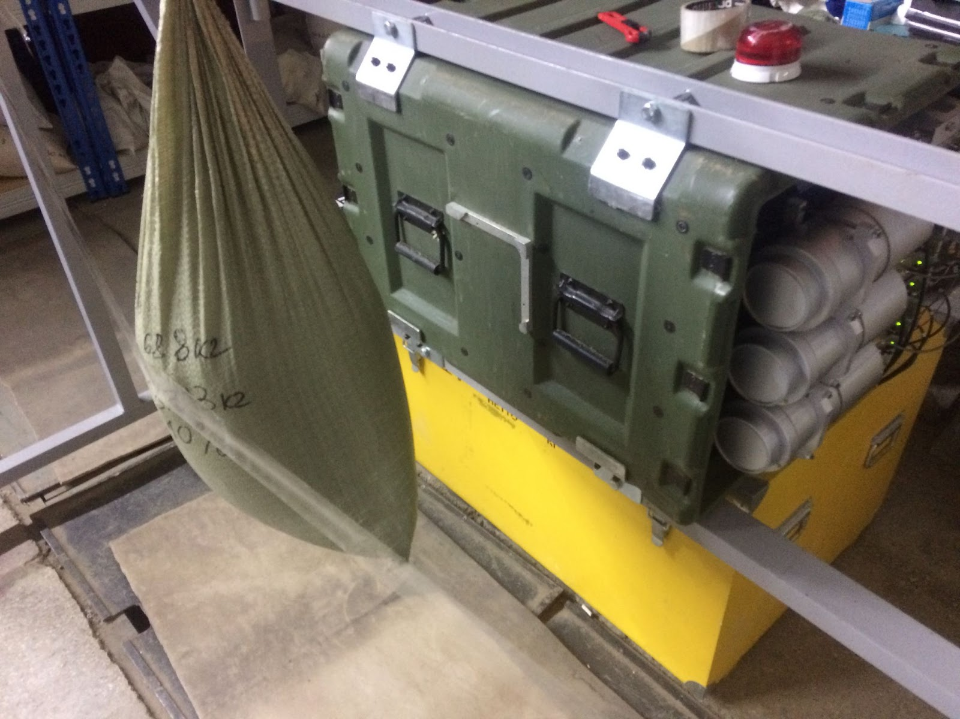
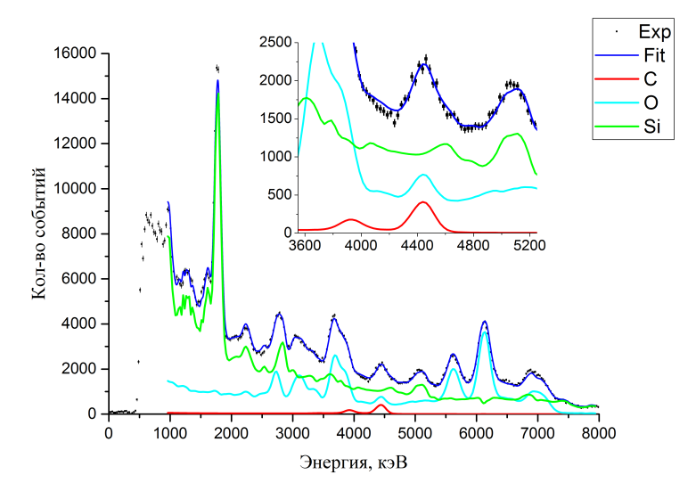
Testing the repeatability of the method
Samples: mixture of sand and sugar. Carbon concentration from 0 to 10%
AGP-S device consisting of
ING-27 and 6 BGO detectors
sample
11

Slide 12
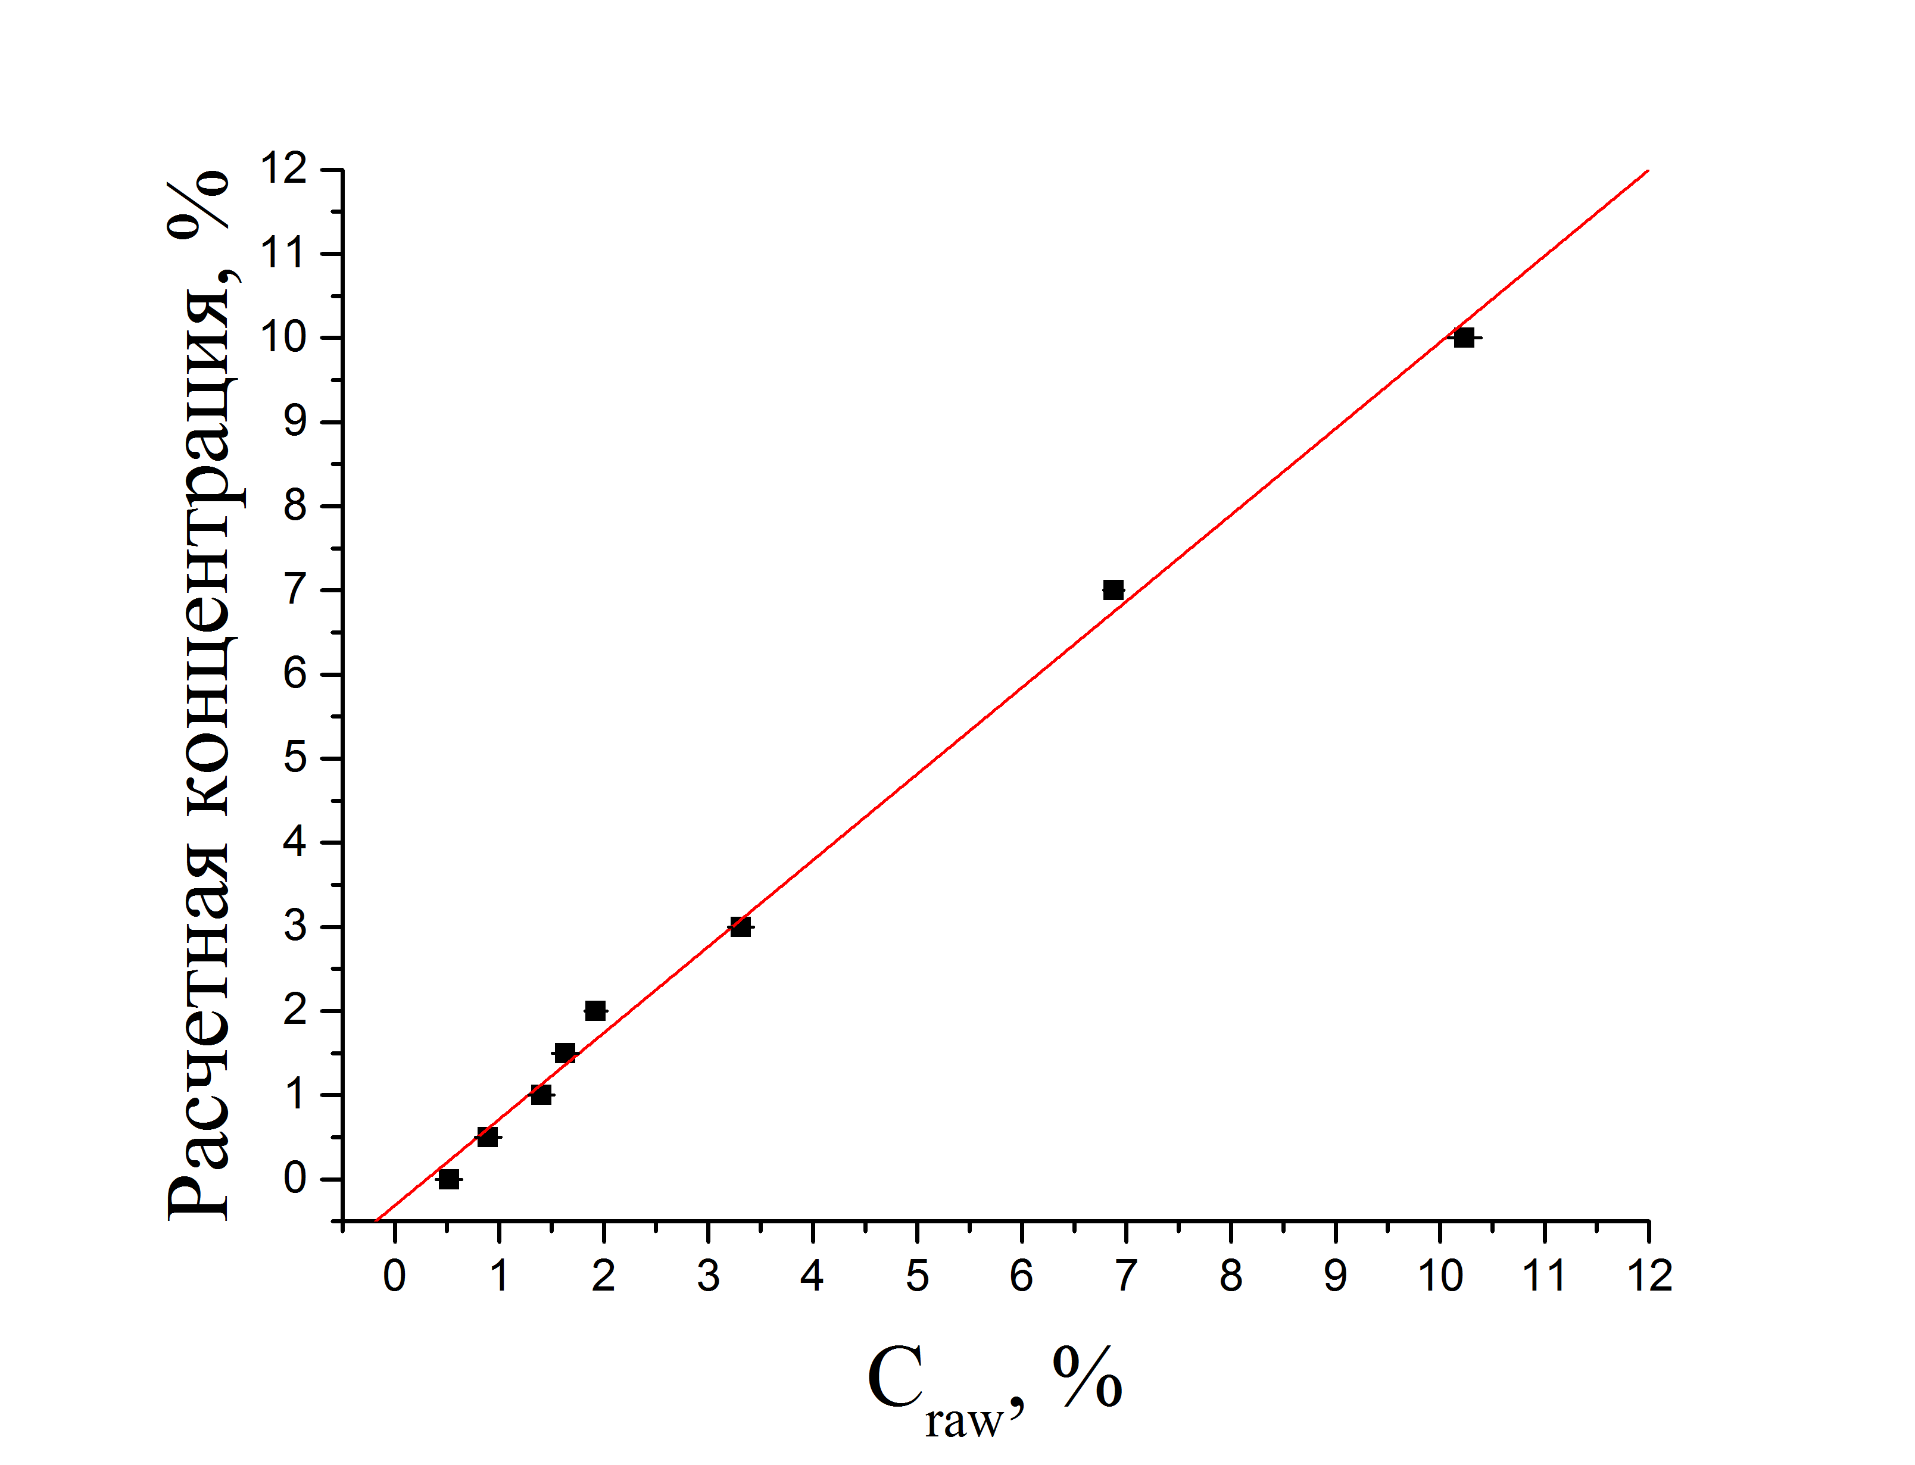
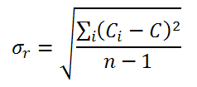
Testing the repeatability of the method
Calibration curve
Two samples with carbon concentrations 1.7% and 3.3% were measured 12 times.
The repeatability was calculated as
Calculated carbon concentration, %
Where C_{i} is the determined concentration value for each measurement, C is the mean concentration value for all measurements.
The results are
σ_{r}(1.7%) = 0.16%
σ_{r}(3.3%) = 0.12%
Measured carbon concentration, %
σ_{rms} = 0.2%
12

Slide 13
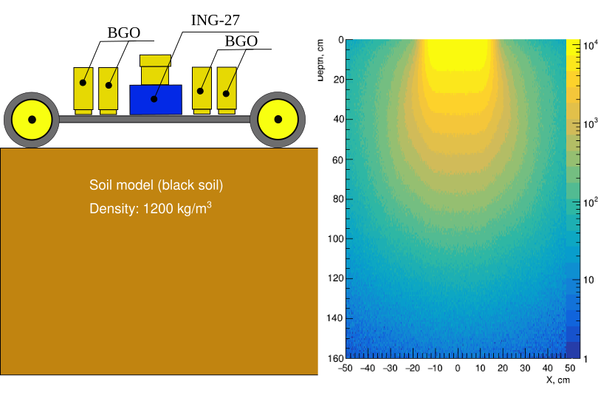
Monte Carlo simulations
Geant4 model
Depth profile
13

Slide 14
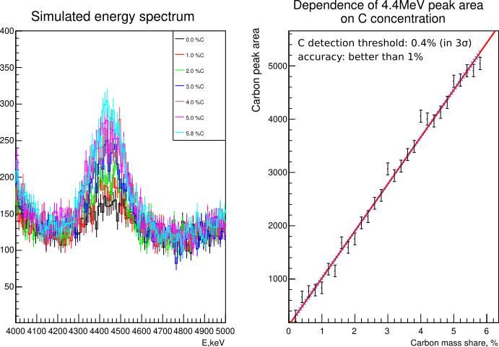
Monte Carlo simulations
The simulation corresponds to the irradiation time of ~100 sec
14

Slide 15
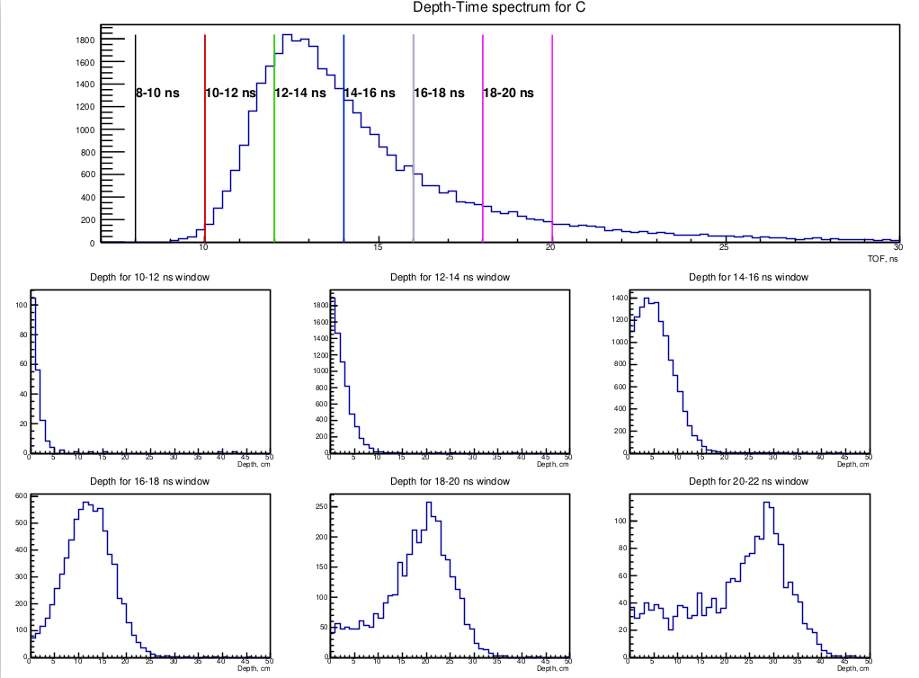
Monte Carlo simulations: TOF spectrum
TOF
t (ns)
Depth (cm)
15

Slide 16
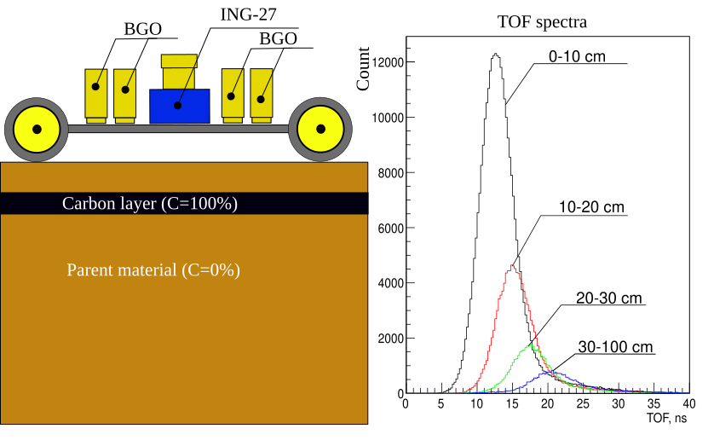
Monte Carlo simulations with pure carbon layers
Reference spectra
16

Slide 17
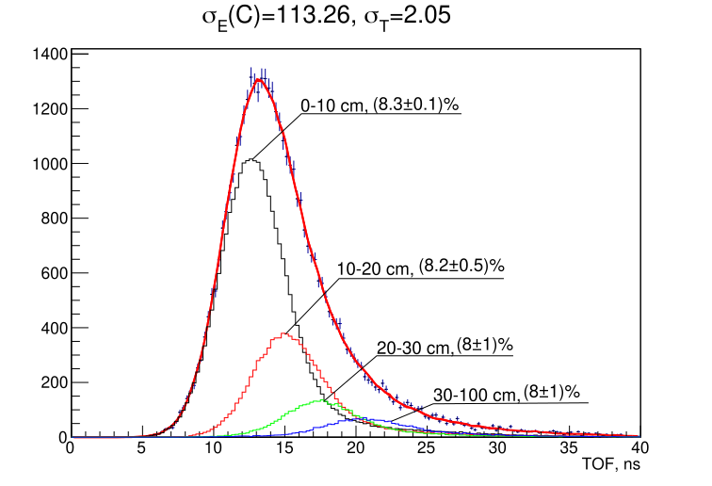
Reconstruction of the carbon depth profile from the TOF spectra
Uniform distribution of carbon
(8% everywhere)
Non-uniform distribution of carbon
The total TOF spectrum is fitted by a set of reference spectra with weights of each spectrum representing the carbon concentration in the corresponding layer
17

Slide 18
Conclusions
The tagged neutron method is a promising tool for determining the carbon concentration is soil.
We showed that gamma detectors with low resolution, but high efficiency are preferable.
We determined the carbon detection level, detection accuracy and repeatability for simple test setups.
We demonstrated that the method is able to determine the depth profile of carbon concentration.
Unsolved problems:
How to take into account the humidity and density of soil?
How to separate organic and non-organic carbon?
How to separate the contribution of plants and roots?
18

Slide 19
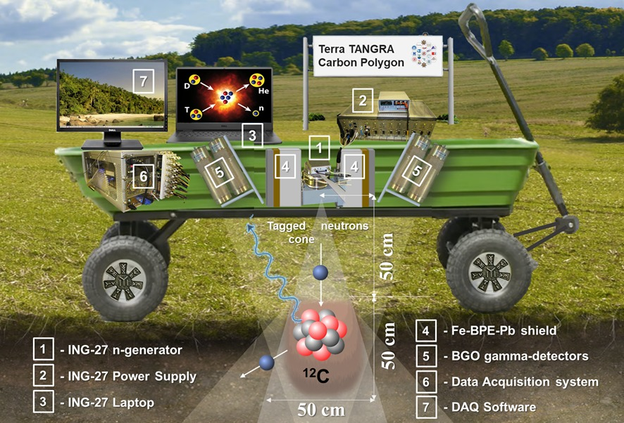
Thank you for your attention

