Slide 1
MONITORING OF PULSED INTERMEDIATE-ENERGY NUCLEON BEEMS USING AIR ACTIVATION
LXXII International Conference "Nucleus-2022”, Moscow
V. M. Skorkin
INR RAS

Slide 2
Use of pulsed beams of protons and neutrons
The intermediate-energy proton and neutron pulsed beams are used for radiation therapy at the proton accelerators and for science material studies at the neutron sources.
Secondary radiation from the interaction of the beam with biological targets, equipment and material is used to control the beam parameters and a absorbed dose.

Slide 3
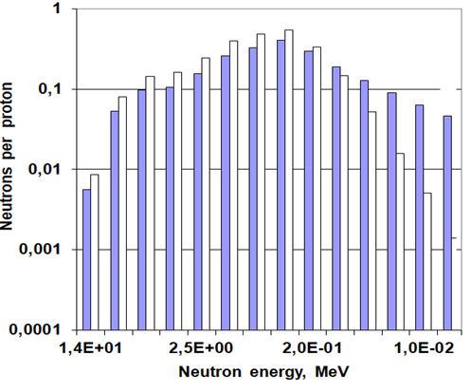

A neutron radiation from p beam losses in equipment
The evaporation neutron spectrum from p pulse losses.

Slide 4
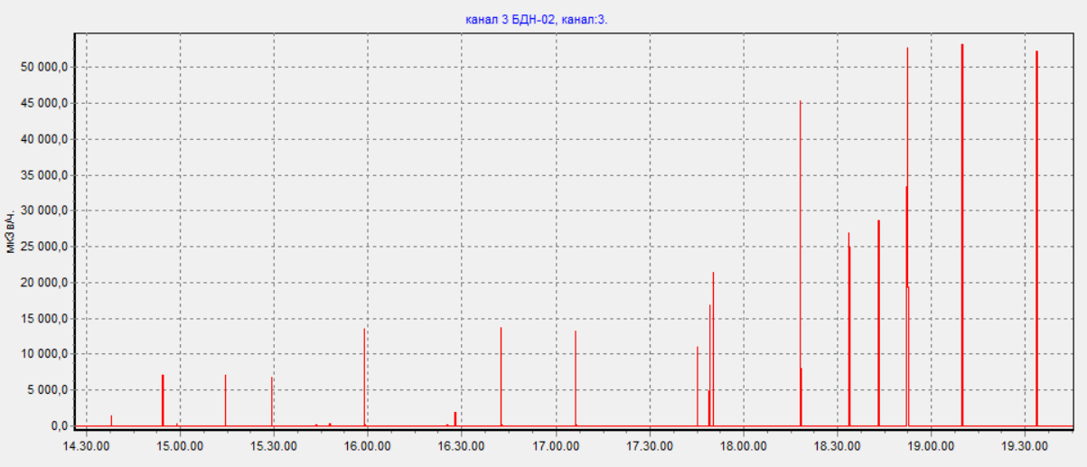
A monitoring system of a proton beam losses used neutron dose measured UDBN detector
The absorbed dose of the proton beam in cell cultures using Gafchromic film and the pulsed neutron flux using UDBN detector were measured.

Slide 5
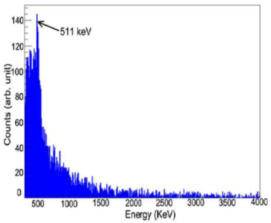
The ¹¹C, ¹⁴N, ¹⁵O short life positron-emitter isotopes emittihg annihilation 511 keV photons
γ , МeV | reaction
1.63 | ¹⁶O(p,xγ)¹⁴N
2.00 | ¹⁶O(p,xγ)¹¹C
2.04 | ¹⁶O(p,xγ)¹⁵O
2.00 | ¹²C(p,xγ)¹¹C
This gamma radiation from p pulse created in biological targets used to pulsed nucleon beam monitoring

Slide 6
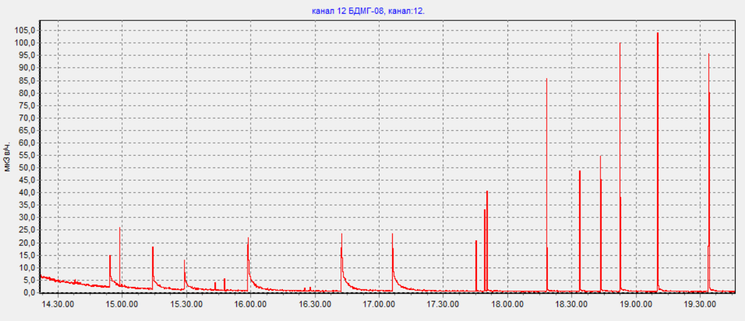
A monitoring system of a proton beam losses used γ - ray dose measured BDMG detector.

Slide 7
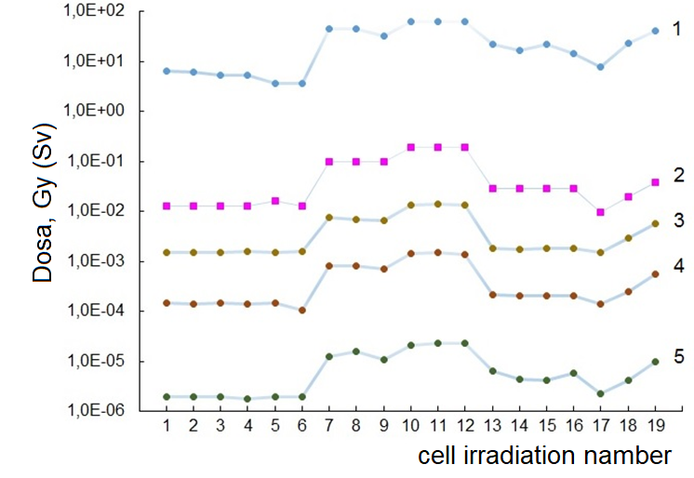
The p pulse beam (1), local cell absorbed (2), neutron (3,4) and gamma (5) dose
10¹⁰ p pulse (30 μs) created 10 Gy cultures at the Bragg peak and the neutron dose is about 1 mSv (at 10 cm distance)

Slide 8
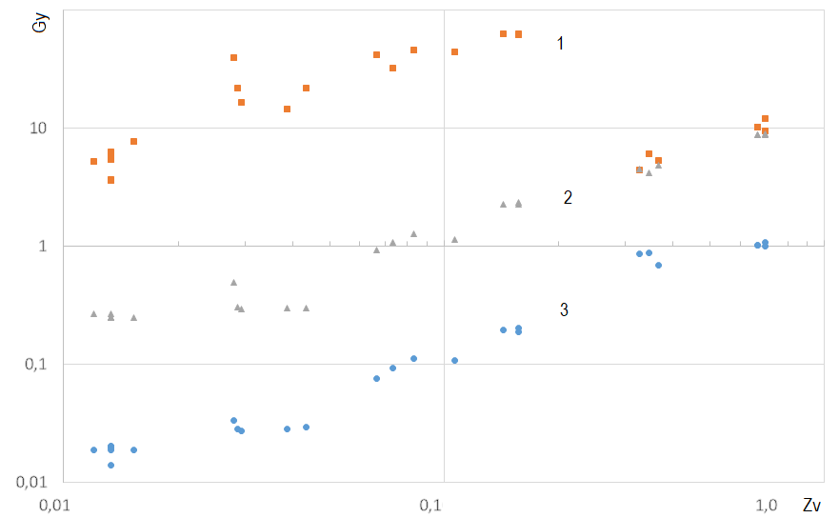
Linear dependence of the absorbed dose of protons by cells (1) and the dose of neutrons (2,3) on the dose of gamma radiation

Slide 9
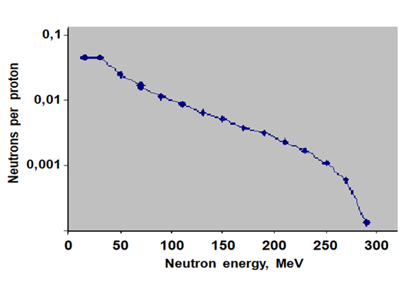
The n spectrum from the cascade neutron pulsed source
The cascade neutrons have intermediate energy over 20 MeV.

Slide 10
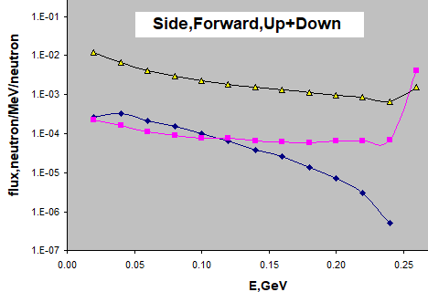
The scattered neutron spectrum on pulsed source
The neutron spectrum from cascade n scattering in pulsed source transporting channel.

Slide 11
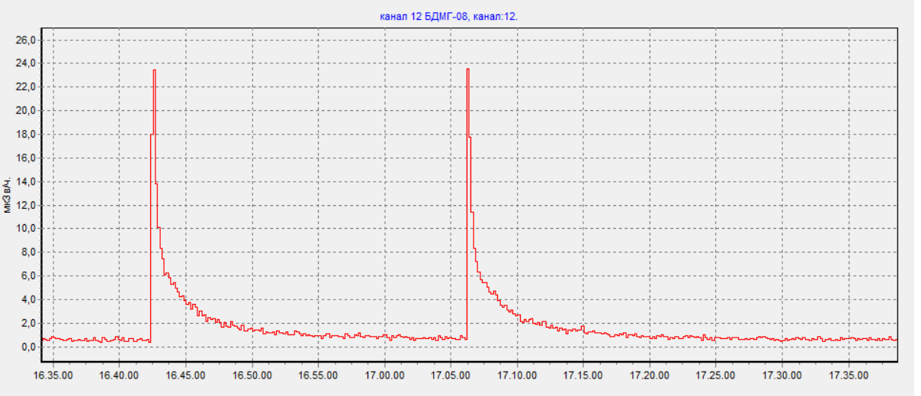
The γ- and β- radiation from n and p irradiated material
A monitoring system of a proton beam losses used γ - ray dose measured BDMG detector.

Slide 12
The radiation dose from p pulse losses when interacting
The 10¹⁰ proton pulse create 1.6 mSv dose of the evaporation neutrons in channels for transporting a beam to targets.
The irradiation of the biological targets and materials with 10¹⁰ intermediate-energy proton and neutron pulse create 24 µSv dose of the gamma and beta radiation.

Slide 13
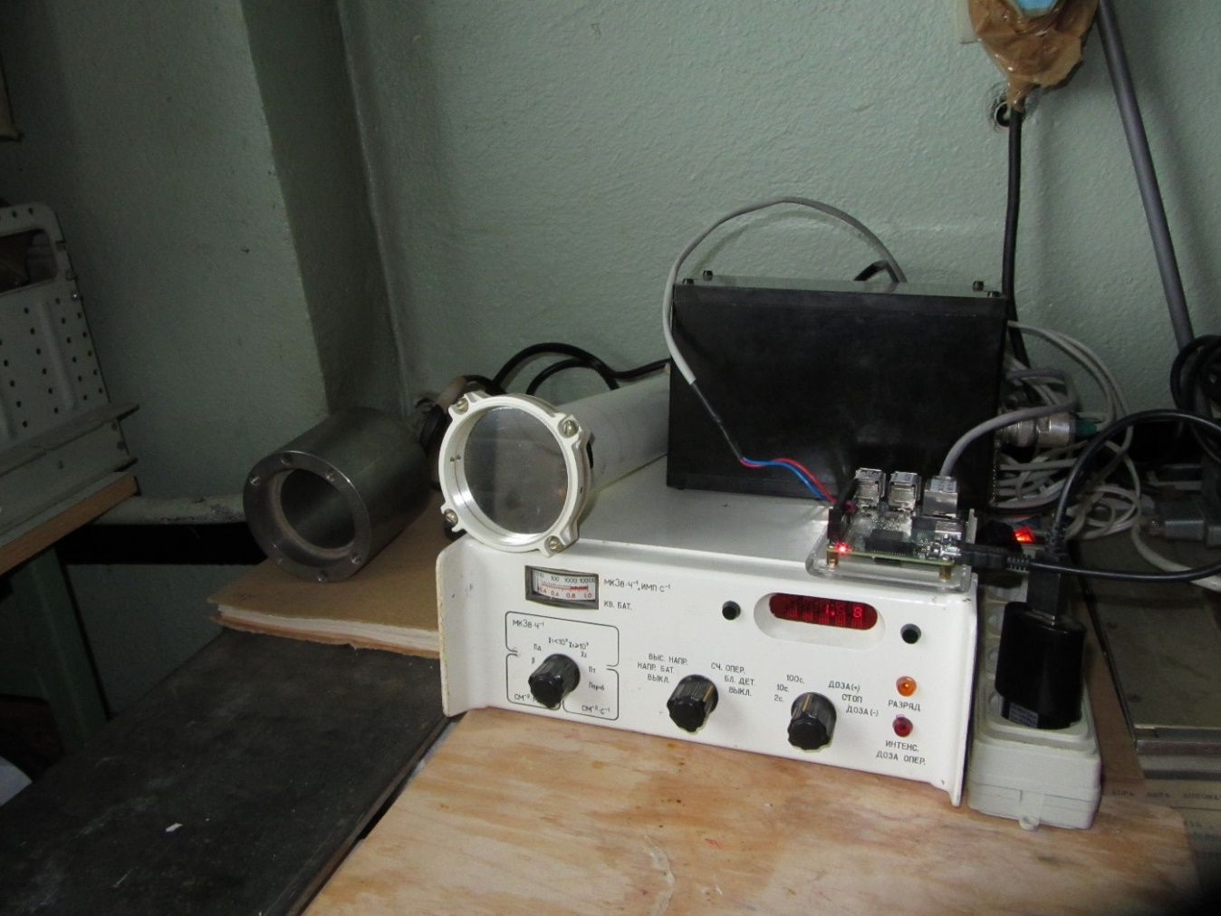
MKS-01R radiometer for measurement of γ- and β- radiation from n and p irradiated material and biological targets

Slide 14
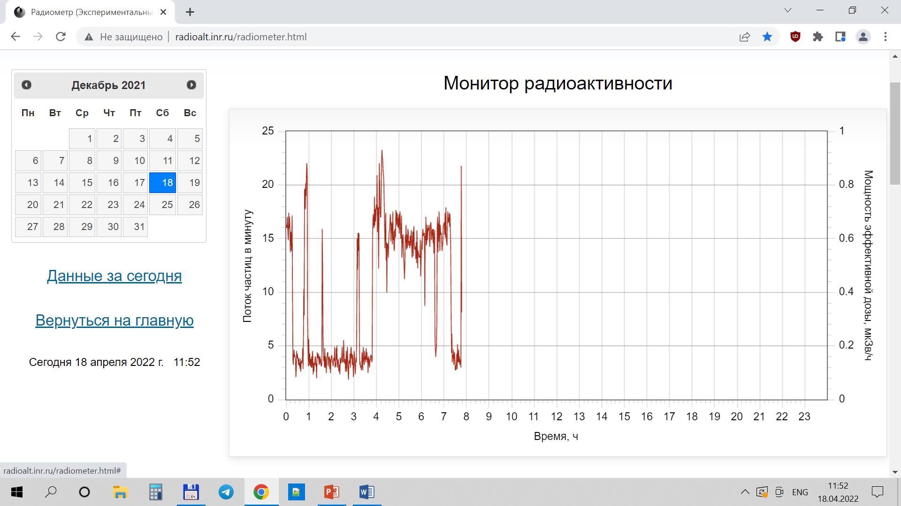
The γ- and β- radiation from p pulse beam γ- and β- radiation, measured MKS-01R radiometer on medical channel

Slide 15
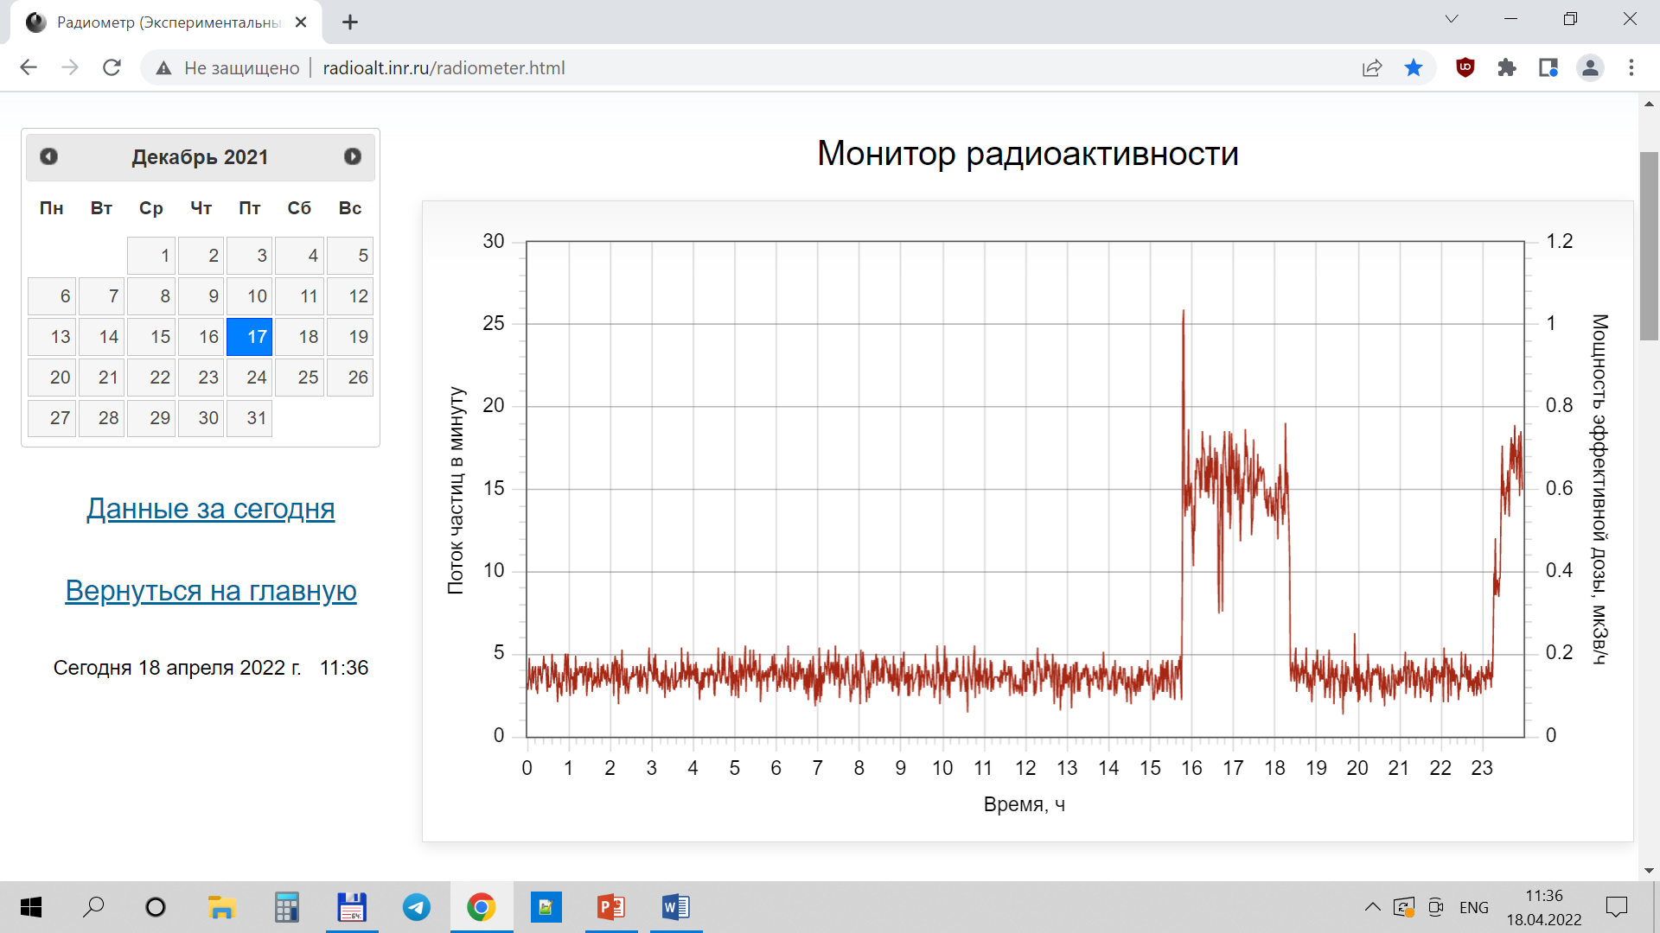
Time diagrams of the radiation, measured used MKS-01R radiometer on TOF neutron channel of pulsed source

Slide 16
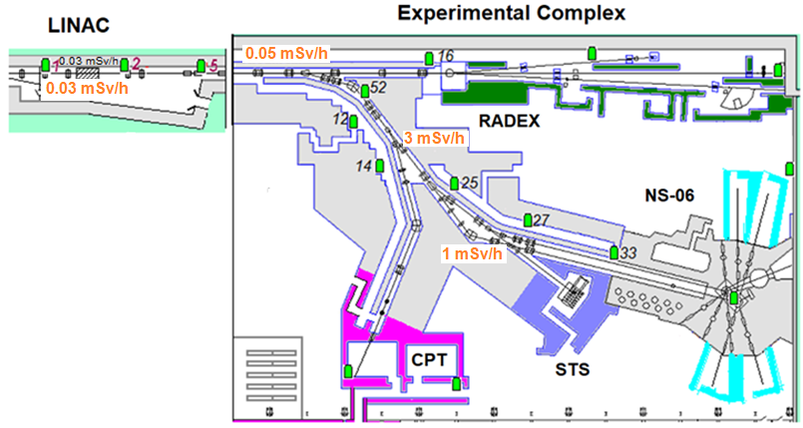
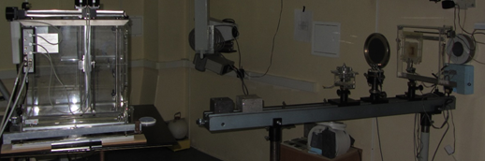
Air gaps in the proton and neutron channels
The channels for transporting p and n pulse beams have air gaps.

Slide 17
The p and n pulsed beams interact with air atoms
It is in this gap that the irradiated samples with the elements under study and the detecting equipment are located. The air contains nuclei of nitrogen, oxygen, carbon and argon, in which medium-energy neutrons (20-200 MeV) create an intranuclear cascade with the emission of nucleons.
The residual nucleus is in a preequilibrium state in various partial-hole configurations at different excitation energies. Then the excited nucleus decays, including the evaporation of particles and the emission of gamma rays.

Slide 18
Intermediate energy nucleons are non-elastically scattered by air atoms (nitrogen, oxygen, argon, etc.) and creates short-lived radionuclides (life tame from 20 ms to 100 s) in spallation process.
The residual nucleus is in a preequilibrium state in various partial-hole configurations at different excitation energies. Then the excited nucleus decays, including the evaporation of particles and the emission of gamma rays.

Slide 19
Gamma and beta radiation from the decay of radionuclides can be used to pulsed nucleon beam monitoring
As a result of the activation of atoms ¹⁴N(99.6%), ¹⁵N(0.4%) in the reactions short-lived radionuclides are formed. As a result of reactions on carbon ¹²C(n, p)¹²B(20 ms) with a threshold of 14 MeV (0.2 mb) and ¹³C(n, p) ¹³B(19 ms) with a threshold of 13 MeV, isotopes with a lifetime of about 20 ms are formed.
In the reaction ¹⁶O(n, p)¹⁶N(7.1s) with a threshold of 3 MeV (41 mb) and ¹⁸O(n, p) ¹⁸N(0.6s), rapidly decaying radionuclides are formed.

Slide 20
Thermal neutrons can activate air (¹⁴N, 80 mb) with the formation of capture gamma rays, which can also contribute to the background.
¹⁴N(99.6%)+n=3n +¹²N(11ms) +(16.4MeV)+ (511keV, 200% +4.43MeV, 2.4%)
3α(196 keV,3%)
¹⁵N(0.366%)+n= p +¹⁵C(2.45s,>80mb) +(16.4MeV)+ (511keV, 200% + 4.43 MeV, 2.4%)

Slide 21
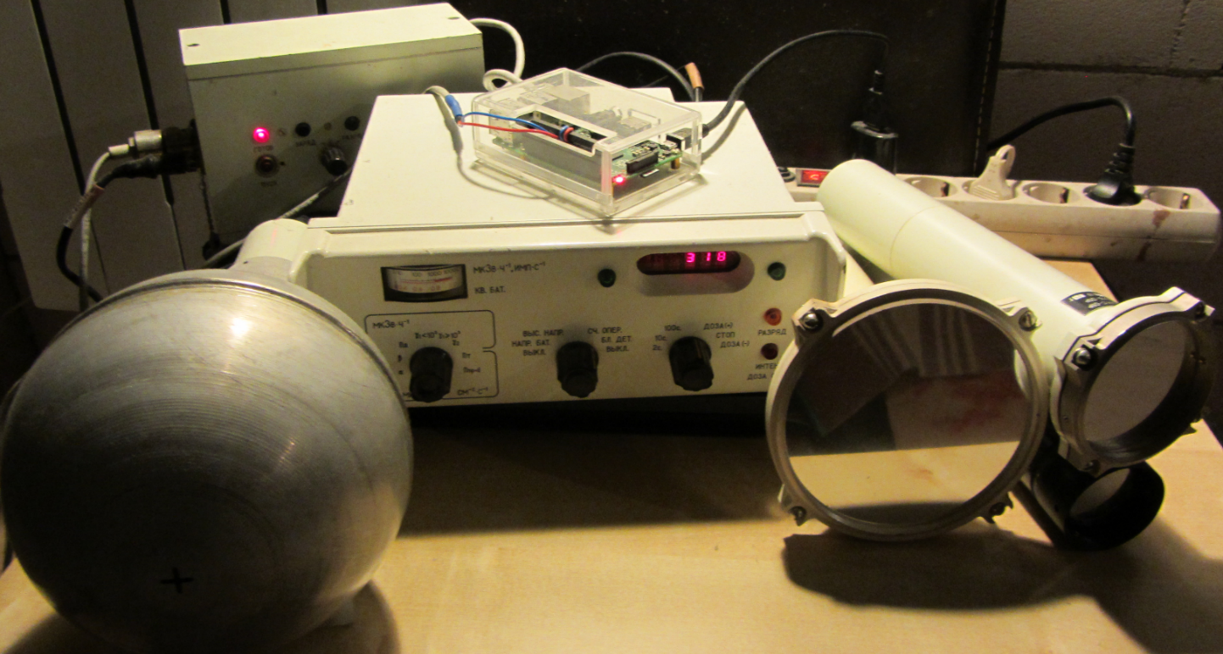
Activation monitor based on MKS-01R radiometer and а single-board microcomputer Raspberry Pi2 for on line pulsed n and p irradiation control
The sensitivity of the monitor to neutrons estimated from these data was about 0.02 - 0.1 pulses/(n/cm2).
The monitor allows to control pulsed beams of protons and neutrons with an energy of 20-200 MeV at a frequency of up to 50 Hz.

Slide 22
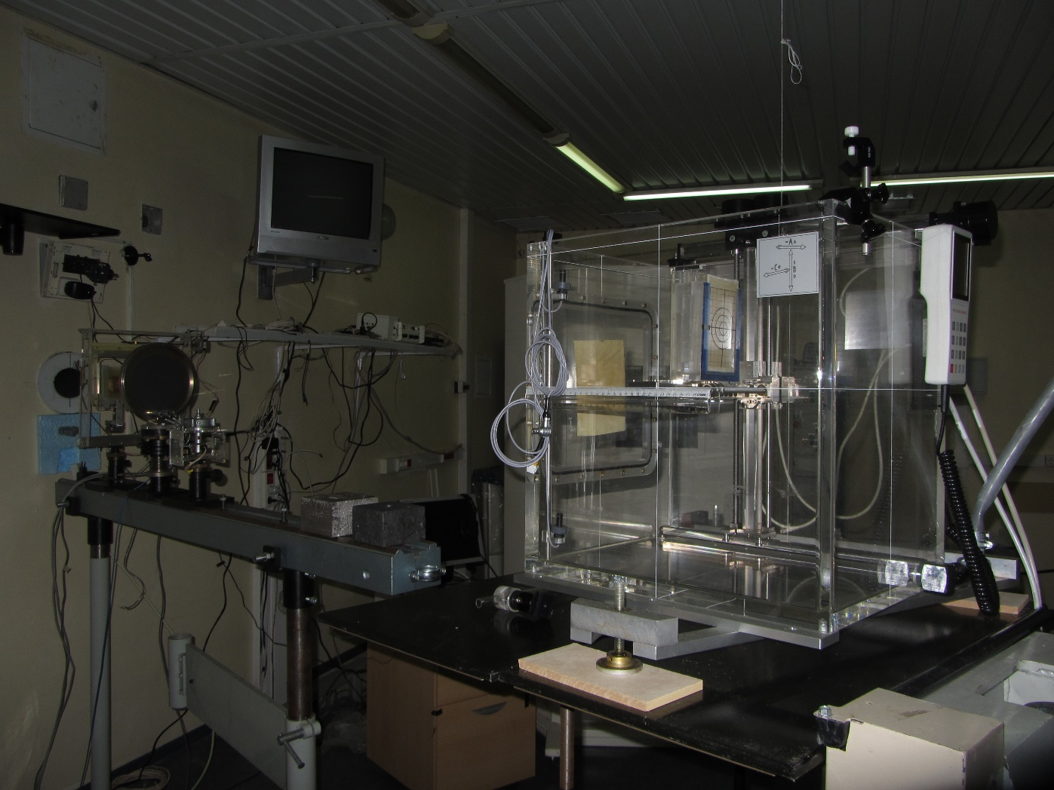
The measurement of γ- and β- radiation from p pulse beam on medical channel used MKS-01R radiometer

Slide 23
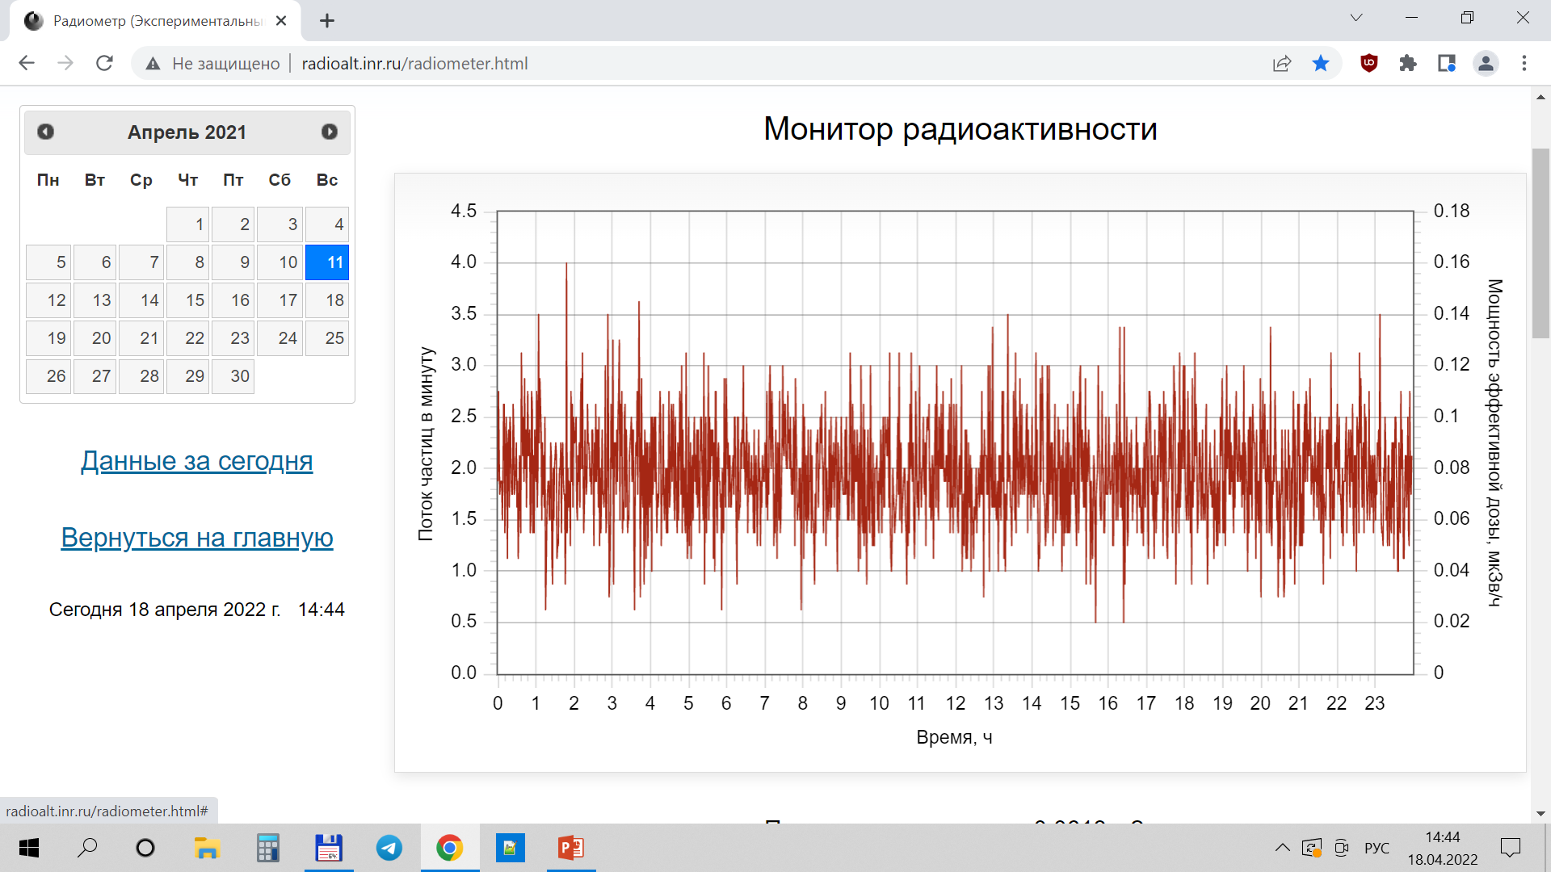
Time diagrams of the radiation background, measured used MKS-01R radiometer on a medical channel

Slide 24
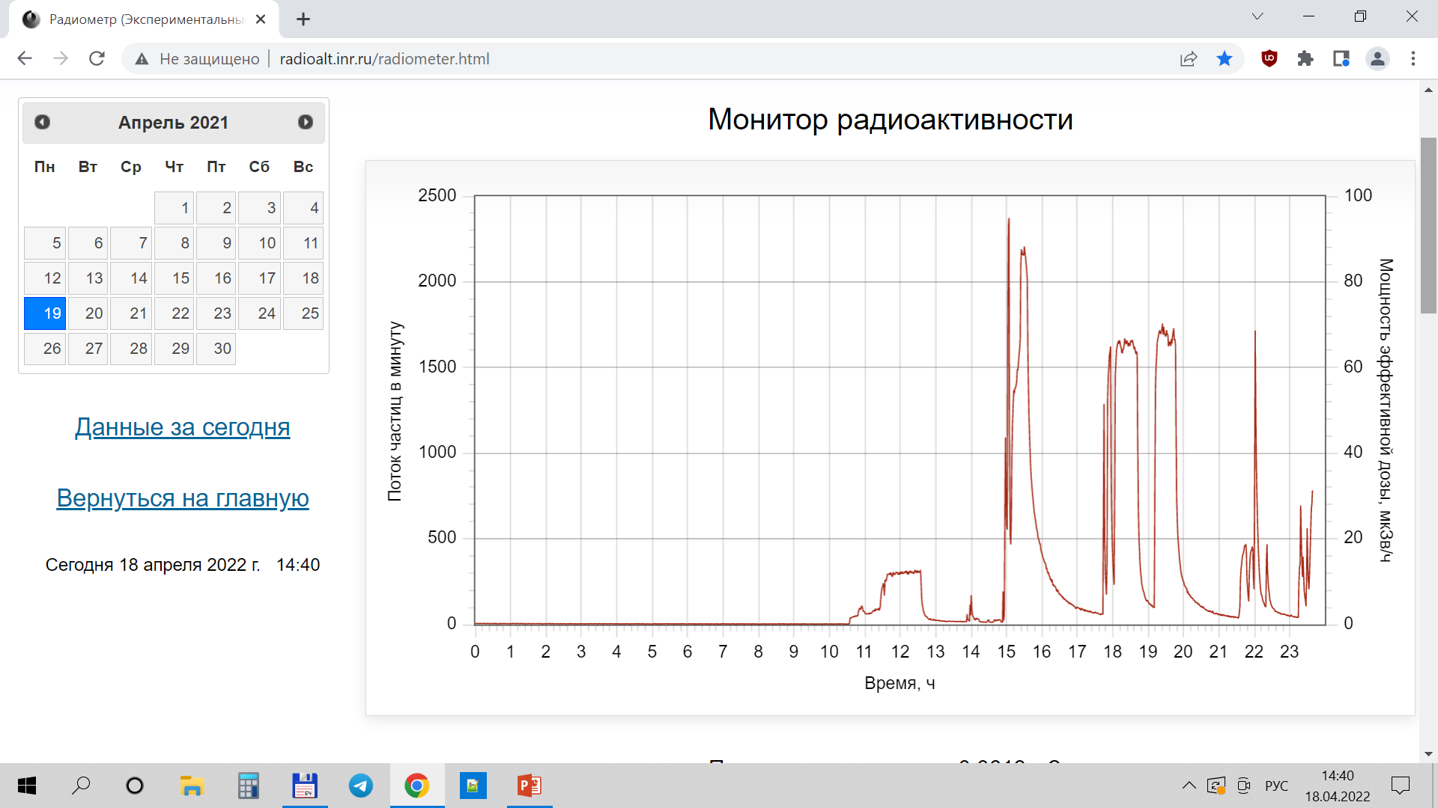
The radiation measured used MKS-01R radiometer activated by p pulsed beam and on the medical channel

Slide 25
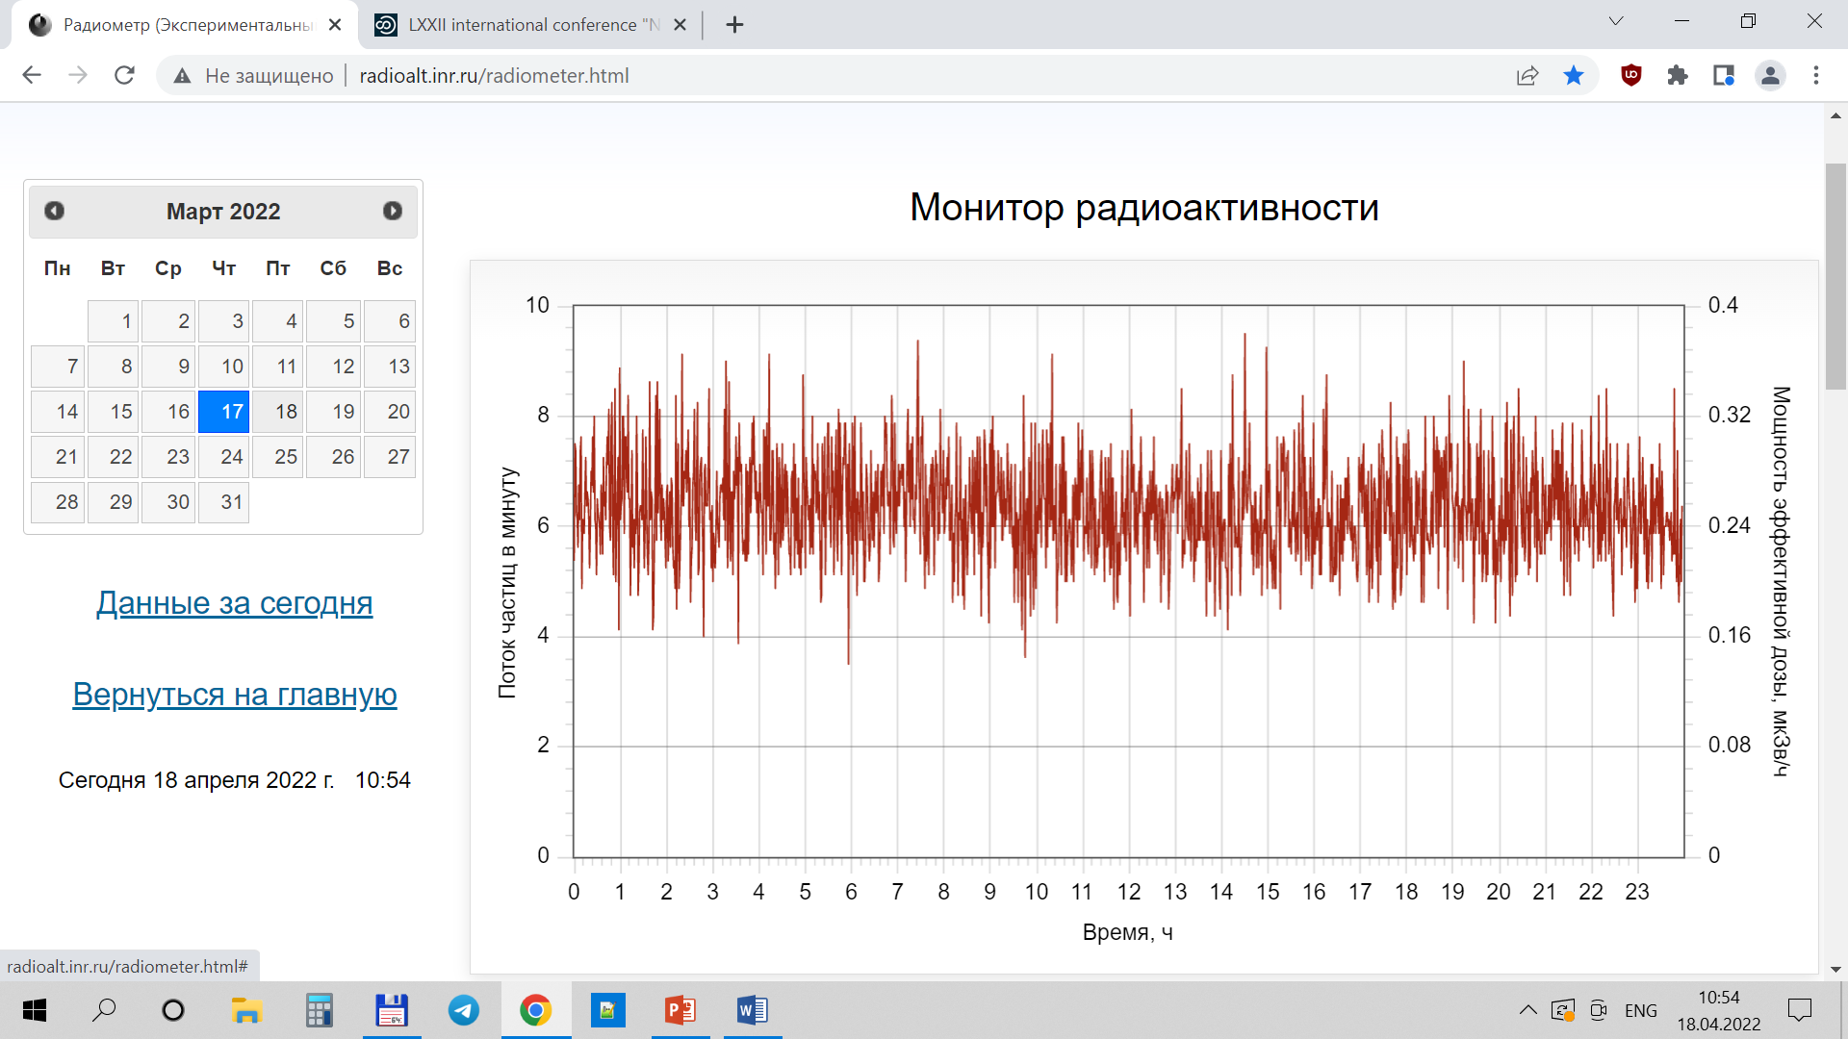
Time diagrams of the radiation background on the pulsed neutron source

Slide 26
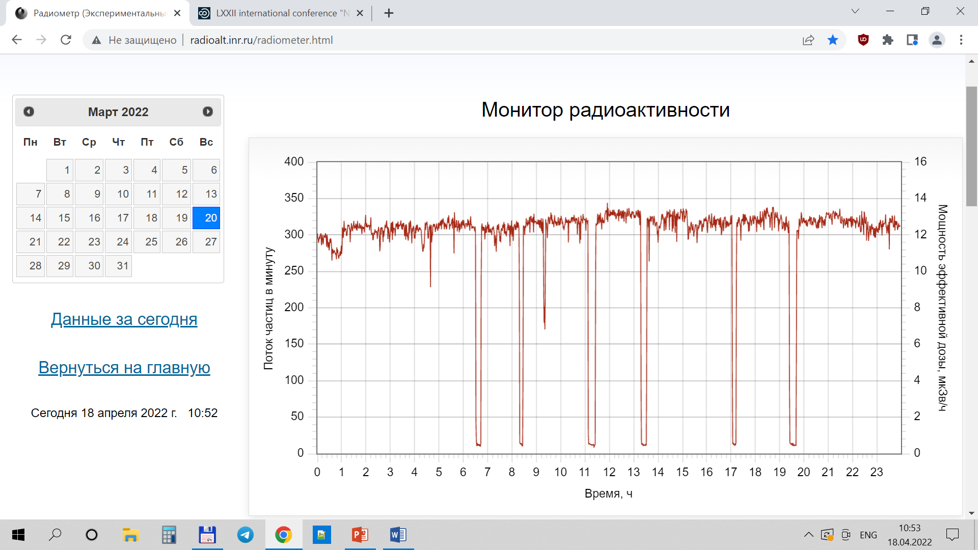
Time diagrams of the gamma and beta radiation from an activated air on the pulsed neutron source

Slide 27
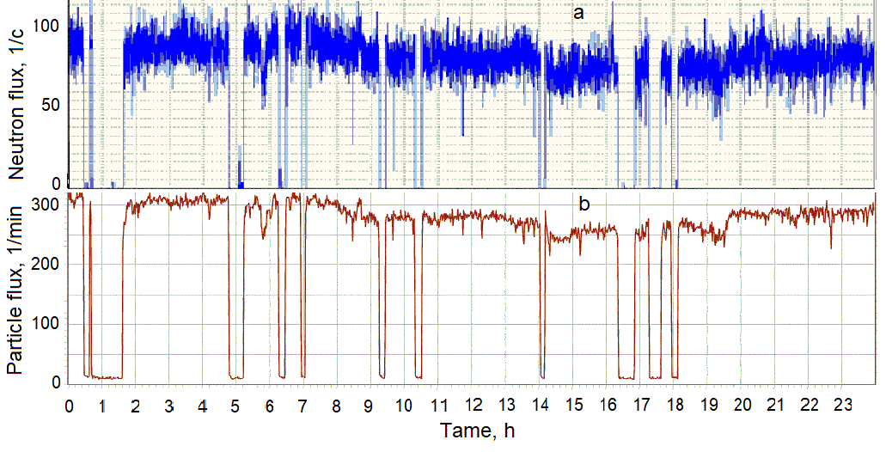
Time diagrams of the neutron beam fluxes of the pulsed neutron source (a) and the gamma and beta radiation from activated air (b).

Slide 28
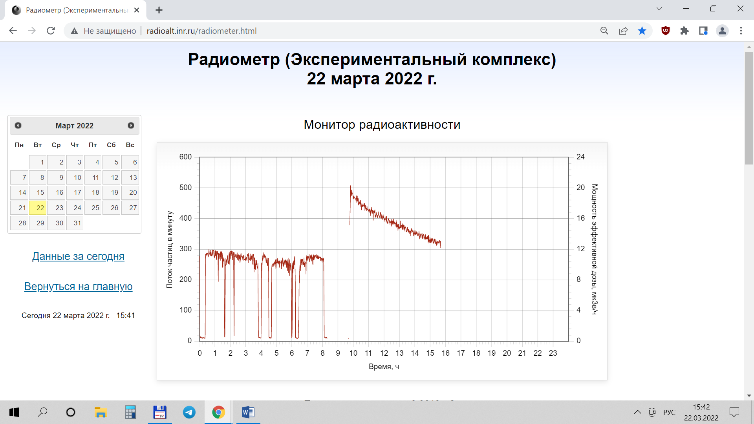
On line monitoring pulsed neutron irradiation of composite protection material used MKS-01R radiometer RADEX

Slide 29
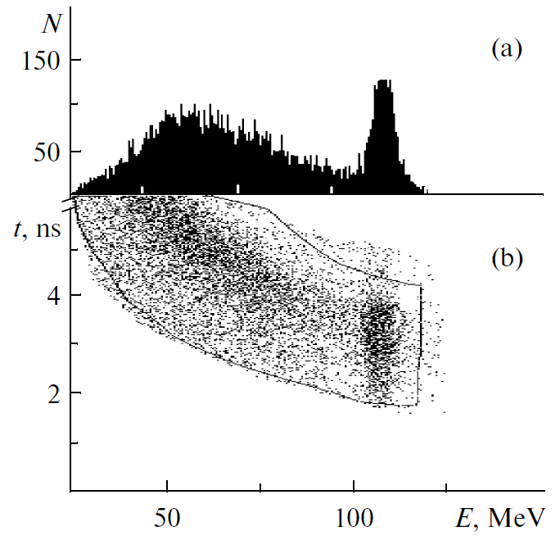
The scattering proton dose control used scintillation detector
System for measuring intensity of scattering protons from p pulse with accuracies of 1%
The dose irradiated personal from 10¹⁰ p pulse scattered by the CH₂ target (1 сm) was 1 mGy.

