Slide 1
On the stability of spherical nuclei in the inner crust of neutron stars
N.A. Zemlyakov^{1,2}, A.I. Chugunov¹
¹Ioffe Institute, SPb, Russia
²SPbPU, SPb, Russia
Zemlyakov&Chugunov, Particles 2022, 5, 225
LXXII international conference
"Nucleus-2022: Fundamental problems and applications"

Slide 2
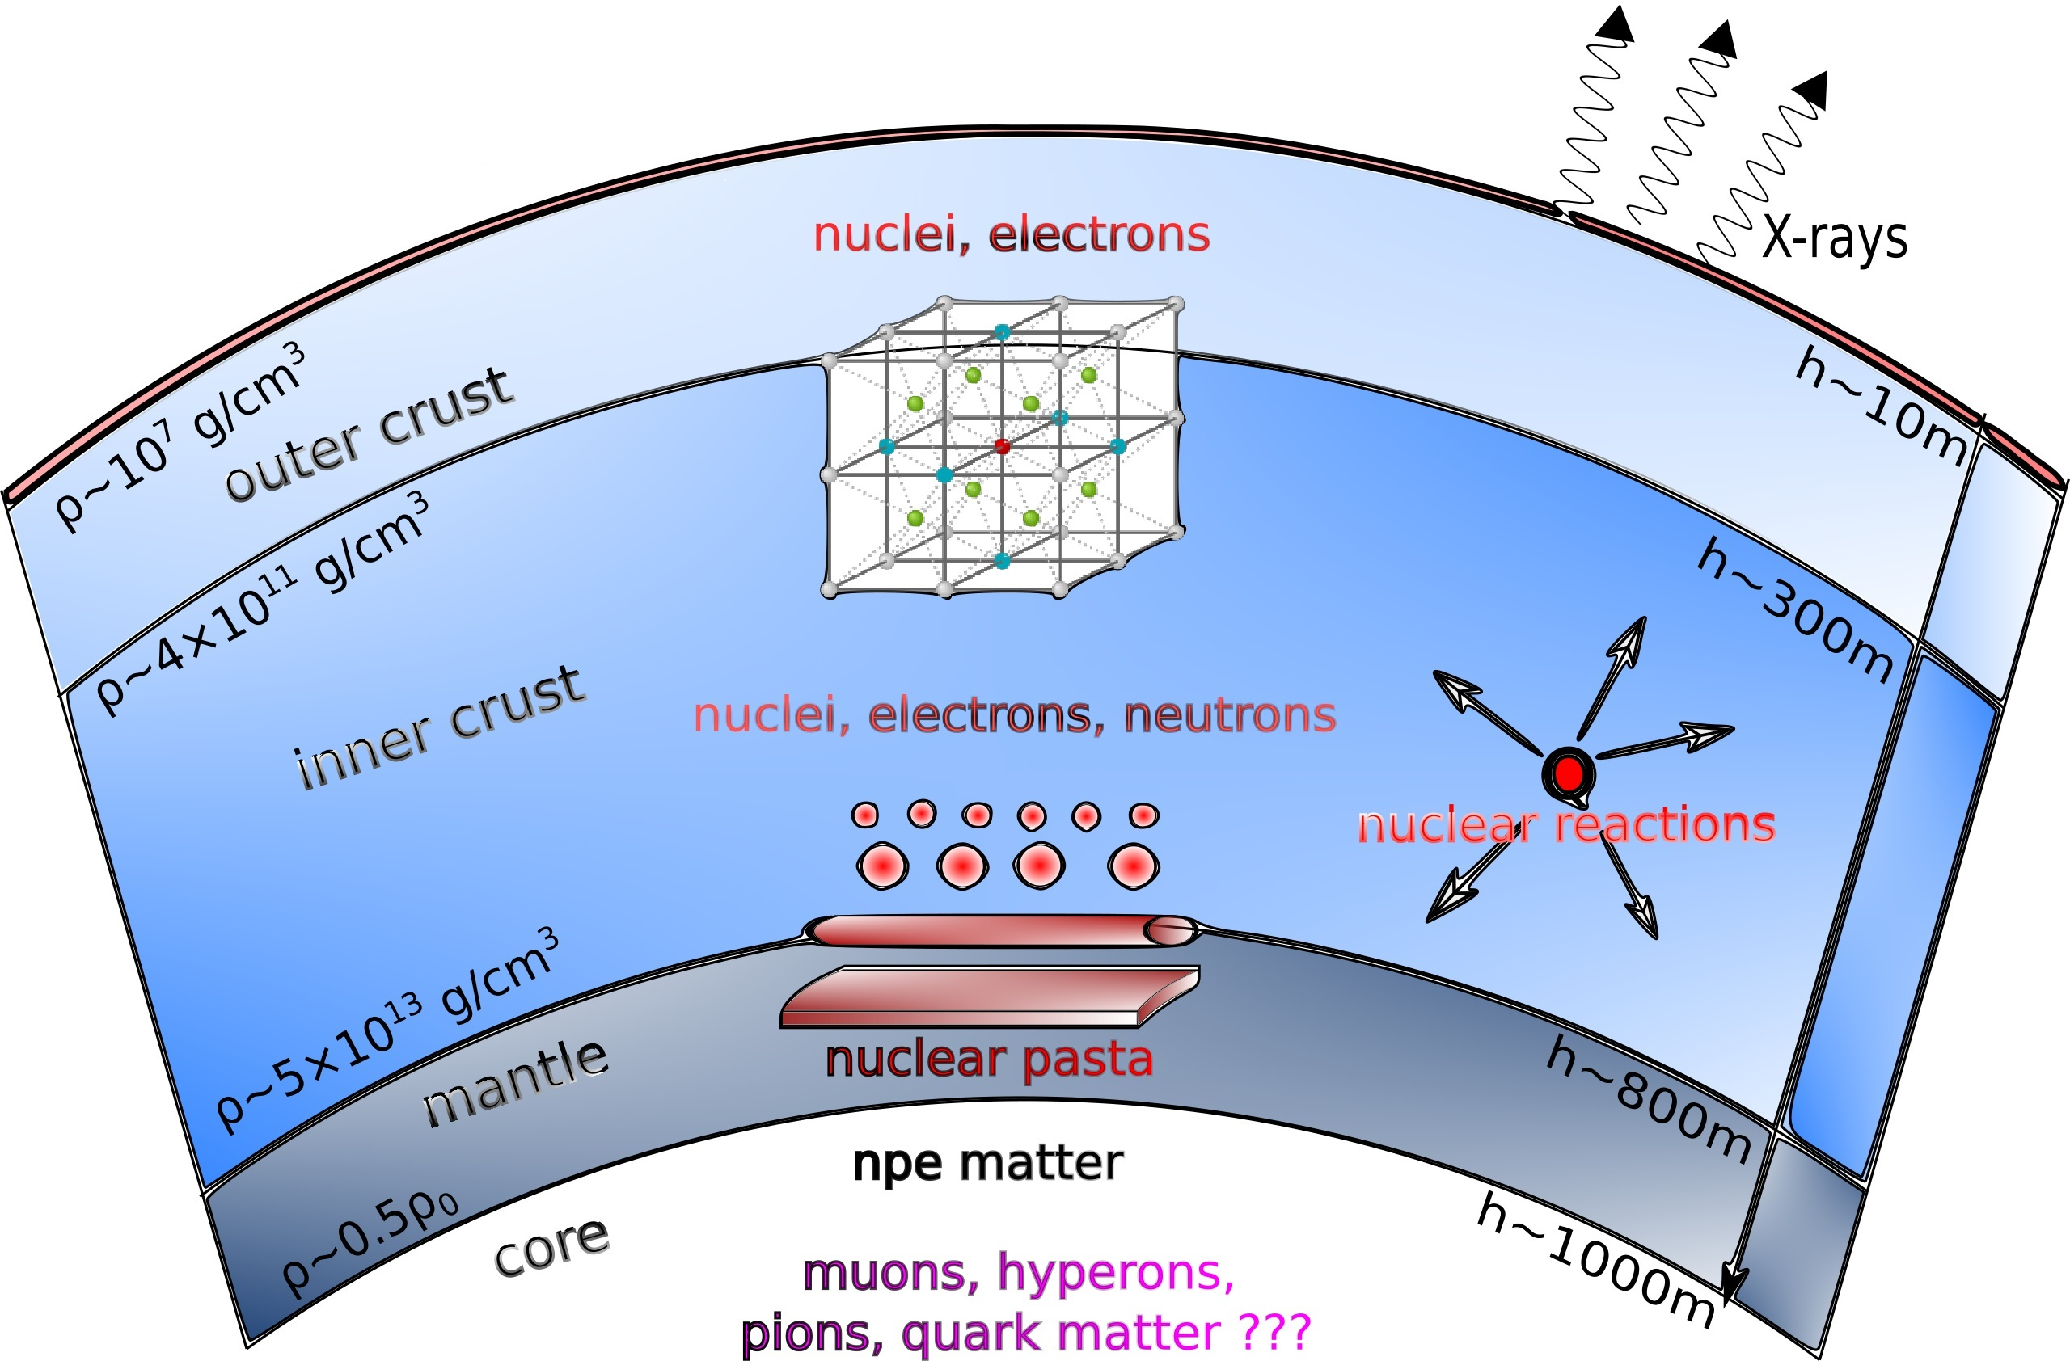
Structure of a neutron star
Author is N.N. Shchechilin (shown with his permission)

Slide 3
Compressible liquid drop model
Wigner-Seitz cell
Nucleus
The crust is modeled as a set of spherical cells. Each cell contains spherical nucleus with number densities $n_{pi}$ and $n_{ni}$ for protons and neutrons, respectively.
Outside the nucleus an unbound neutrons are present. Their number density is $n_{no}.$
The quasineutrality of the cell is maintained by a homogeneous background of electrons.

Slide 4
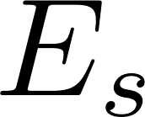
Compressible liquid drop model
Wigner-Seitz cell
Nucleus
Surface energy
Accounting to neutron adsorption
Neglecting neutron adsorption
(used in the report for simplicity, but it does not affect the result)

Slide 5
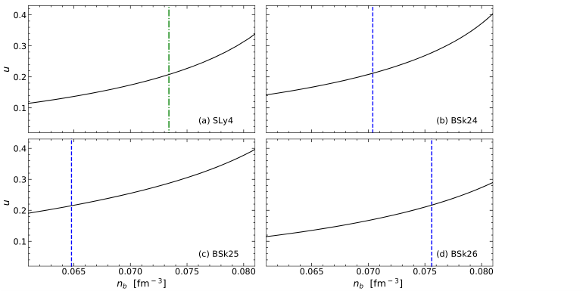
The spherical nuclei domain
Spherical nuclei
Spherical nuclei
filling factor of spherical nuclei
Spherical nuclei
Spherical nuclei
nucleon number density, fm⁻³
From Zemlyakov, Chugunov, Shchechilin (2021)
Spherical nuclei are energetically favorable up to filling factors $u≈$0.2
(The filling factor u is the ratio of the volume of the nuclei to the volume of the whole system).
Pethick&Ravenhall (1995): Spherical nuclei should become unstable at the filling factor 0.125
How to find a solution to the problem???

Slide 6
How to find a solution to the problem???
For $u\sim 0,125−0,2$ complex cluster shapes are possible
For example,
Newton et al., Phys. Rev. C 105, 025806,2022
Berry et al., Phys. Rev. C 94, 055801, 2016
Instability is suppressed

Slide 7
How to find a solution to the problem???
For $u\sim 0,125−0,2$ complex cluster shapes are possible
For example,
Newton et al., Phys. Rev. C 105, 025806,2022
Berry et al., Phys. Rev. C 94, 055801, 2016
Instability is suppressed

Slide 8
Instability of nuclei with respect to quadrupole deformations
1) Bohr&Wheeler (1939, Physical review, V.56)
$$2×4π{σR}^{2}>\frac{3}{5}\frac{Z^{2}e^{2}}{R}$$
It is the criterion for the stability of nuclei with respect to quadrupole deformations for isolated nucleus
(terrestrial conditions)

Slide 9
Instability of nuclei with respect to quadrupole deformations
1) Bohr&Wheeler (1939, Physical review, V.56)
$$2×\underline{4π{σR}^{2}}>\frac{3}{5}\frac{Z^{2}e^{2}}{R}$$
2) Pethick&Ravenhall (1995, Ann. Rev. Nucl. Part. Sci., V. 45)
$$\underline{4π{σR}^{2}}−2\frac{3}{5}\frac{Z^{2}e^{2}}{R}\left(1−\frac{3}{2}u^{\frac{1}{3}}+\frac{1}{2}u\right)=0$$

Slide 10
Instability of nuclei with respect to quadrupole deformations
1) Bohr&Wheeler (1939, Physical review, V.56)
$$2×\underline{4π{σR}^{2}}>\frac{3}{5}\frac{Z^{2}e^{2}}{R}$$
2) Pethick&Ravenhall (1995, Ann. Rev. Nucl. Part. Sci., V. 45)
$$\underline{4π{σR}^{2}}−2\frac{3}{5}\frac{Z^{2}e^{2}}{R}\left(1−\frac{3}{2}u^{\frac{1}{3}}+\frac{1}{2}u\right)=0$$
Wigner-Seitz cell
$$u_{crit}=\frac{1}{8}$$
There is a reference by Brandt (1985, Master's thesis, Copenhagen University) that the correction of the order of filling factor is due to the presence of a lattice.
Nucleus

Slide 11
Our model
Wigner-Seitz cell
Wigner-Seitz cell
Nucleus
Nucleus
The nucleus is a spheroid with semi – axes $R(1+ε)$ и $R/\sqrt{1+ε}$,
$$V_{nucleus}=const$$
The nucleus is a sphere with radius $R$
$$E_{s}=4π{σR}^{2}\left(1+\frac{2}{5}ε^{2}\right)$$
$$E_{C}=\frac{3}{5}\frac{Z^{2}e^{2}}{R}\left(1−\frac{3}{2}u^{1/3}+\frac{1}{2}u\right)−\frac{3}{5}\frac{Z^{2}e^{2}}{R}\left(\frac{1}{5}−\frac{1}{2}u\right)ε^{2}$$

Slide 12
Our model
Wigner-Seitz cell
Wigner-Seitz cell
Nucleus
Nucleus
The nucleus is a spheroid with semi – axes $R(1+ε)$ и $R/\sqrt{1+ε}$,
$$V_{nucleus}=const$$
The nucleus is a sphere with radius $R$
$$E_{s}=4π{σR}^{2}\left(1+\frac{2}{5}ε^{2}\right)$$
$$E_{C}=\frac{3}{5}\frac{Z^{2}e^{2}}{R}\left(1−\frac{3}{2}u^{1/3}+\frac{1}{2}u\right)−\frac{3}{5}\frac{Z^{2}e^{2}}{R}\left(\frac{1}{5}−\frac{1}{2}u\right)ε^{2}$$

Slide 13
Our model
Wigner-Seitz cell
Wigner-Seitz cell
Nucleus
Nucleus
The nucleus is a spheroid with semi – axes $R(1+ε)$ и $R/\sqrt{1+ε}$,
$$V_{nucleus}=const$$
The nucleus is a sphere with radius $R$
$$E_{s}=4π{σR}^{2}\left(1+\frac{2}{5}ε^{2}\right)$$
$$E_{C}=\frac{3}{5}\frac{Z^{2}e^{2}}{R}\left(1−\frac{3}{2}u^{1/3}+\frac{1}{2}u\right)−\frac{3}{5}\frac{Z^{2}e^{2}}{R}\left(\frac{1}{5}−\frac{1}{2}u\right)ε^{2}$$

Slide 14
Equilibrium composition: The virial theorem
(couples surface and Coulomb terms for equilibrium composition)
$$\underline{4π{σR}^{2}}−2\frac{3}{5}\frac{Z^{2}e^{2}}{R}\left(1−\frac{3}{2}u^{\frac{1}{3}}+\frac{1}{2}u\right)=0$$
(see Baym, Bethe,Pethick, 1971)
The energy change is associated with the deformation of a nucleus in the crust:
$$δE=\left[\frac{2}{5}\underline{4π{σR}^{2}}−\left(\frac{1}{5}−\frac{u}{2}\right)\frac{3}{5}\frac{Z^{2}e^{2}}{R}\right]ε^{2}$$
$$δE=\frac{3}{5}\frac{Z^{2}e^{2}}{R}\left(\frac{3}{5}−\frac{6}{5}u^{\frac{1}{3}}+\frac{9}{10}u\right)ε^{2}>0$$

Slide 15
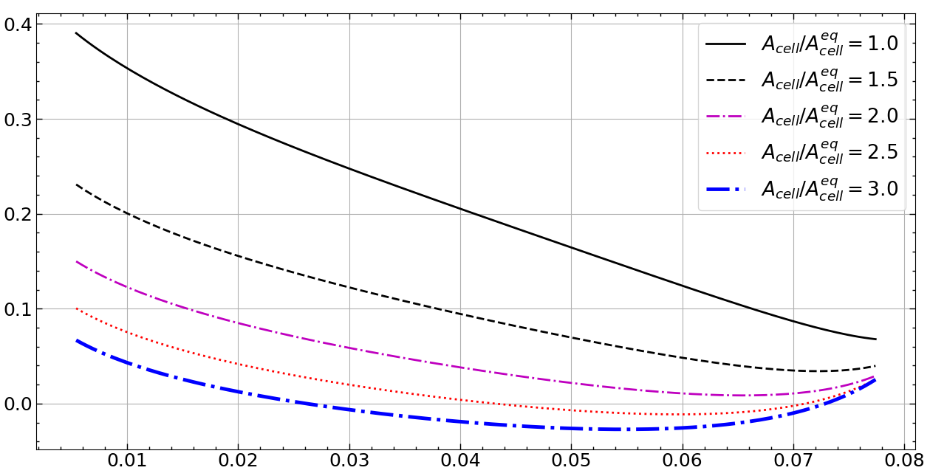
Instability for nonequlibrum composition
The energy change
nucleon number density, fm⁻³
The figure is shown for SLy4

Slide 16
Results
Reminder: We consider only infinitesimal quadrupole deformations, which does not guaranty thermodynamic stability
Spherical nuclei are stable at all filling factors with respect to quadrupole deformations, if their number density (and thus charge, size, etc) is optimal.
Instability occurs only if $A_{cell}$is much larger than the optimal value.
The results are the same, if neutron adsorption is taken into account (for more details, see Zemlyakov&Chugunov, Particles 2022, 5, 225).
Similar results were obtained by Kubis&Wojcik (2021, arXiv:2102.06675), but these authors used incorrect boundary for Coulomb potential at the cell boundary. It leads to quantitative differences from our work.

