Slide 1
Systematics of reaction plane determination with the MPD experiment.
V.Troshin¹, O.Golosov^{1,2}, M.Mamaev¹, E.Kashirin¹ for the MPD Collaboration
¹National Research Nuclear University MEPhI, Moscow, Russia
²National Research Center “Kurchatov Institute”, Moscow, Russia

Slide 2
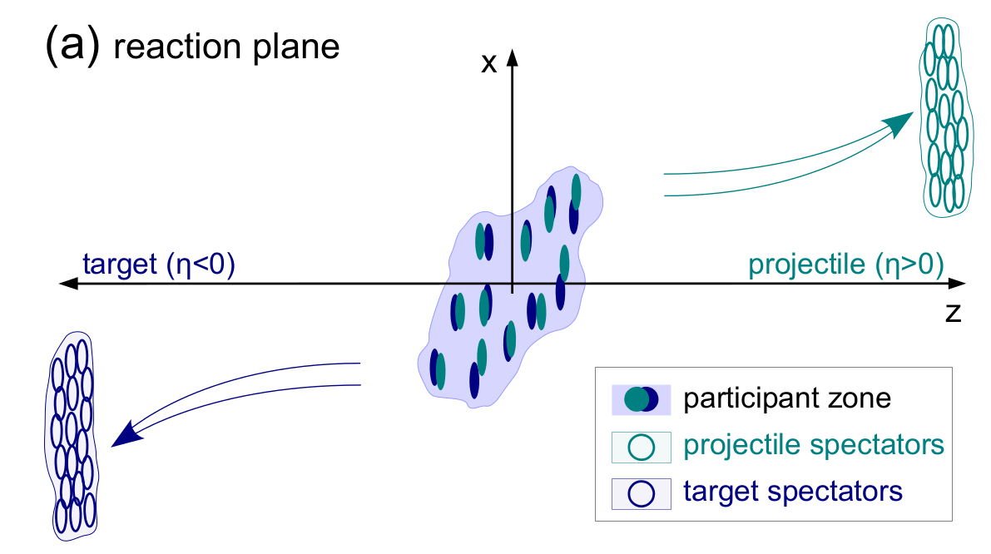
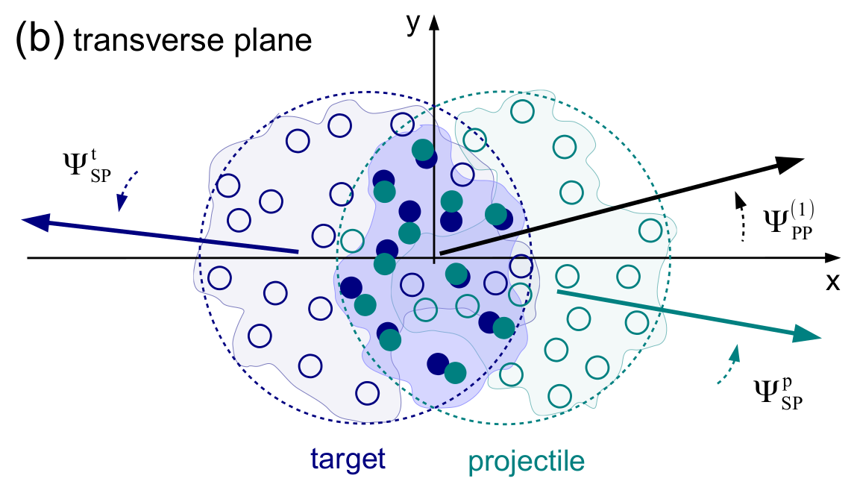
Anisotropic transverse flow
Spatial asymmetry of energy distribution at the initial state is transformed, through the strong interaction, into momentum anisotropy of the produced particles.
In the experiment reaction plane angle Ψ_{RP} can be approximated by
participant Ψ_{PP} or spectator Ψ_{SP} symmetry planes.

Slide 3
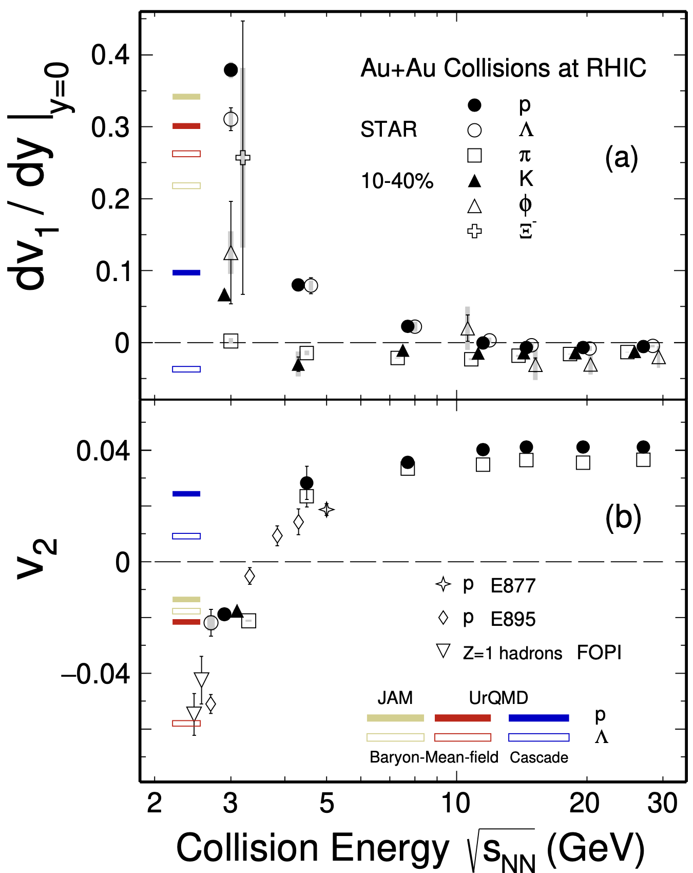
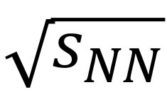
Anisotropic transverse flow in heavy-ion collisions at Nuclotron-NICA energies
Strong energy dependence of dv₁/dy and v₂ at SNN =4-11 GeV.
Anisotropic flow at FAIR/NICA energies is a delicate balance between:
The ability of pressure developed early in the reaction zone and
Long passage time (strong shadowing by spectators).
Differential flow measurements v_{n}( SNN , centrality, pid, p_{T}, y) will help to study:
effects of collective (radial) expansion on anisotropic flow
interaction between collision spectators and produced matter
baryon number transport
Several experiments (MPD, BM@N, STAR FXT, CBM, HADES, NA61/SHINE) aim to study properties of the strongly-interacted matter in this energy region.
BM@N
CBM
MPD
M. Abdallah et al. [STAR Collaboration] 2108.00908 [nucl-ex]

Slide 4
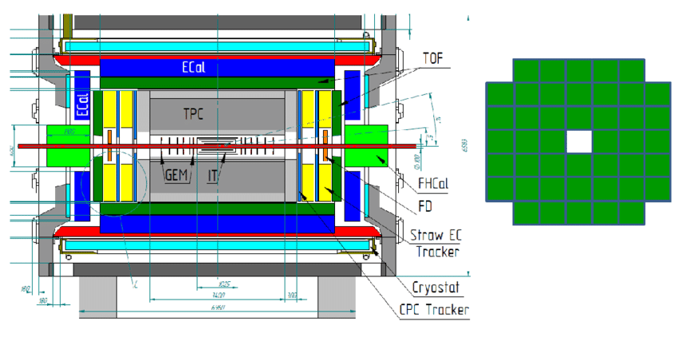
MPD experiment
4π spectrometer designed to work at high luminosity in the energy range
of the NICA collider (4-11 GeV)
Сapable of detecting of charged hadrons, electrons and photons.
Precise 3-D tracking system and a high-performance particle identification
system based on the time-of-flight measurements and calorimetry.
Two hadron calorimeters (FHCal) allow for reconstruction of projectile
and target spectator symmetry planes.
FHCal (transverse plane)

Slide 5
Dataset
Analysis description
DCM-QGSM-SMM model (realistic yields of spectator fragments for symmetry plane reconstruction)
Bi-Bi @ 9.2 GeV, 4M events
Geant4 transport (important for proper simulation of hadronic showers)
Simulation and reconstruction within MpdRoot environment
Centrality based on multiplicity of reconstructed tracks
Event selection
Successfully reconstructed primary vertex position
Track selection
|DCA|<0.5
number of hits in TPC >16
track matched to TOF hit
Particle identification
PDG of matched Monte Carlo track

Slide 6
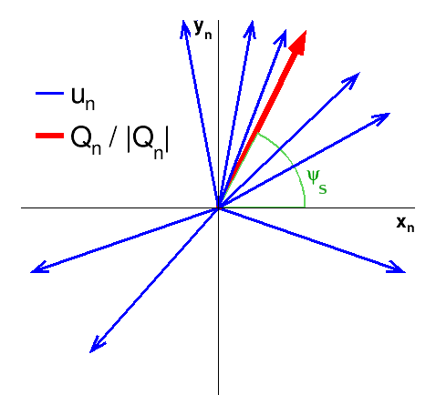
Scalar product method for v_{n} measurement
u and Q-vectors:
Here w^{k} is energy in k-th module of FHCal.
Scalar product method gives independent estimates for flow values obtained with different Q-vector components and symmetry plane sources.
v₁ with respect to symmetry plane Ψ_{S} is calculated using group of particles (modules) “a”:
Rª_{1,i} is a 1st order event plane resolution correction (details in the following slides)

Slide 7
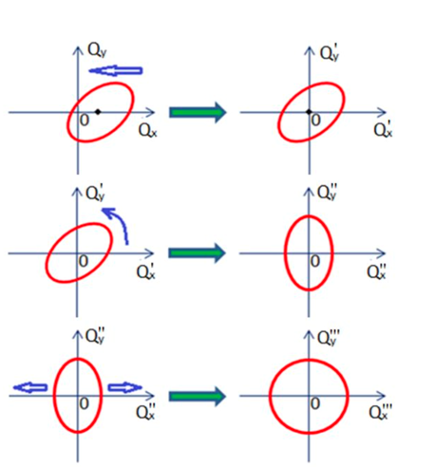
Corrections for azimuthal acceptance non-uniformity
recentering
Non-uniformity of azimuthal acceptance may introduce substantial bias on the flow measurement results.
Data-driven differential (centrality, primary vertex position, particle type or kinematics, etc.) corrections were applied for u and Q-vectors:
recentering
twist
rescaling.
Implemented in QnTools framework (along with multidifferential Q-vector correlations and tools for correlation arithmetics and error propagation).
https://github.com/HeavyIonAnalysis/QnTools
twist
rescaling

Slide 8
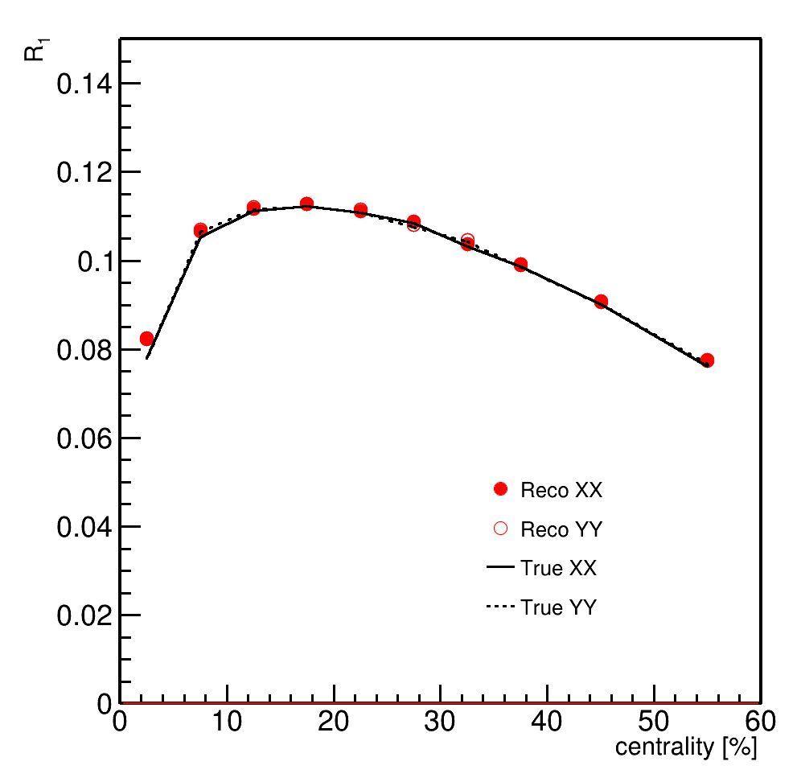
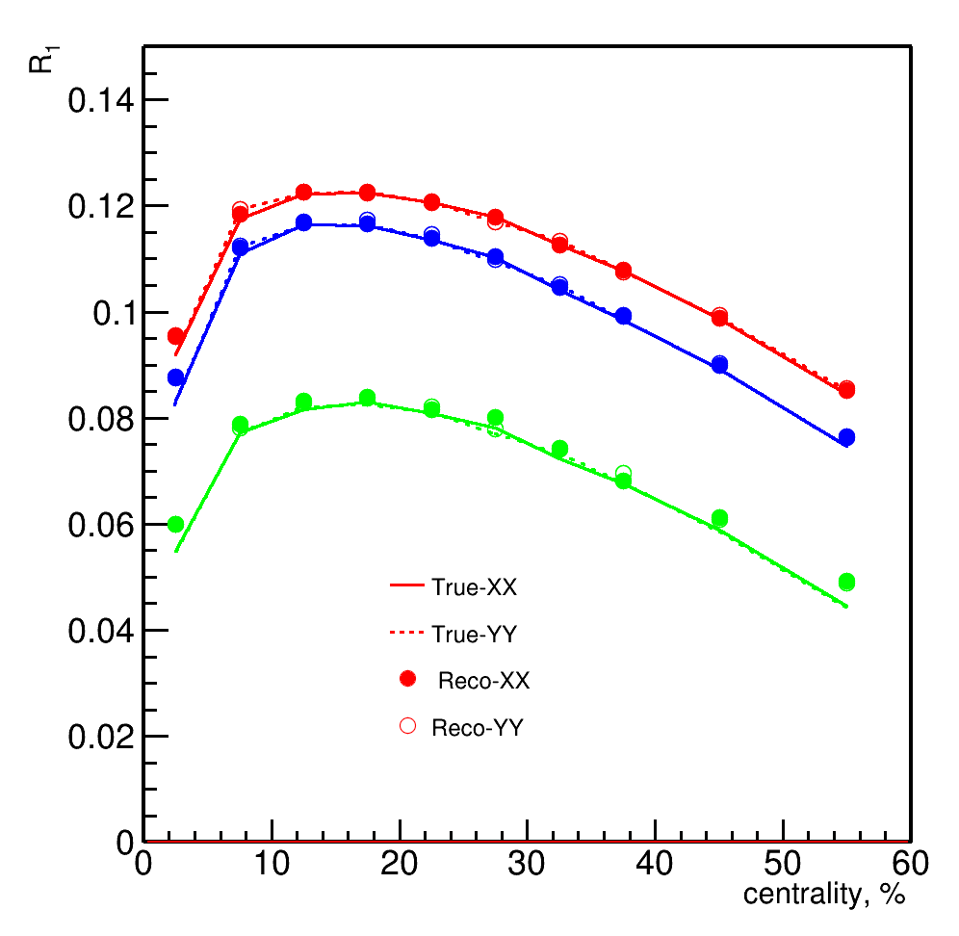
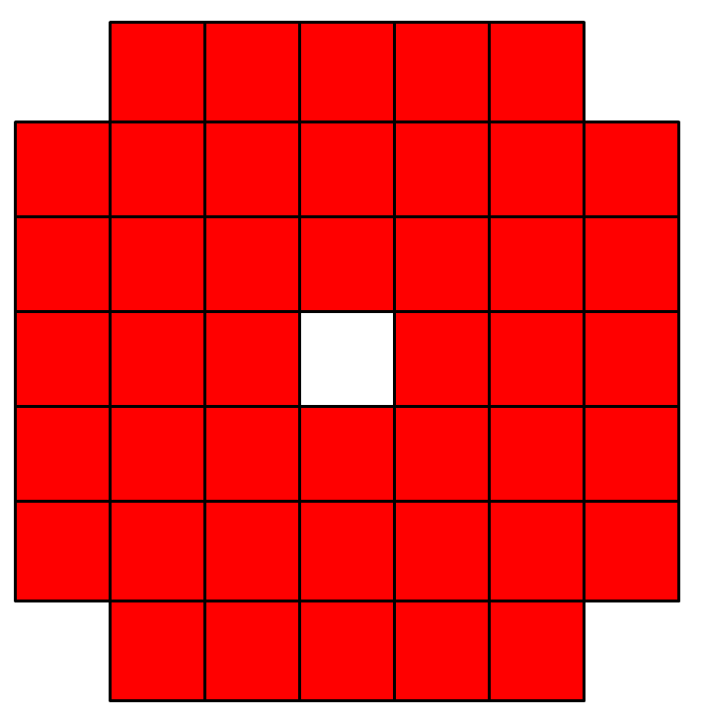
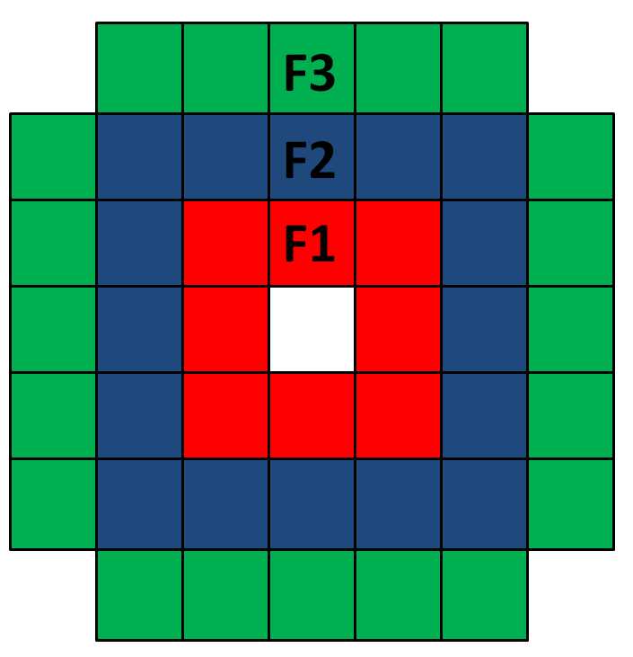
Reconstructed resolution correction (2-subevent method)
N - northern FHCal
S - southern FHCal
Good agreement with true resolution for the full FHCal and separate module rings
except for most central events (minimal anisotropy of nuclei overlap area).
Consistent results for X and Y components - only combined values on further slides.

Slide 9
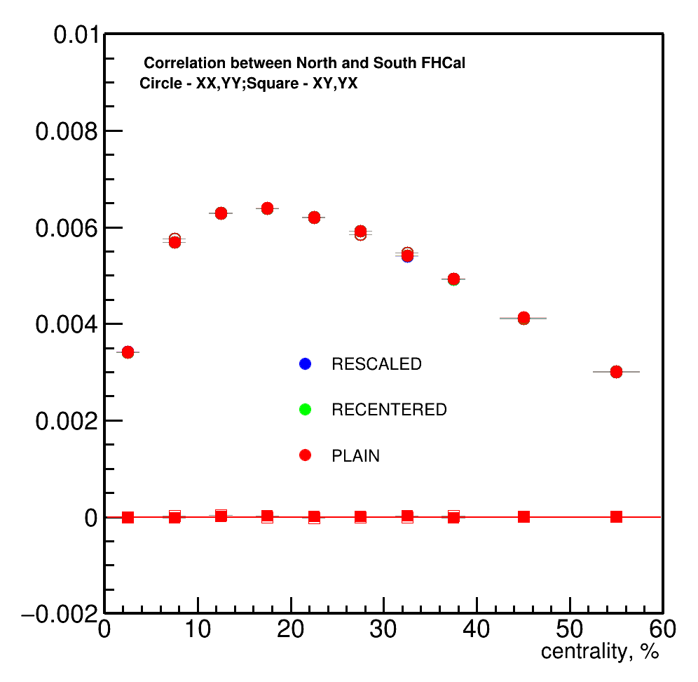
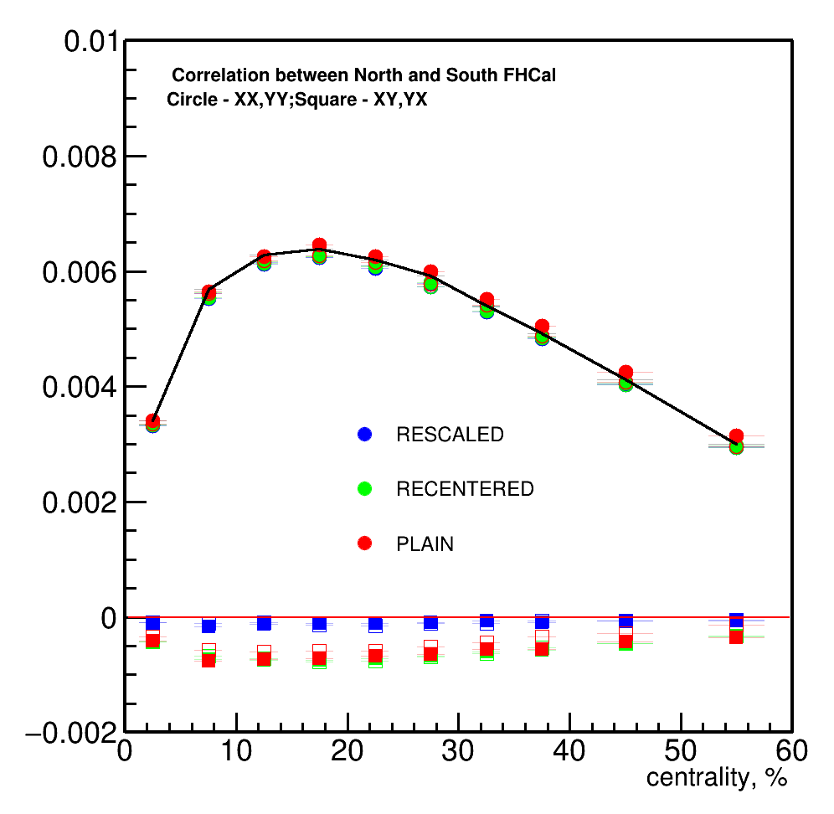
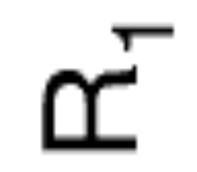
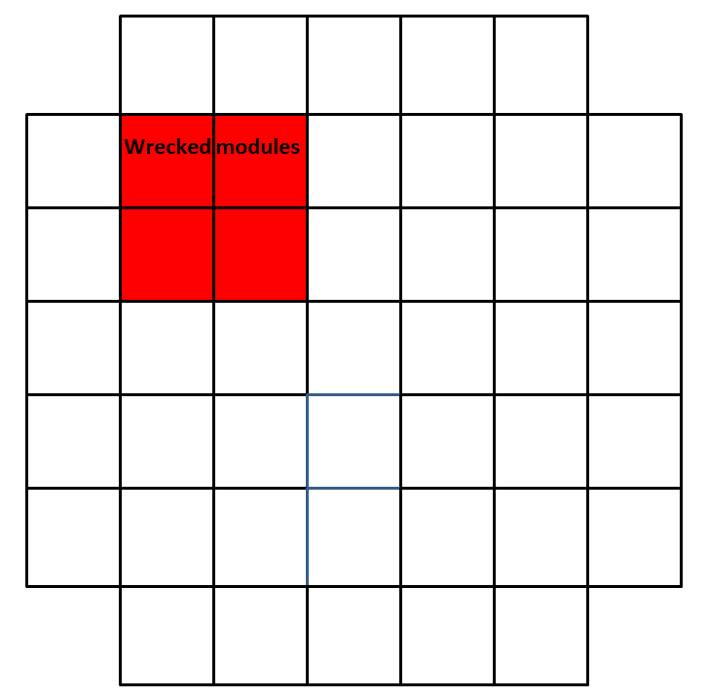
Effect of acceptance corrections on full FHCal resolution
No effect in case of fully functional detector
Rescaling minimizes the effect of failing modules (marked red) on the symmetry plane estimate

Slide 10
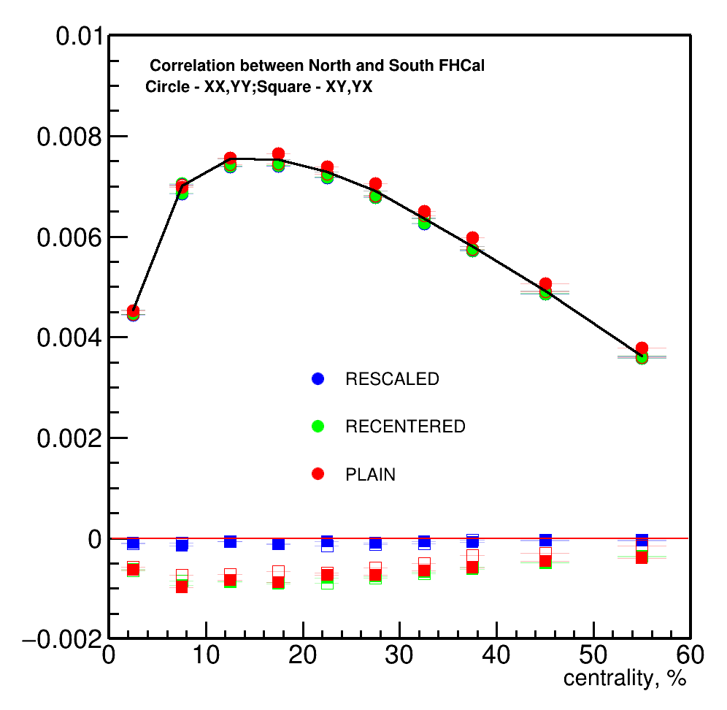
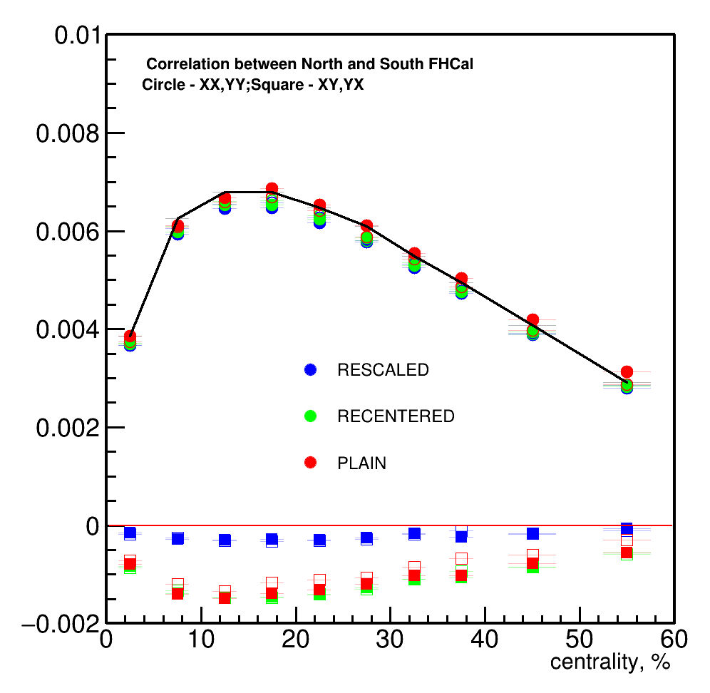
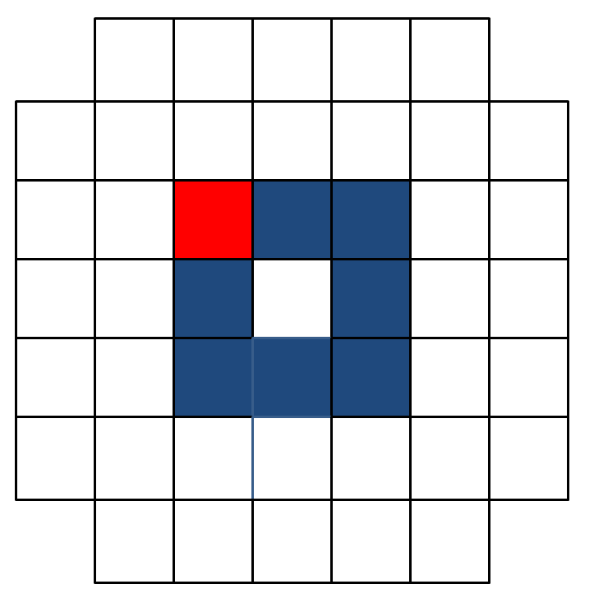
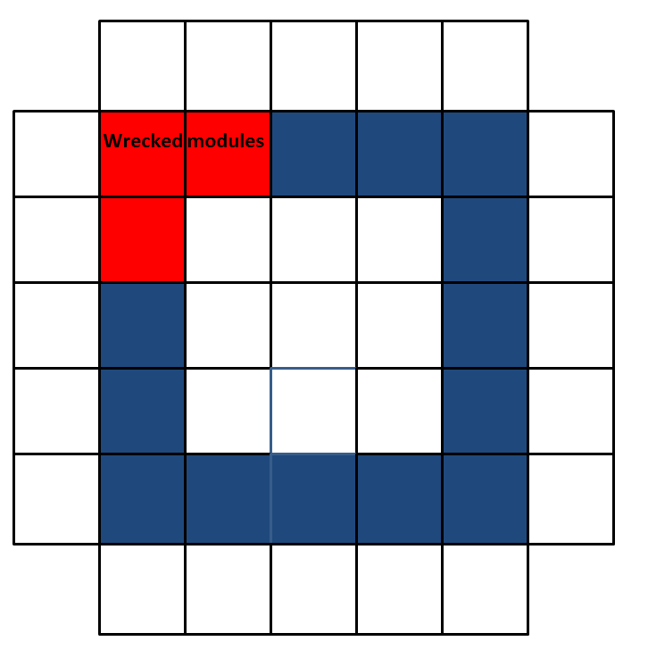
Effect of acceptance corrections on FHCal rings resolution
Rescaling minimizes the effect of failing modules (marked red)
on the symmetry plane estimates from module rings

Slide 11
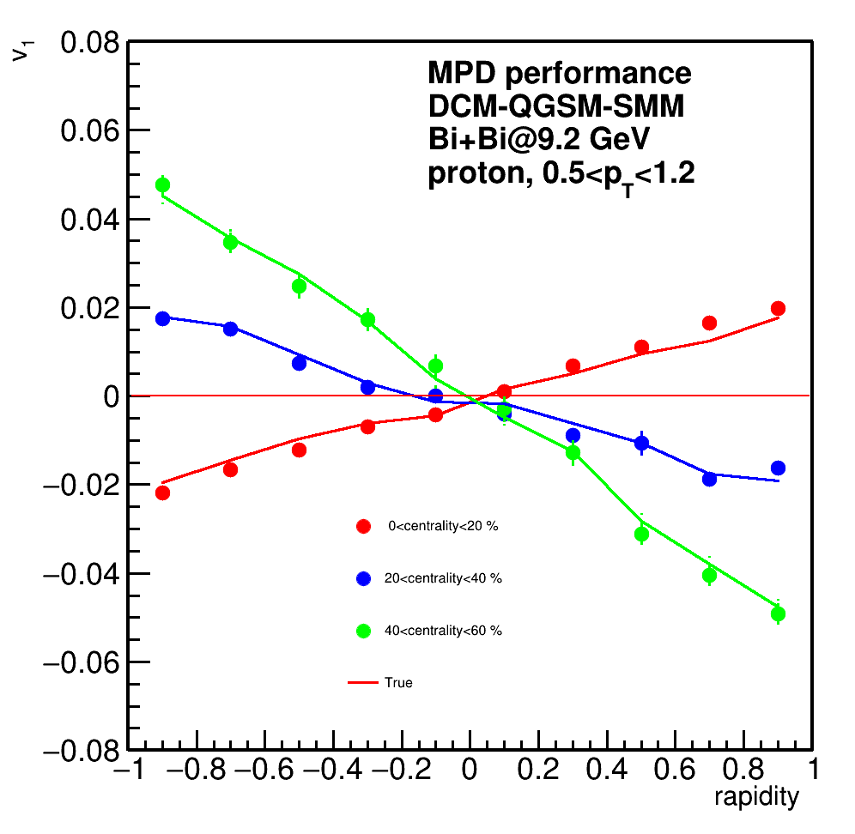
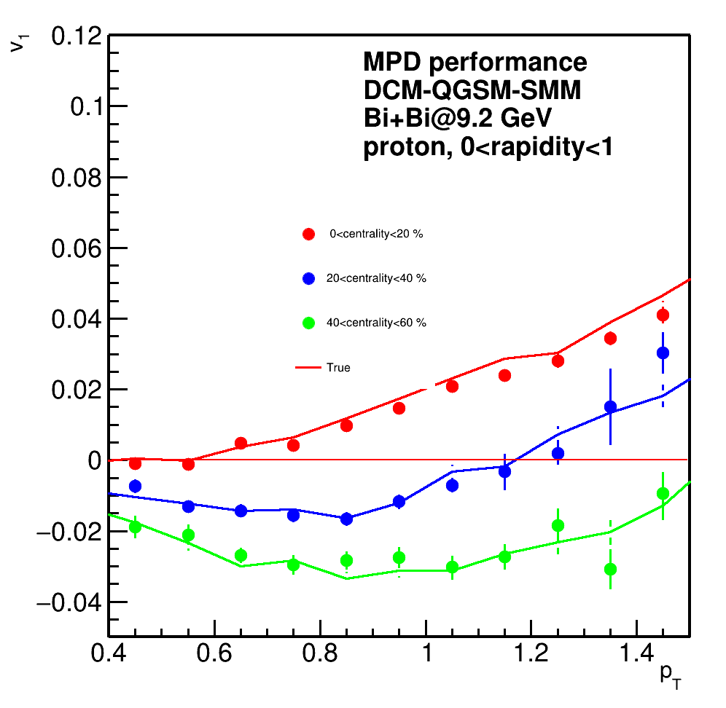
Proton directed flow relative to spectator symmetry plane
v₁ dependences calculated relative to spectator symmetry plane are in good agreement with those from the event generator.

Slide 12
Summary
Good agreement of reconstructed and true resolution for the full FHCal and separate module rings except for most central events with 2 subevent method.
Consistent resolution values obtained with X and Y components of Q-vectors.
Corrections for non-uniform acceptance can minimize the effect of failing FHCal modules.
p_{T} and rapidity dependences of directed flow calculated relative to spectator symmetry plane are in good agreement with values from the event generator.
Outlook:
Systematics of flow measurements relative to different spectator symmetry plane estimates (FHCal module groups) and participant plane

