Slide 1
Development of DCS for forward spectator detectors at the BM@N, MPD/NICA and NA61/SHINE experiments
Oleg Petukhov, INR RAS
Nucleus 2022, MSU

Slide 2
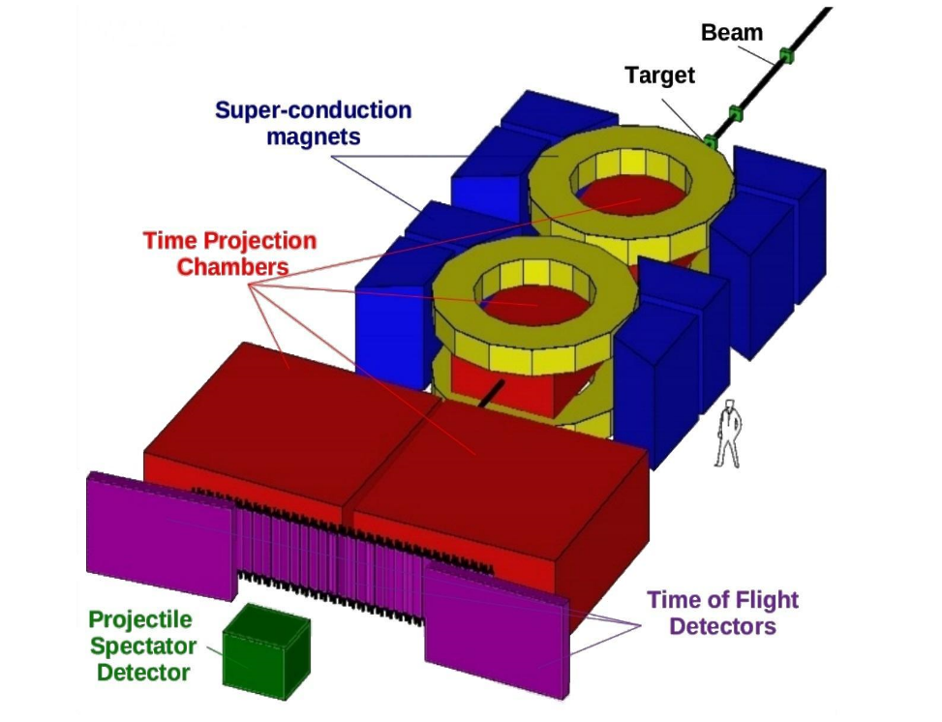
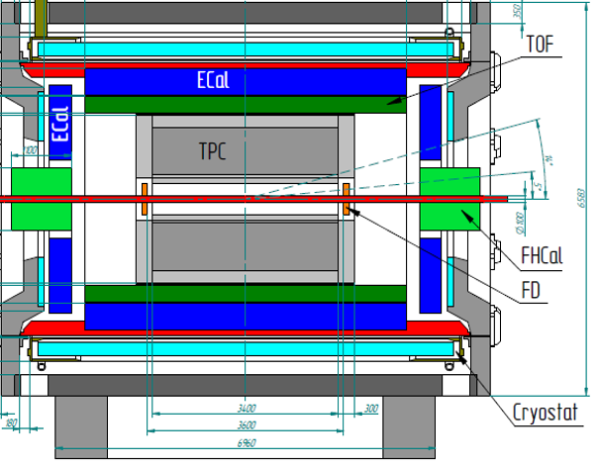

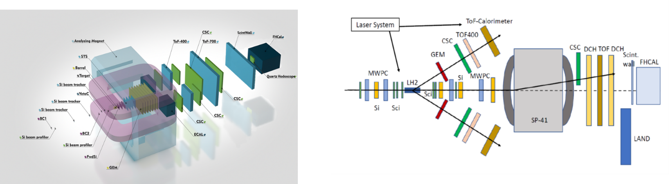
Forward Spectator Detectors
NA61/SHINE: Main PSD + Forward PSD
MPD/NICA: FHCal (dual)
BM@N: FHCal + Scintillation Wall +
Beam Hodoscope
SiPM readout requires temperature control with
a DCS
MPD FHCal

Slide 3
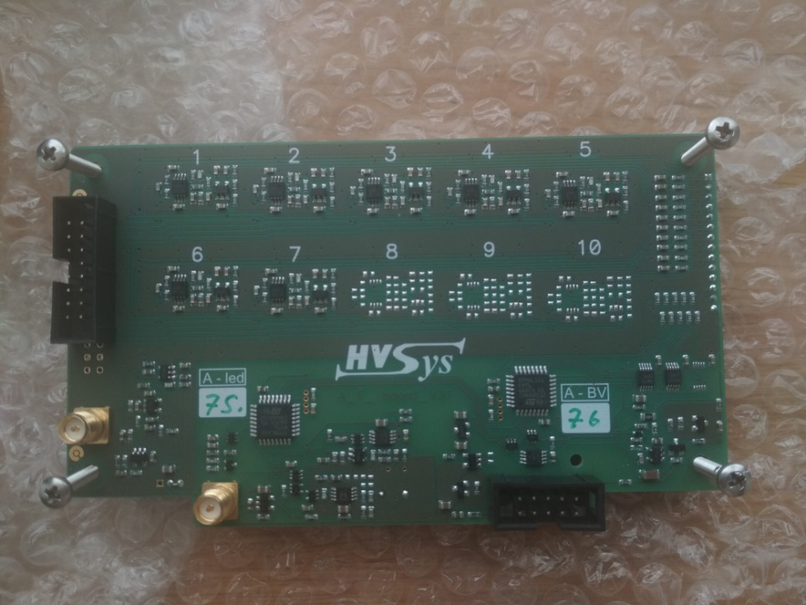
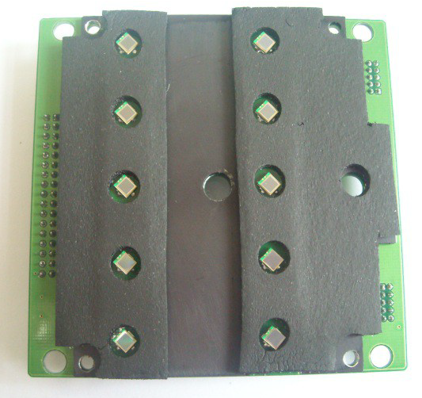
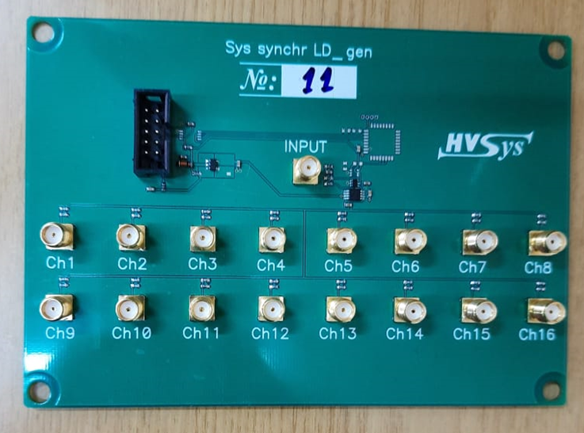
Forward Detectors Hardware
Front-End Electonics (FEE) boards with onboard SiPM manufactured by HVsys (Dubna) with microcontroller-managed photodetector high voltage and monitoring
FEE share same control protocol (simple request + response over RS485 serial line).
Several FEE generations have different implementation (register set, HV calibration, etc)

Slide 4
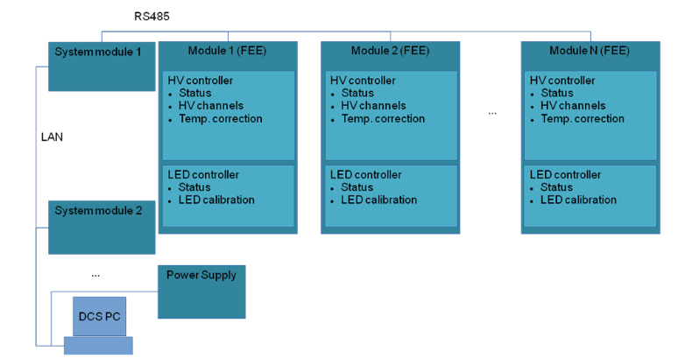
DCS (Detector Control System) Tasks
LAN
RS485
DCS Tasks:
Control of HV at photodetectors (SiPM);
Temperature control of photodetectors;
Compensation of temperature drift of SiPM gain;
Monitoring of SiPM gain with stabilized light source
Easy configuration: add/remove detectors and parts
General
DCS
System Module
FEE
FEE
Forward Detector DCS
FEE
System Module
FEE
Historical
Database
FEE
FEE
Connection diagram

Slide 5
MPD FHCal Hardware
FHCal has two equal shoulders, each with a single SM-G761 control box, 44x 7-channel HV and LED FEEs with temperature sensors

Slide 6
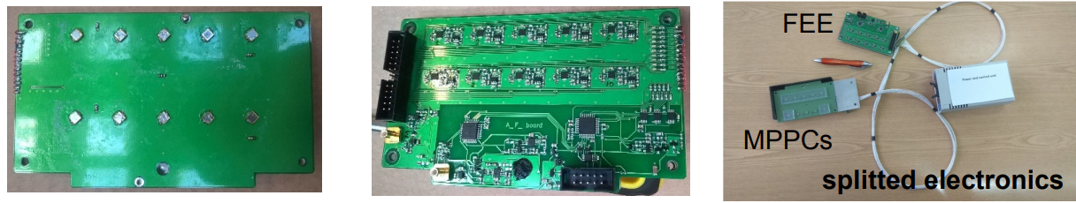
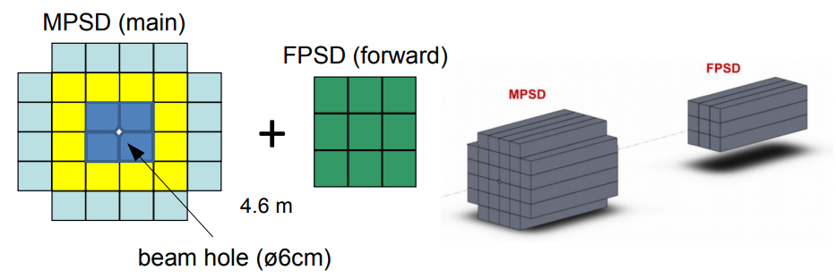
Main PSD and Forward PSD
(NA61/SHINE)
Main PSD has a single control box and 32x 10-channel HV and LED FEEs
Forward PSD has 9x 10-channel HV and LED FEEs (moved out of the high-radiation area)

Slide 7
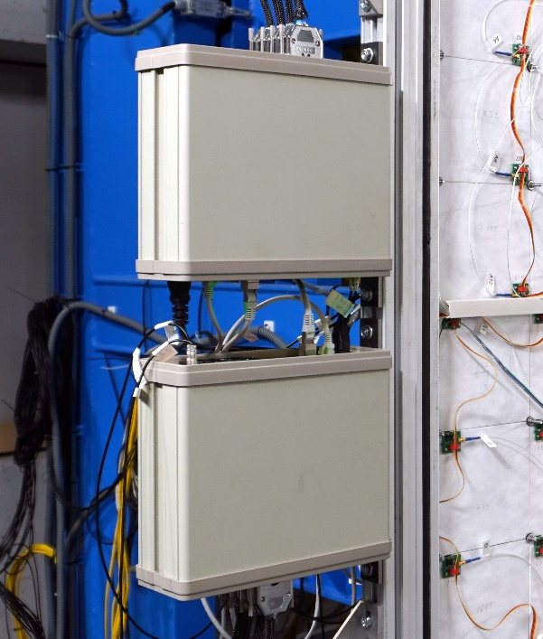
Forward Detectors Hardware (BM@N)
BM@N:
  FHCal has a single SM-G761 control box, 34x 7-channel HV and LED FEEs,
  20x 10-channel and LED FEEs with temperature sensors, and LED synchronization board;
  Scintillation Wall has 3x DM64_V2_17-4 integrated readout and control boxes, 170 front-end boards in 12 groups with 1 temperature sensor per group
  Beam Hodoscope has a single SM-G761 control box and integrated box with 4x 8-channel HV FEEs, two of them equipped with temperature sensors

Slide 8
Connection Diagram (BM@N)

Slide 9
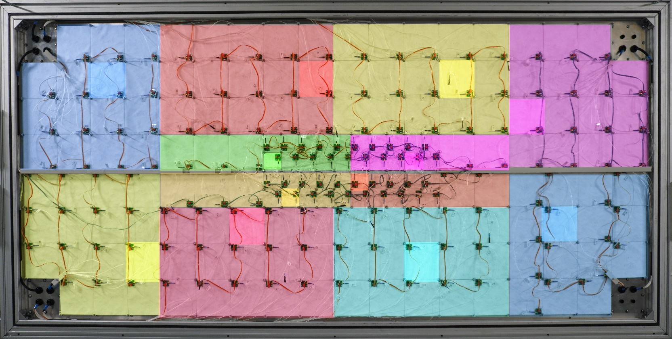
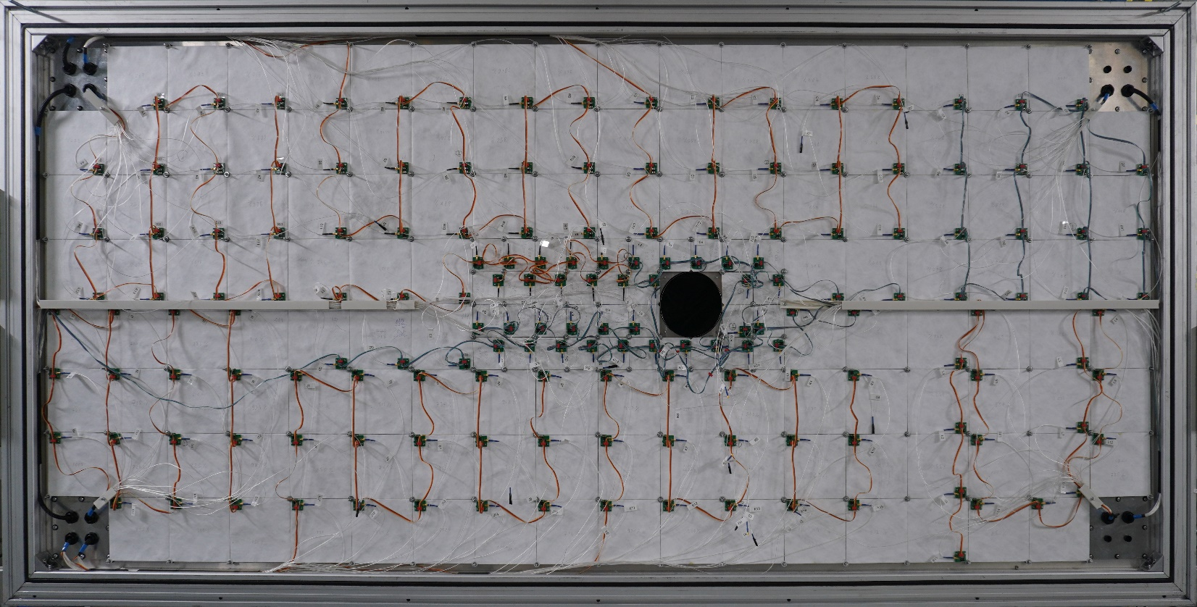
Scintillation Wall Temperature Sensors Map
170 front-end boards in 12 groups with 1 temperature sensor per group

Slide 10
SRC Data Runs at BM@N
Data taking with DCS in March 2022
Three DCS instances with three socket managers running
SiPM Voltage, V

Slide 11
Conclusion
Versatile DCS developed and tested in experiments
Multiple instances running each controlling hundreds of channels
TODO:
Experiment DCS integration
Notifications and alerts

