Slide 1
Software for processing and analyzing data obtained from hybrid pixel detectors of the Medipix family
Aleksandr Lapkin (JINR)(lapkin@jinr.ru)
Nucleus-2022
15.07.2022

Slide 2
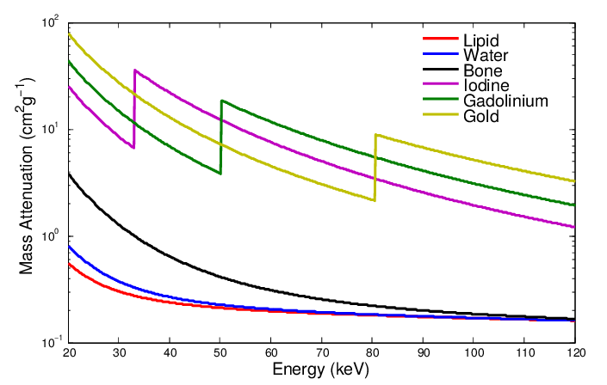
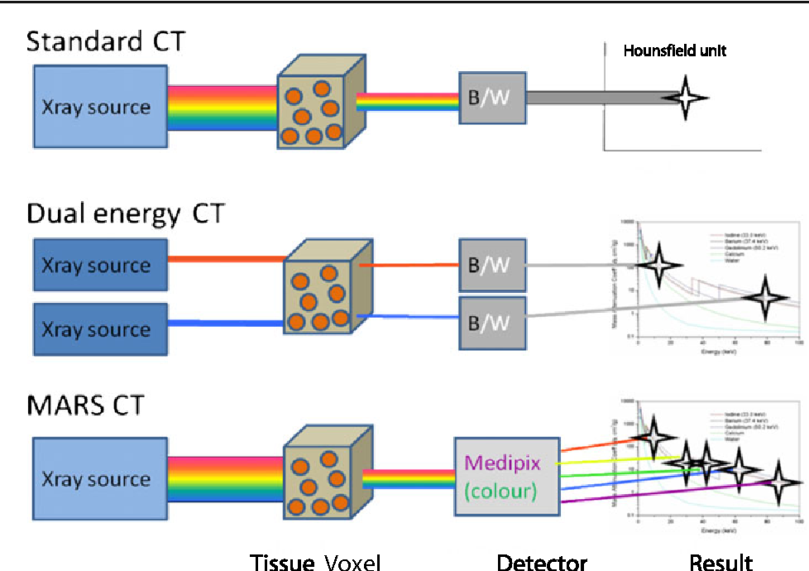
Multi-energy tomography
Bateman, Christopher & Rajendran, Kishore & Ruiter, Niels & Butler, Anthony & Butler, Philip & Renaud, Peter. (2015). The Hidden K-edge Signal in K-edge Imaging.
Our group is developing a multi-energy tomograph using Medipix family detectors
To obtain energy information Medipix detectors perform threshold scans (series of frames of the object with different thresholds)
We need a tool to operate threshold scan data
Multi-energy CT
Anderson, Nigel G. et al. “Spectroscopic (multi-energy) CT distinguishes iodine and barium contrast material in MICE.” European Radiology 20 (2010): 2126-2134.

Slide 3
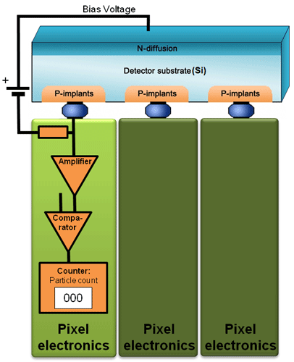
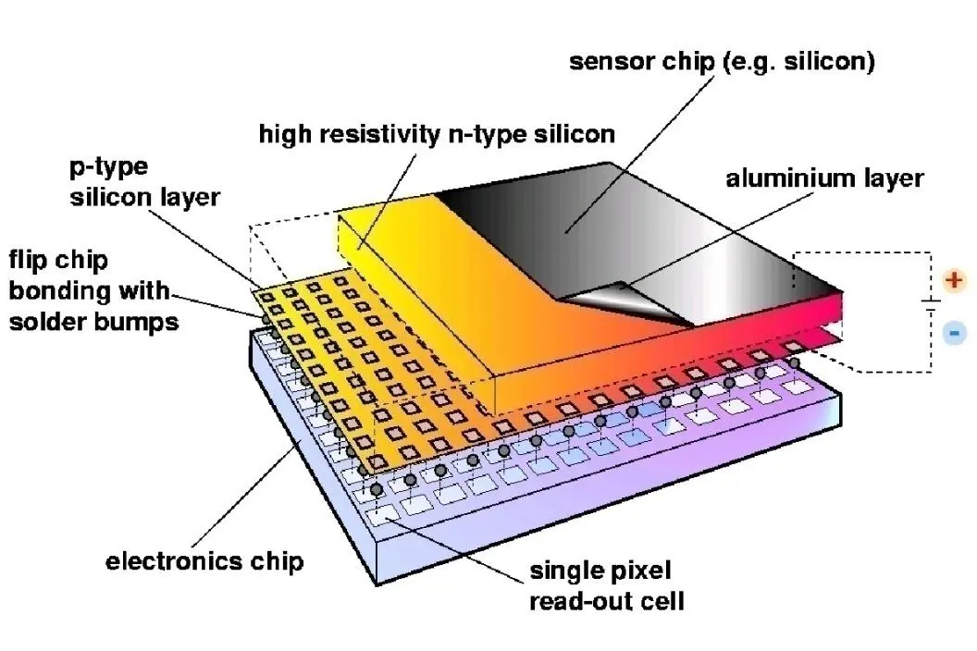
Medipix
Medipix series detectors are hybrid semiconductor pixel detector
Developed by Medipix collaboration (https://medipix.web.cern.ch/)
Consists of a semiconductor sensor and a readout integrated circuit
Photons are detected by their transferring energy to electrons. The appeared free electrons move to the pixel contact pads, causing a signal
The signal is digitized and compared with the threshold in a pixel. Pixels operate independent

Slide 4
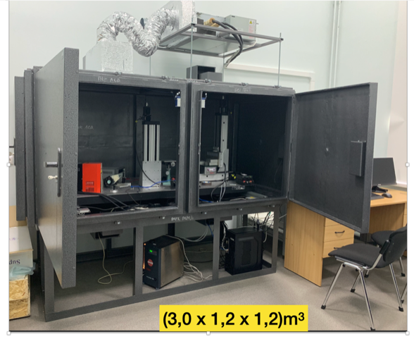
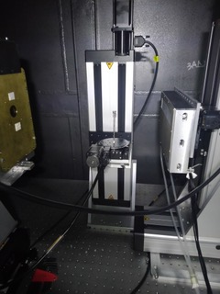
Experimental Setup (“Kalan” )
X-ray tube
Sample
Widepix
detector

Slide 5
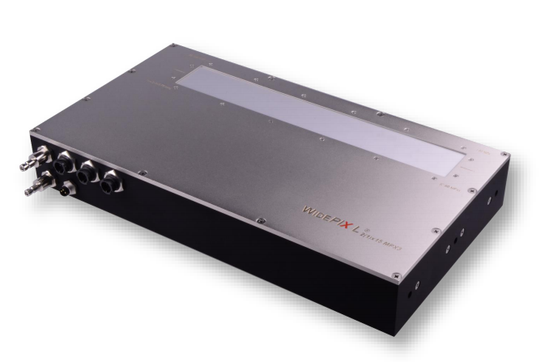
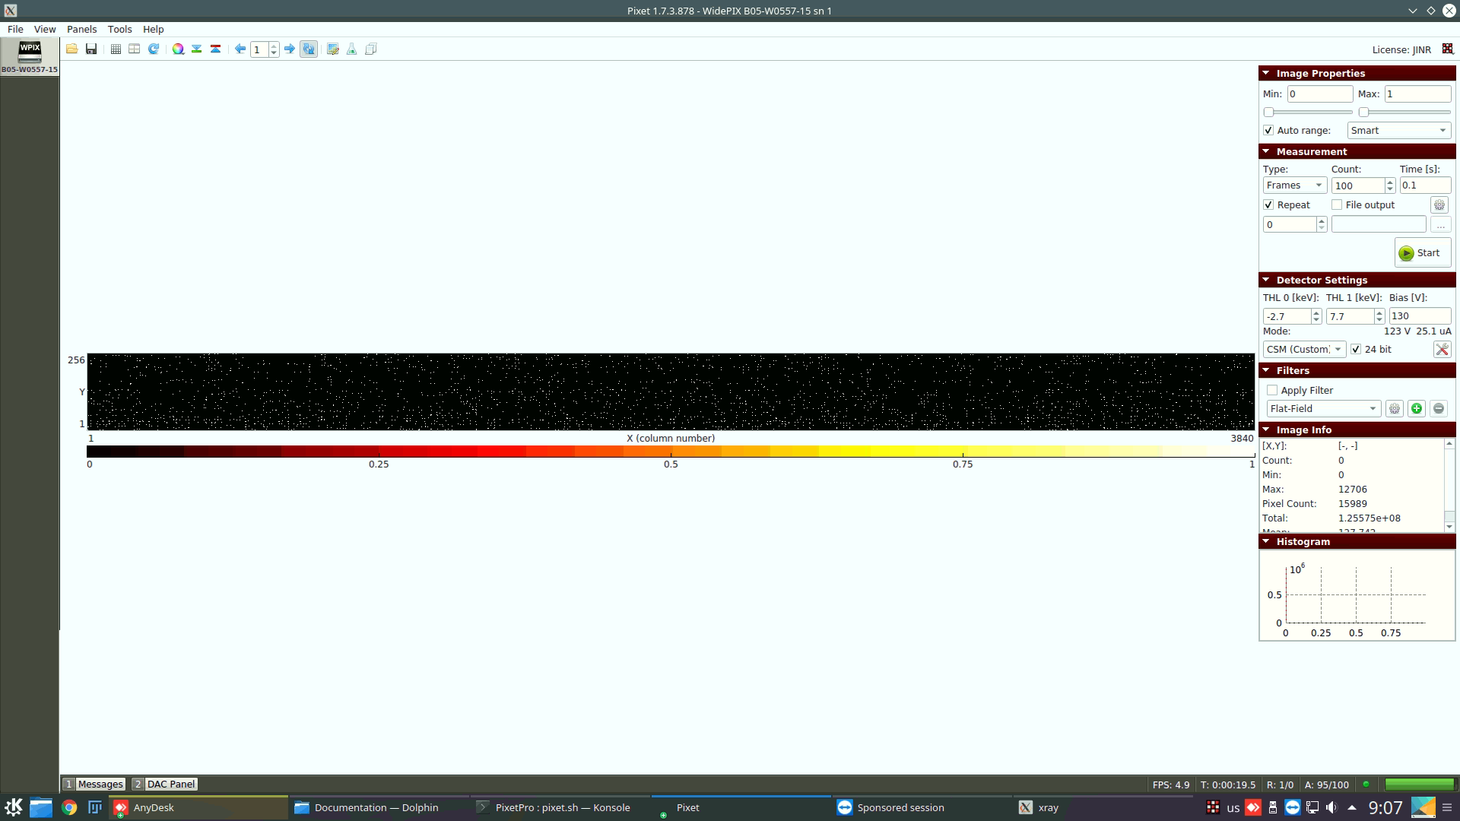
Widepix
Widepix detector (15х1):
15 Medipix3RX in one row
Charge Summing Mode for compensation the effect of charge spreading
256х3840 = 983040 pixels
Two registration channels with one counter for each channel
CdTe sensor
Pixet Software:
Standard software for driving of Medipix detectors
Allows to make readout of frames series, threshold scans, equalization and detector setup
Python interpreter
Pixet cannot provide analysis which is required for our researches

Slide 6
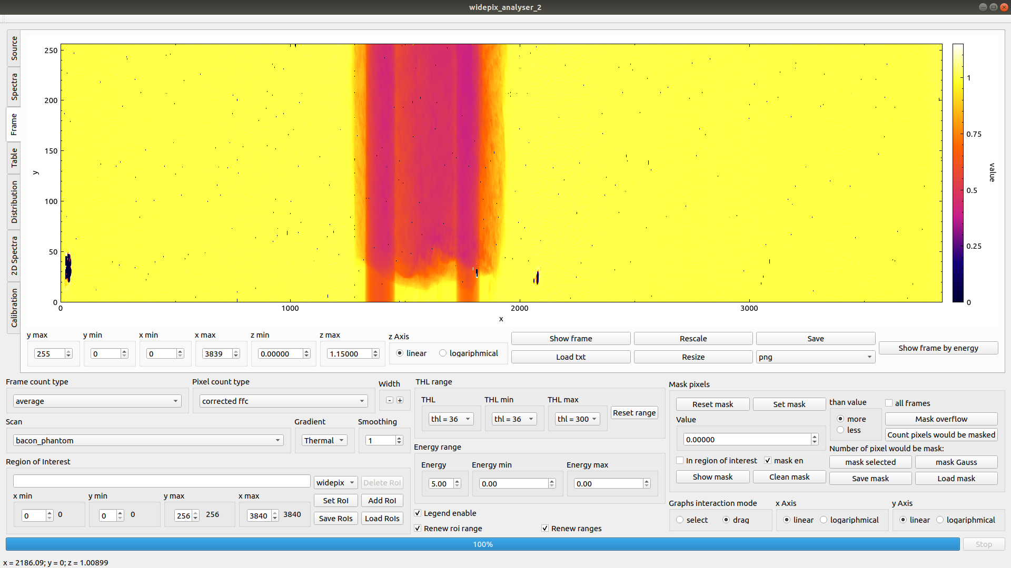
Widepix analyser
The program was written to analyze threshold scans data
It was written in C++ language using Qt and CERN ROOT libraries
There is the phantom with tubes with La and Gd and pork fat on the frame (the phantom is showing in the next slide)

Slide 7
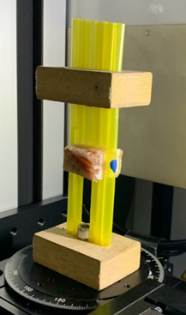
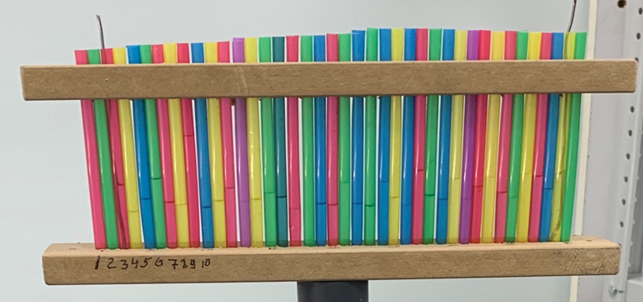
Phantoms
Phantom with tubes. There are I, Gd, La solutions and H₂O in the tubes
(Cocktail phantom)
Phantom with tubes and pork fat
These phantoms allow to compare X-ray energy absorption of different materials in different concentrations
Pork fat emulates soft tissue

Slide 8
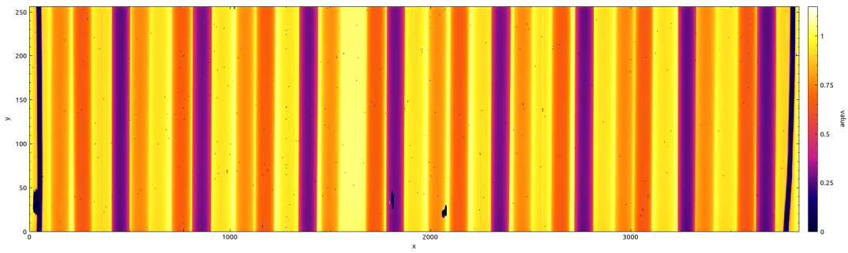
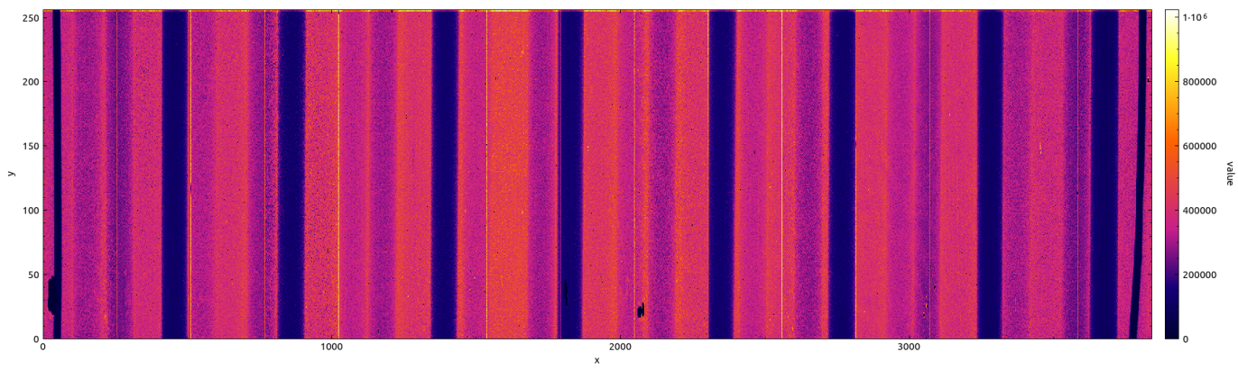
Frames
FFC frame THL = 36
250
1
200
150
0.75
FFC pixel value
y, pixel
0.5
100
50
0.25
0
0
0
1000
x, pixel
2000
3000
3840
Raw data frame THL = 36
250
1000000
200
800000
Cocktail phantom
150
600000
Counter 1 pixel value
y, pixel
100
400000
50
200000
0
0
0
1000
x, pixel
2000
3000
3840
Frame is an image from the detector
Frame is a 2D histogram
A bin value is calculated from the counter values of the corresponding pixels (raw data, FFC,…)

Slide 9
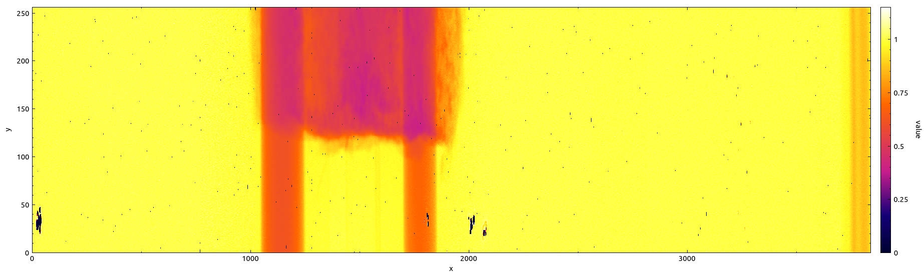
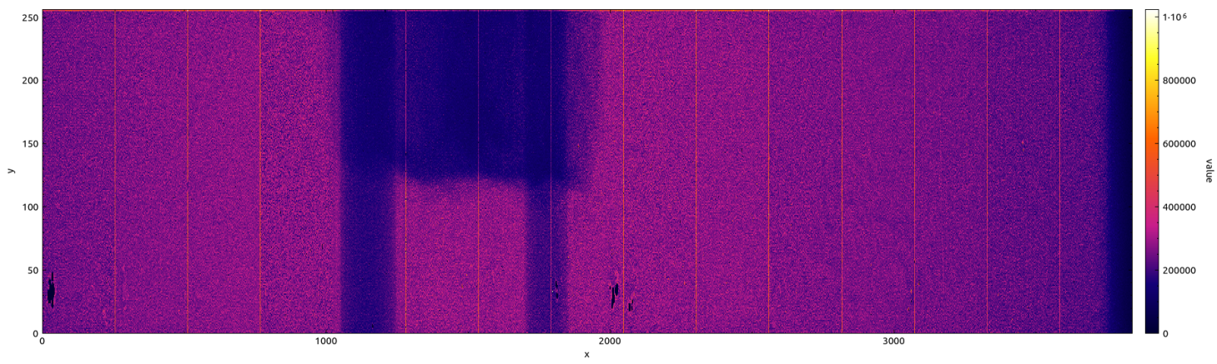
Frames
FFC frame THL = 36
250
1
200
150
0.75
y, pixel
FFC pixel value
100
0.5
50
0.25
0
0
0
1000
2000
3000
3840
x, pixel
Raw data frame THL = 36
250
1000000
200
800000
150
600000
y, pixel
Counter 1 pixel value
100
400000
Phantom with pork fat
50
200000
0
0
0
1000
2000
3000
3840
x, pixel
Frame is an image from the detector
Frame is a 2D histogram
A bin value is calculated from the counter values of the corresponding pixels (raw data, FFC,…)

Slide 10
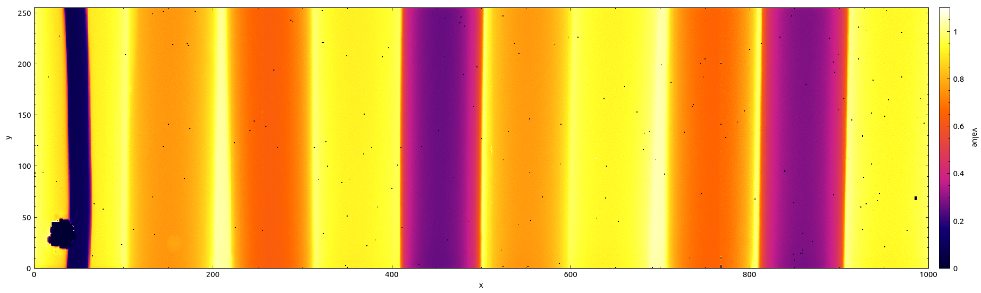
Regions of Interest (RoI)
Tube 1
Tube 35
Tube 15
empty
Tube 2
Tube 34
Frame area, FFC, THL = 36
Solder wire
Tube 3
Tube 33
Solder wire
Tube 2
Gd
Tube 4
I
Tube 6
H₂O
Tube 8
I
Solder wire
Tube 1
La
Tube 3
H₂O
Tube 5
La
Tube 7
Gd
Tube 9
H₂O
250
1
200
0.8
150
y, pixel
FFC pixel value
0.6
100
0.4
50
0.2
0
0
0
200
400
600
800
1000
Cocktail phantom
x, pixel
There are 35 tubes and 2 solder wires on the frame
The program can operate a set of different RoI
Region of interest is a detector area which is processed independently

Slide 11
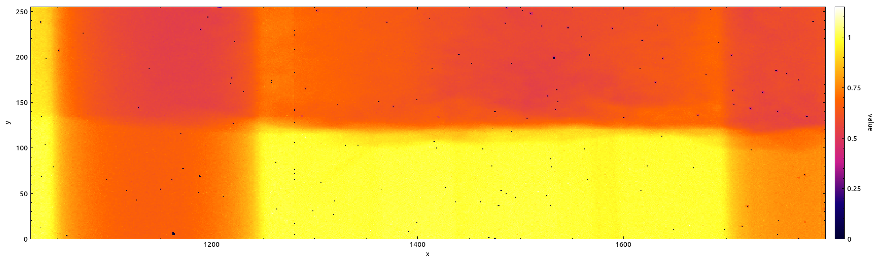
Regions of Interest (RoI)
Frame area, FFC, THL = 36
Fat
Chip 5
Chip 6
Chip 7
250
Fat chip 6
Fat chip 7
Fat + Gd
La + Fat
1
200
150
0.75
y, pixel
FFC pixel value
100
La
0.5
Gd
50
0.25
La
0
0
1024
1200
1400
1600
1792
Gd
1280
x, pixel
1536
Phantom with pork fat
The program can operate a set of different RoI
Region of interest is a detector area which is processed independently

Slide 12
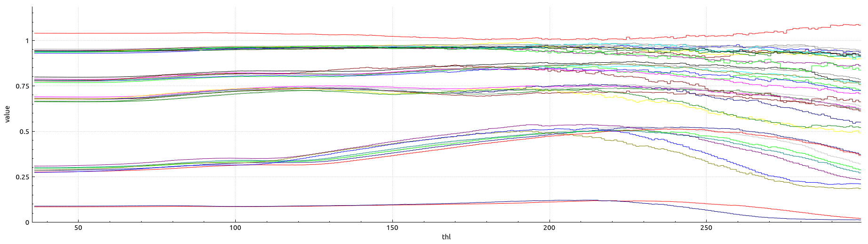
Spectra
Cocktail phantom spectra by tubes
Tube 15 empty
1
H₂O
La
0.75
Gd
Median FFC in RoI
0.5
I
0.25
Solder
0
50
100
250
300
36
150
200
THL
Spectrum means the dependence of the frame value on the threshold value
The frame value is calculated from pixel values (sum, mean, median, min, max,…)
Spectra can be calculated for RoI

Slide 13
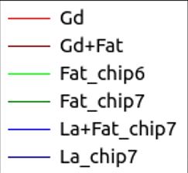
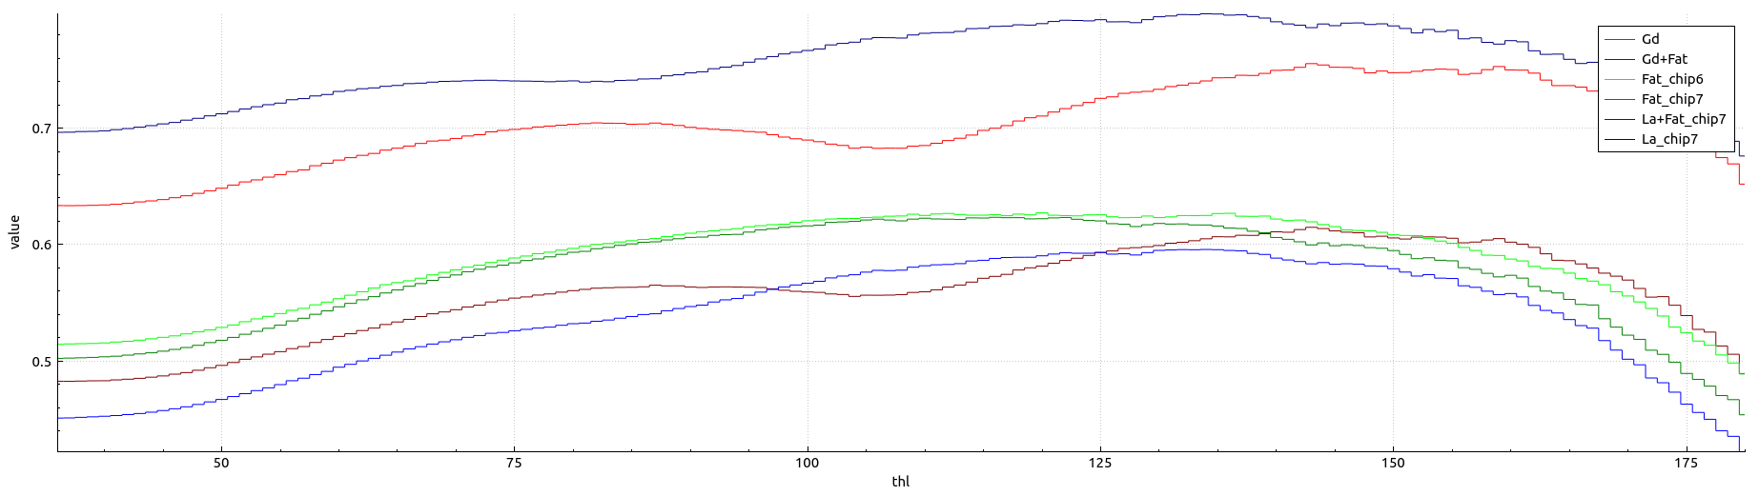
Spectra
Phantom with pork fat spectra
0.7
Median FFC in RoI
0.6
0.5
36
50
75
100
THL
125
150
180
Spectrum means the dependence of the frame value on the threshold value
The frame value is calculated from pixel values (sum, mean, median, min, max,…)
Spectra can be calculated for RoI

Slide 14
Statistic data
Cocktail phantom data, THL = 100, pixel value is FFC
The program calculates data:
Number of pixels
Minimum
Maximum
Sum
Mean
Median
Number of zero pixels
Number of filtered pixels
Number of overflowed pixels
Standard deviation
Signal to noise resolution
Variance
Most probable value of pixel in RoI
RoI | Number of pixels | Sum | Mean | Median | Standard deviation | Signal to noise resolution
Tube 1 (La) | 17466 | 14091.2 | 0.806778 | 0.799718 | 0.03115 | 28.8349
Tube 2 (Gd) | 17834 | 12761.3 | 0.715558 | 0.704645 | 0.0377045 | 22.4352
Tube 3 (H₂O) | 22140 | 21153.9 | 0.955462 | 0.952464 | 0.00329717 | 29.6459
Tube 4 (I) | 18772 | 6430.13 | 0.342539 | 0.324684 | 0.0486977 | 12.0184
The statistic data is calculated on the whole Widepix detector, each Medipix3RX chip and each regions of interest
The statistic analysis is made pixel by pixel. The pixel value is calculated on the counter values (counter1, counter0, FFC, counter1/counter0,…)

Slide 15
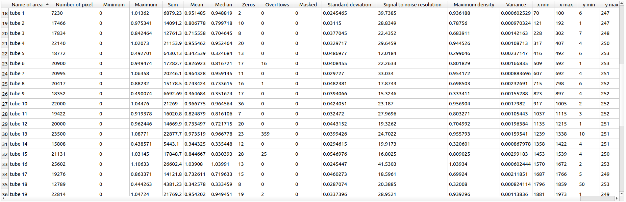
Table of statistical values
Cocktail phantom data, THL = 100, pixel value is FFC
The program generates statistic data in the form of a table

Slide 16
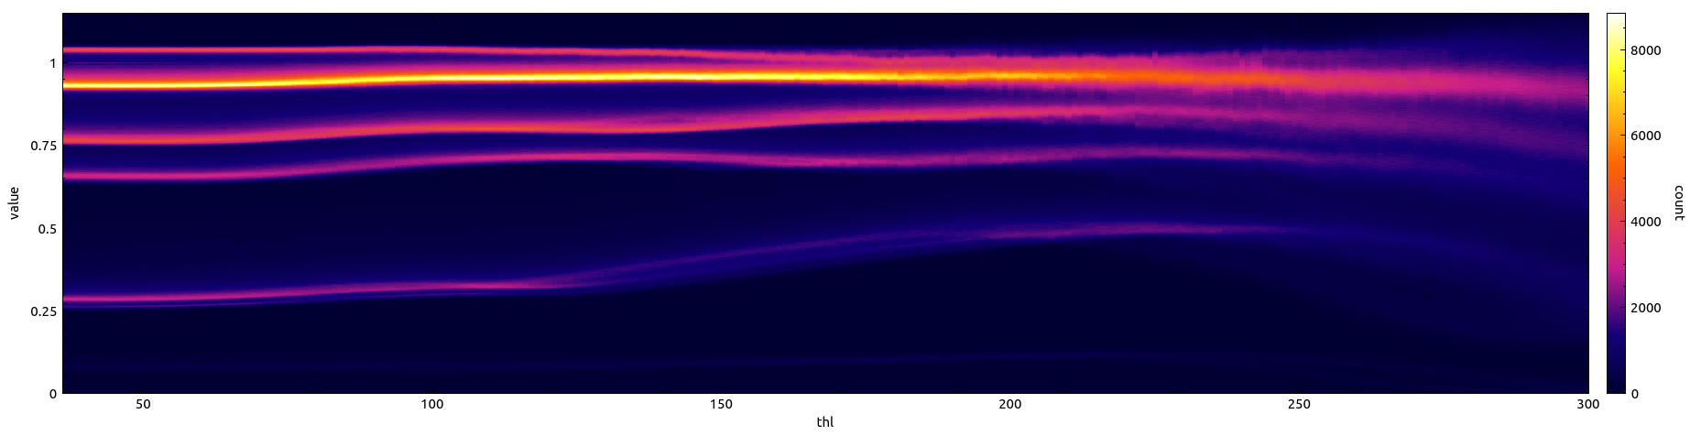
Two dimension spectra
H₂O
Tube 15 empty
La
Cocktail phantom
Number of pixels
1
8000
0.75
6000
FFC pixel value
Gd
0.5
4000
I
0.25
2000
0
50
100
150
200
250
300
0
36
THL
Two dimension spectrum is a 2D histogram
  X axis is the threshold value
  Y axis is the pixel value
The bin value is the number of pixels with the corresponding value at the given threshold.
Two dimension spectra show the dependence of the pixel distribution by the threshold value
Ranges and numbers of bins can be set by user

Slide 17
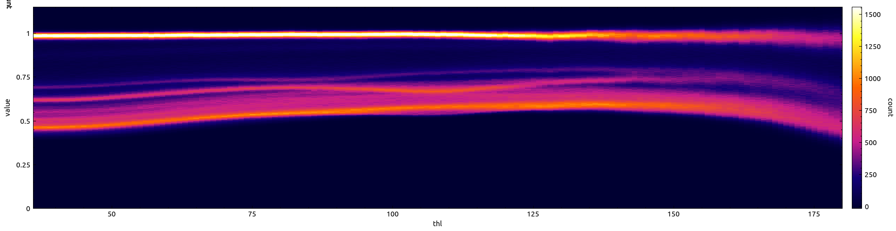
Two dimension spectra
Gd
Empty space
La
Phantom with pork fat
Number of pixels
1500
1
1250
0.75
1000
FFC pixel value
750
0.5
Fat
500
0.25
250
0
50
75
100
125
150
175
0
36
THL
Chip 5
Chip 6
Chip 7
Two dimension spectrum is a 2D histogram
  X axis is the threshold value
  Y axis is the pixel value
The bin value is the number of pixels with the corresponding value at the given threshold
Two dimension spectra show the dependence of the pixel distribution by the threshold value
Ranges and numbers of bins can be set by user
250
La + Fat
Fat chip 6
Fat chip 7
Fat + Gd
1
200
150
0.75
y, pixel
FFC pixel value
100
La
Gd
0.5
50
0.25
0
0
1024
1200
1400
1600
1792
1280
x, pixel
1536

Slide 18
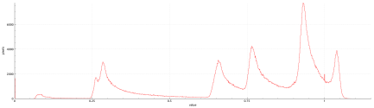
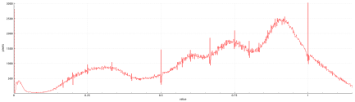
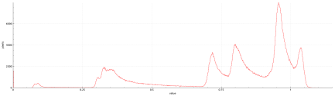
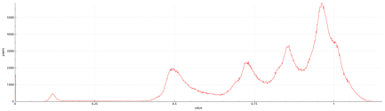
Distribution
THL = 36
Cocktail phantom
THL = 300
1
8000
0.75
6000
FFC pixel value
Number of pixels
0.5
4000
0.25
2000
0
50
100
150
200
250
300
0
36
THL
THL = 125
THL = 215
Distribution is a y-profile of 2D-Spectrum

Slide 19
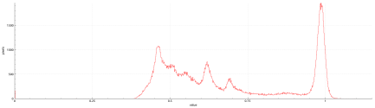
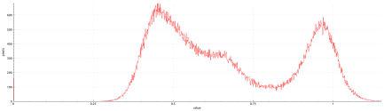
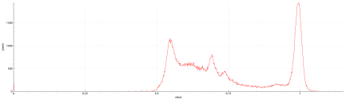
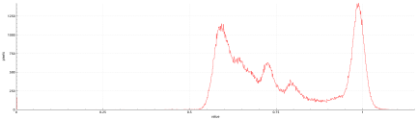
Distribution
THL = 36
Pork fat phantom
THL = 180
1500
1
1200
0.75
1000
FFC pixel value
Number of pixels
0.5
750
500
0.25
250
0
50
75
125
175
180
0
36
100
THL
150
THL = 84
THL = 132
Distribution is a y-profile of 2D-Spectrum

Slide 20
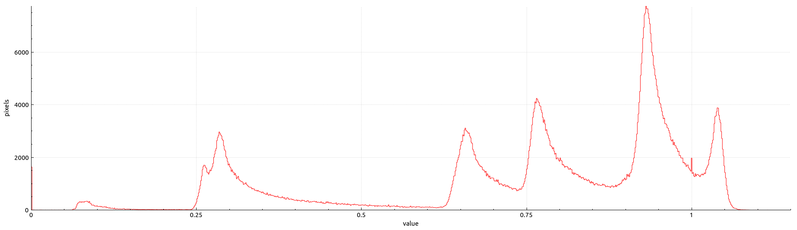
Distribution
Cocktail phantom, THL = 36
H₂O
6000
La
Tube 15 empty
4000
Number of pixels
Gd
I
2000
Solder
0
0.25
0.5
0.75
1
0
FFC pixel value
The distribution is a histogram
  X axis is the pixel value
  Y axis is the number of pixels
The distribution provides a probability distribution of pixel value
The distribution of the frame with threshold THL = 36 with cocktail phantom is shown on the figure
20

Slide 21
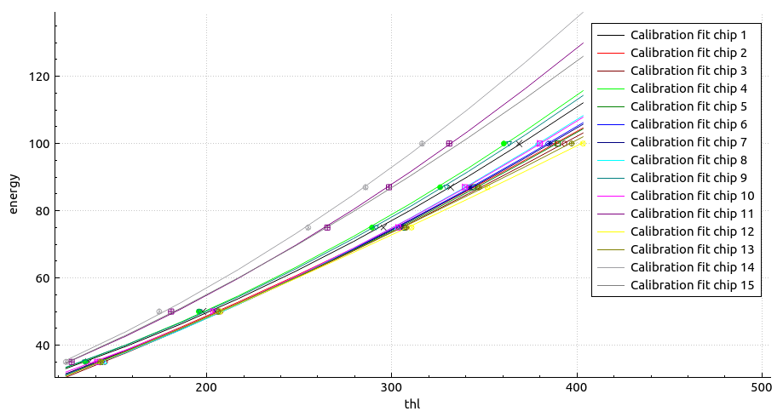
Calibration
120
100
Energy, keV
80
60
40
200
300
400
500
THL, DAC units
The program provides possibilities to make calibration for Medipix3RX in Widepix detector
The calibration is calculated from a series of open-beam threshold scans with different X-ray tube voltage
The calibration data is used to align Medipix3RX detector with each other
The calibration data allows to plot spectra using energy scale

Slide 22
Additional features of the program
Pixel filtering (filtering by a condition for pixel value, filtering by deviation from mean value, filtering areas,…)
Saving pictures in different formats
Mathematical operations with spectra
Further plans
Writing documentation
Embedding of material identification algorithms
Rebinning
Porting on Windows system
Modification to work with other Medipix detectors (on demand)

Slide 23
All source code is available to all interested colleagues for free.
https://github.com/lapkinspjinr/widepix_analyser_2.git
Any suggestion for adding features to the program are welcome (lapkin@jinr.ru)
The program is available at (unzip, run widepix_analyser_2.sh):
https://drive.google.com/file/d/1DxxsUFTb3vQFS9L-cpTprQJD-n9RQ4fi/view?usp=sharing
Thanks for your attention
Are there any questions?

