Slide 1
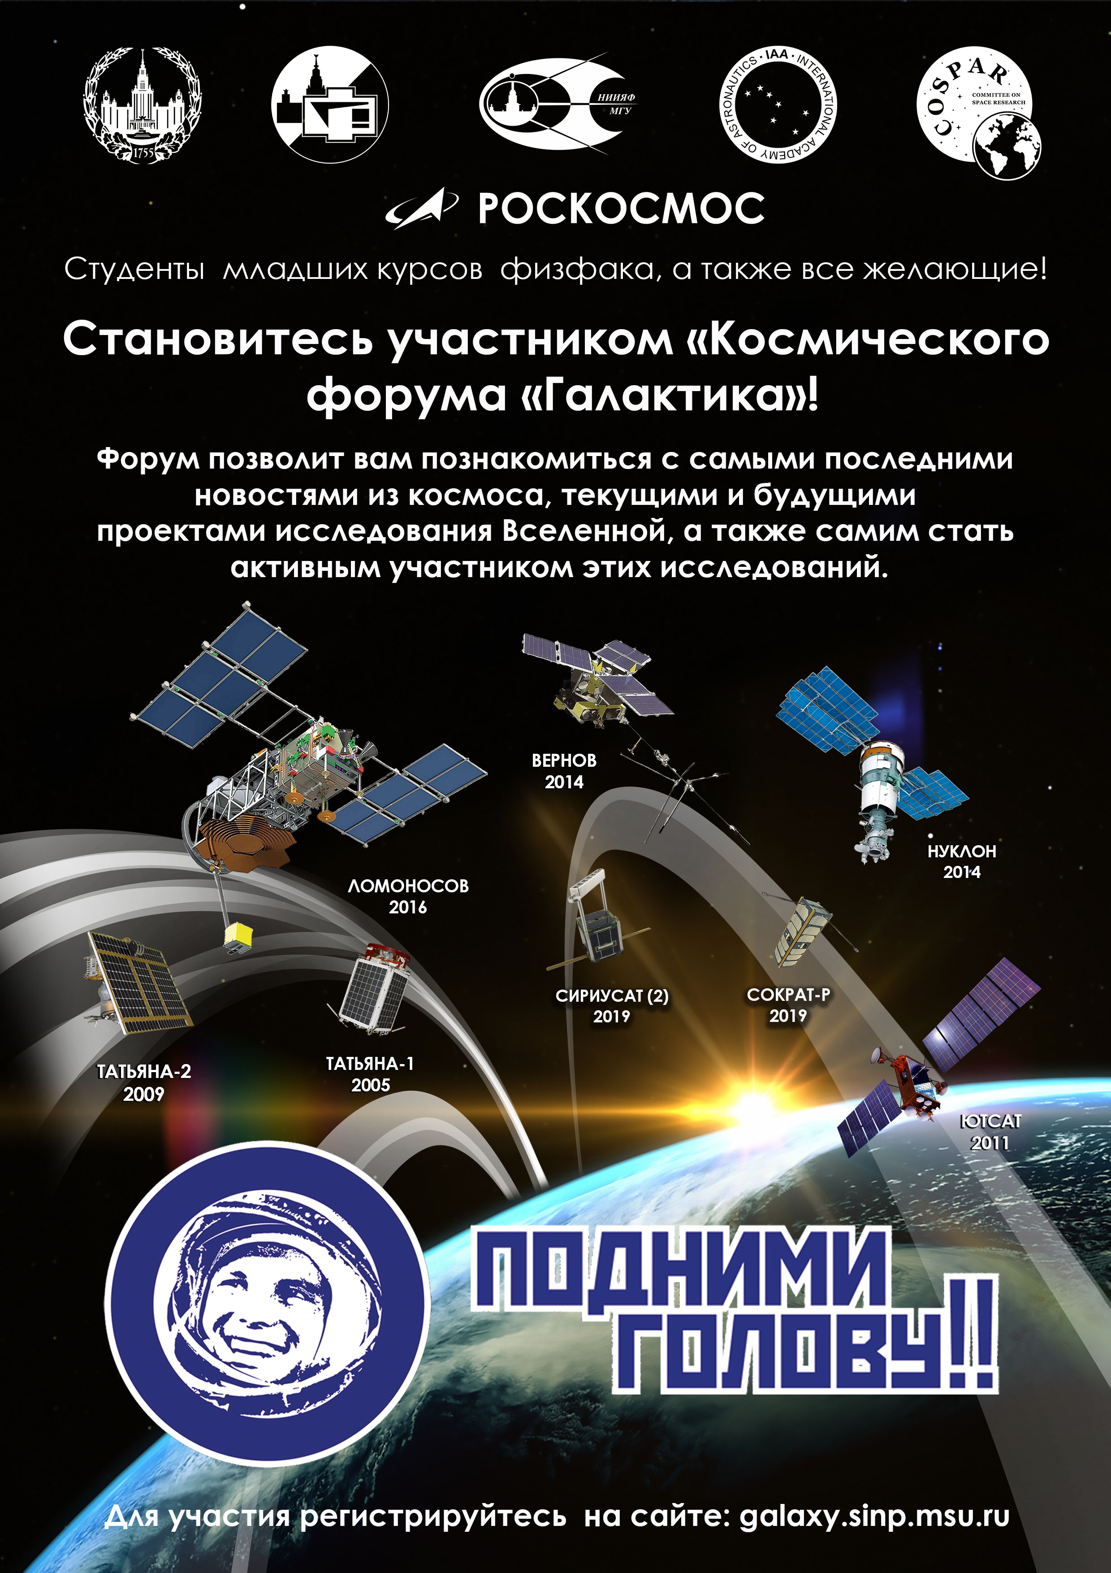
В программе:
Вступительное слово М.И.Панасюка, заведующего кафедрой физики космоса физического факультета, директора НИИЯФ МГУ: «Космическая программа МГУ».
2. Выступление профессора, главного научного сотрудника НИИЯФ МГУ, участника первых космических экспериментов в СССР, начиная
с 1957 г., Ю. И. Логачева: «Как это было».
Космический форум «Галактика», НИИЯФ МГУ 24.12.2019 г.

Slide 2
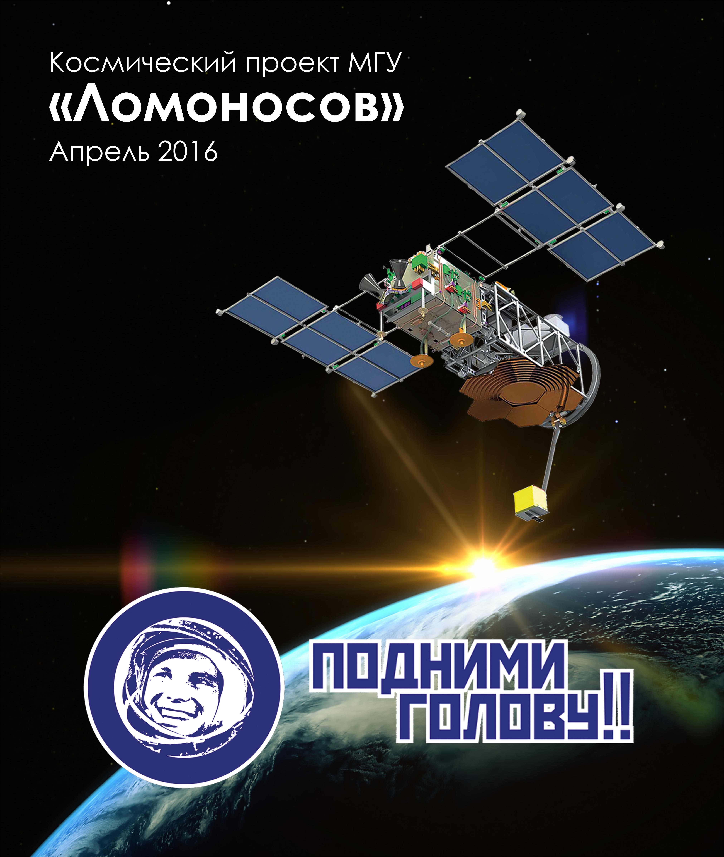
Spaceport “Vostochny”
Service farm
MSU EXPERIMENTS
IN SPACE
MIKHAIL PANASYUK
MOSCOW STATE UNIVERSITY
RAISE A HEAD! = TO PERK!
Space Forum ‘Galaxy” SINP MSU, 24.12.2019

Slide 3
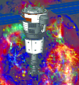
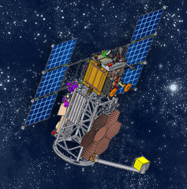
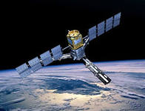
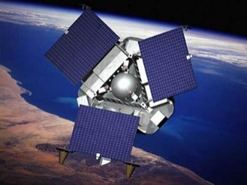
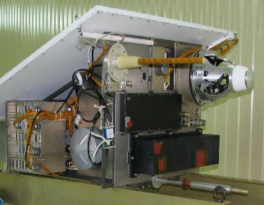
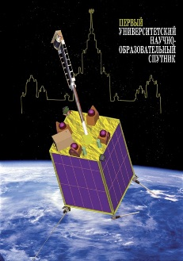
MSU space program
Vernov
2014
Nucleon
2016
Lomonosov
2016
Youthsat
2011
Tatiana-2
2009
Tatiana
2005

Slide 4
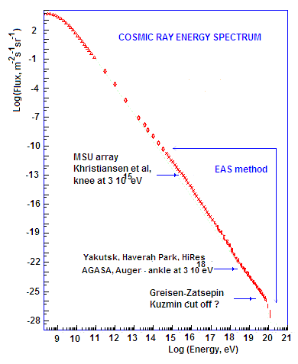
COSMIC RAY SPECTRUM
Extragalactic Ultra High Energy
Cosmic Rays (UHECR)
E > 10¹⁹eV
Sources ?
Acceleration?
Notes:
4

Slide 5

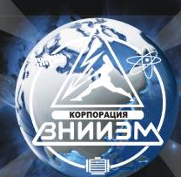
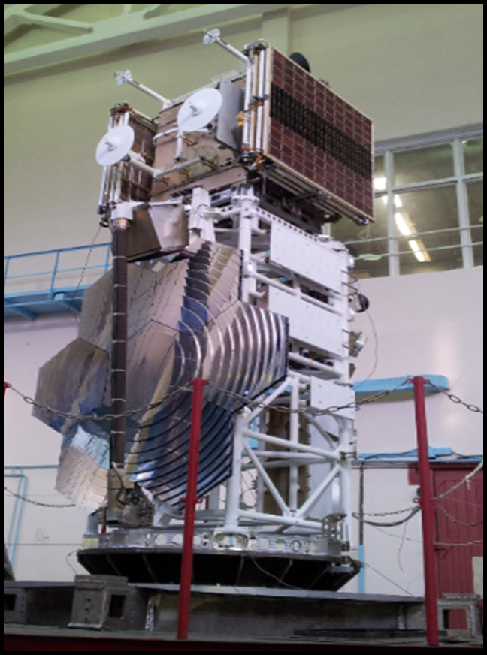
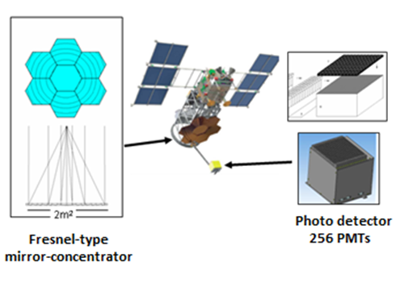
Looking for EAS/UHECR
Top-down measurements as advantages of satellite’s measurements
TUS orbital telescope
S_{eff} ~ kkm²

Slide 6
Top –down measurements for EAS/UHECR
The TUS detector is the first space mission aimed for UHECR EAS measurements. TUS gave an important information on the UV background for EAS measurements.
Background
problem
6

Slide 7
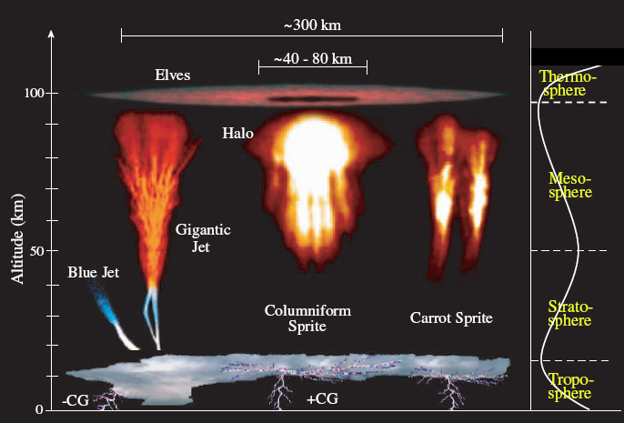
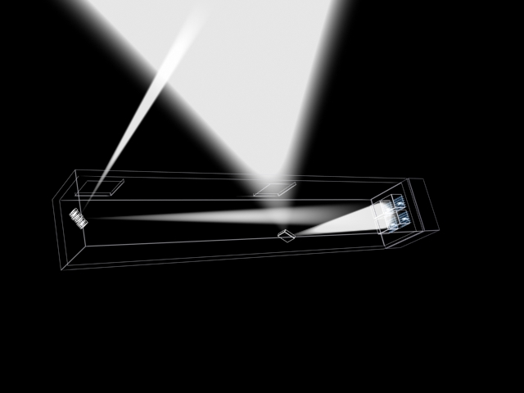
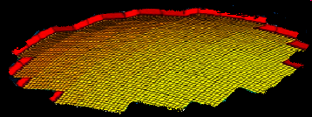
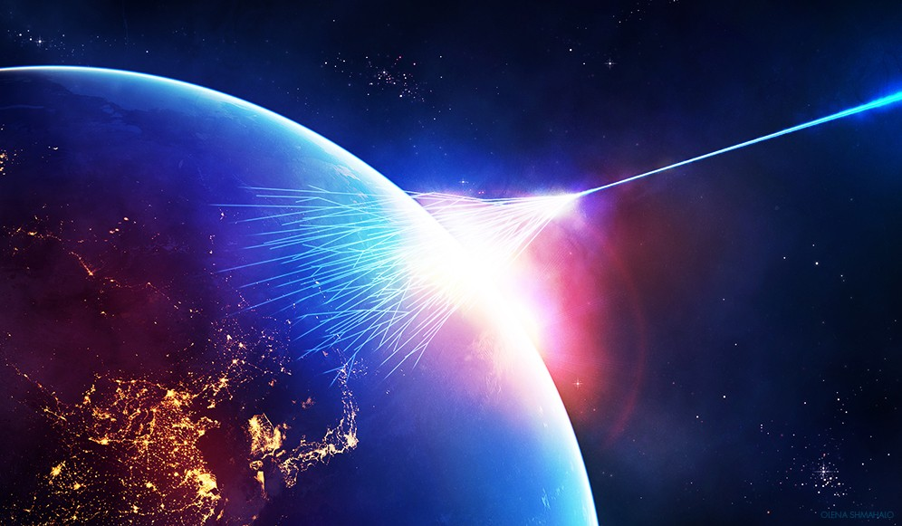
UHECR signal vs TLE’s energy release
Extreme Lighting (TLE) from space → small aperture
Extreme Energy (UHECR) from space → large aperture
Mega Watt
10⁵¹erg
1 Watt
COMPILED AFTER ILPARK
Notes:
7
MEMS 우주망원경 연구단

Slide 8
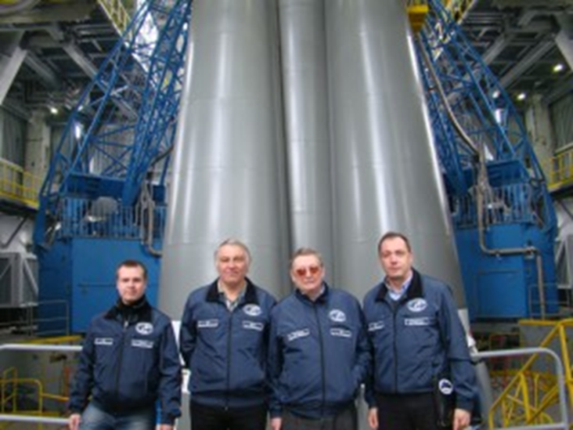
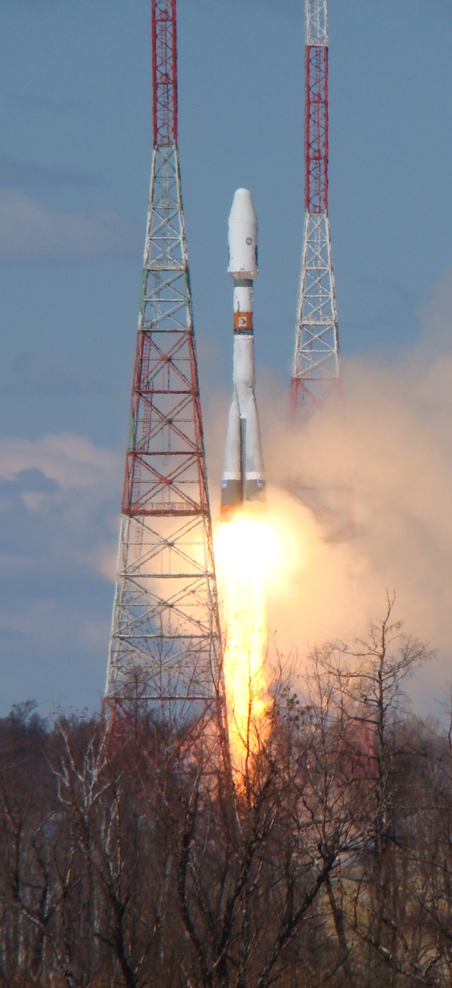
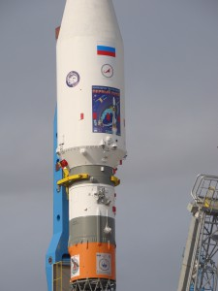
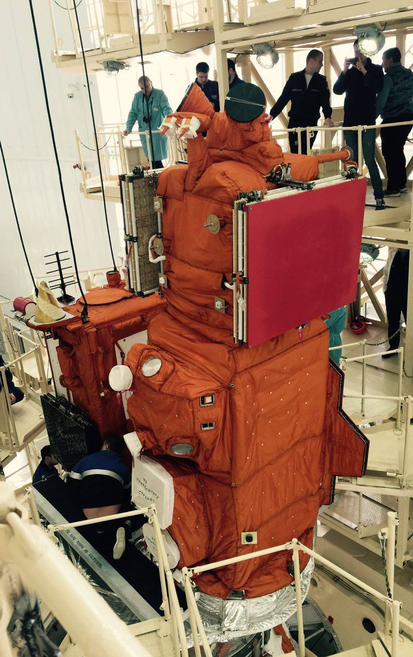
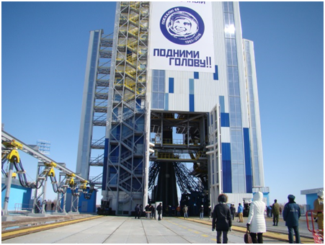
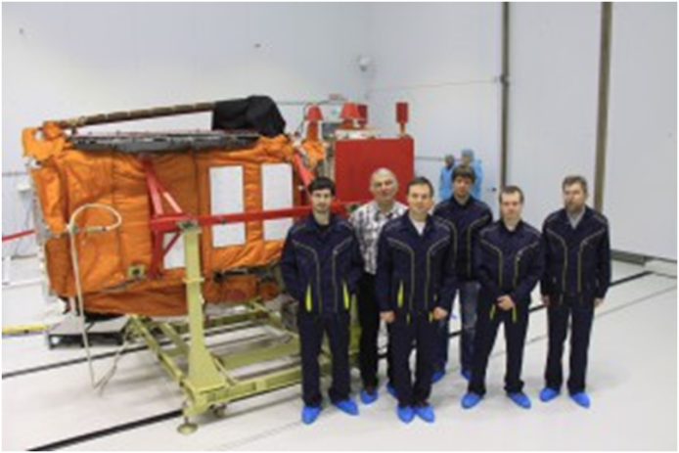
Spaceport “Vostochny”, April, 28, 2016

Slide 9
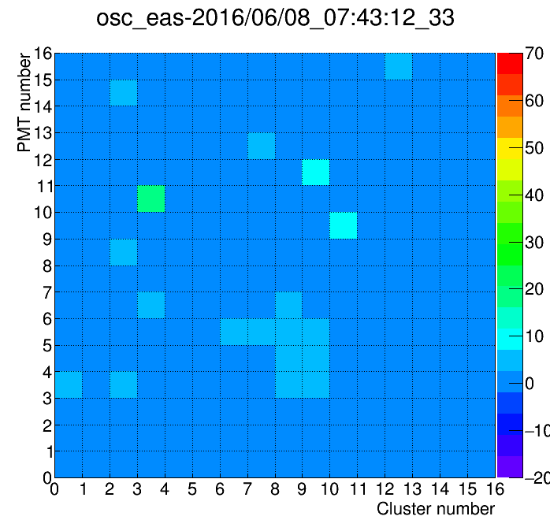
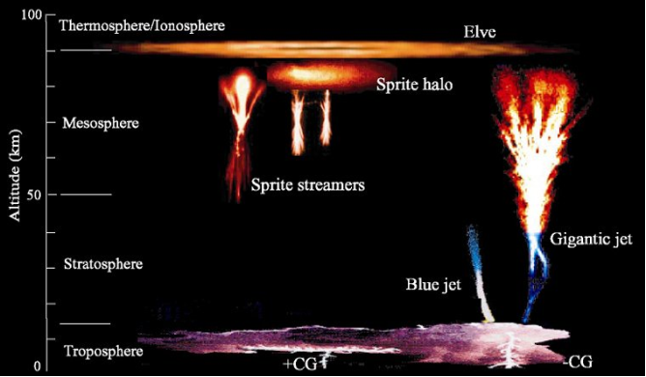
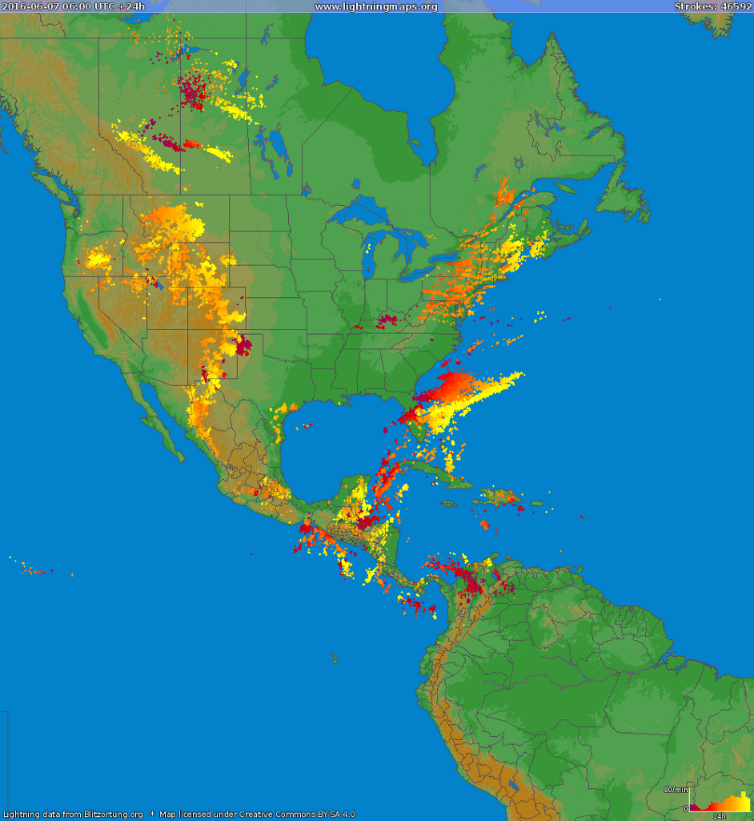
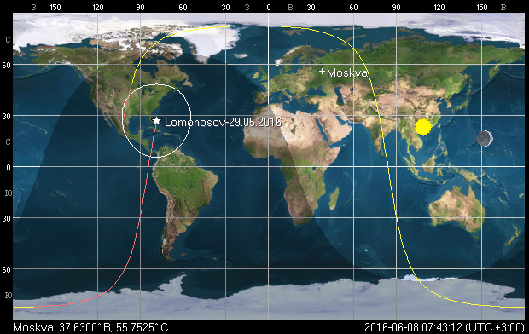
Photodetector 256 pxl
The short (0,8 µs) event (ELVE –type) above the thunderstorm (EAS regime)
The short (0,8 µ sec )
event (ELVE –type) above the thunderstorm (EAS regime)

Slide 10
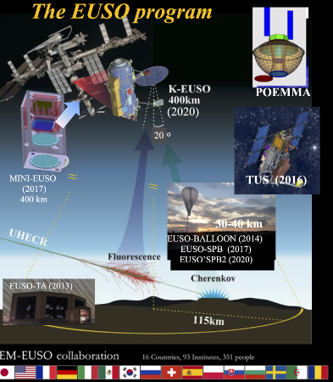
EXTREME UNIVERSE SPACE OBSERVATORY
Russian (MSU)
participation
2021?
2027?
SOYUZ -13
SUCESSEFULLY DOCKED
ON AUGUST 27, 2019!!!
2016

Slide 11
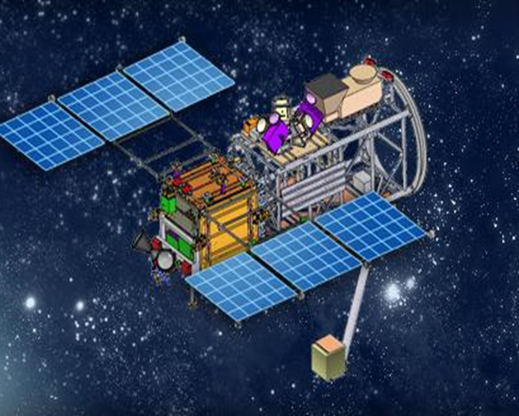
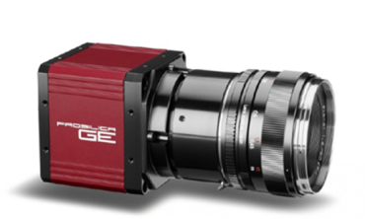
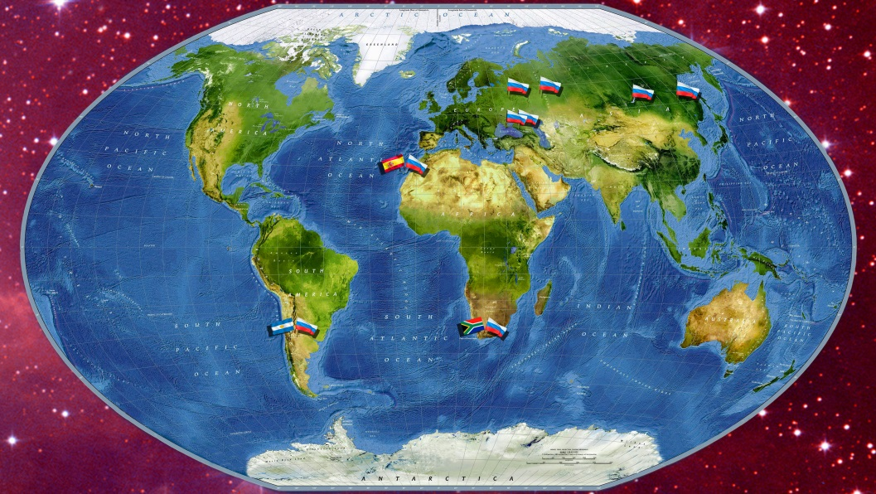
SHOK ONBOARD AND MASTER ONGROUND
Wide-angle optical cameras :
2X 12 Mpx CCD 24*36 mm
Optical
observations
of GRB
MASTER robotized
wide-angle telescopes on ground

Slide 12
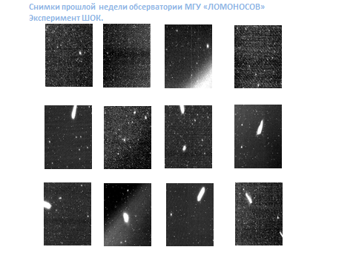
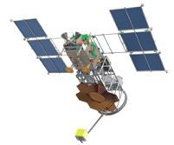
By-product of Lomonosov : technogenic objects
in the near Earth’s space

Slide 13






Lomonosov: object’s mapping
2016-05-14 10:01:27.608 UT
Ra=273.541622 Dec=-76.66425
Спутник Iridium 15,
расстояние 322 км, блеск 4m
2016-05-14 10:56:59.206 UT
Ra= 301.070945 Dec=40.400331
Некатологизированный объект
2016-05-14 19:27:17.633 UT
Ra=277.679859 Dec=-59.34641
Некатологизированный объект
?
?
2016-05-14 19:33:34.201 UT
Ra=325.298015 Dec=-71.05177
Спутник SL-3 R/B,
расстояние 481 км, блеск ~5m
2016-05-15 00:15:49.736 UT
Ra=304.056670 Dec=-76.88071
Спутник SL-8 R/B,
расстояние 336 км, блеск 3m
2016-05-15 00:15:49.736 UT
Ra= 3.861084 Dec=-70.164646
Спутник GeoSat,
расстояние 300 км, блеск 4.7m
Notes:
13

Slide 14
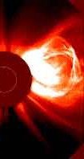
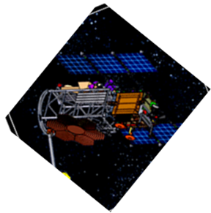
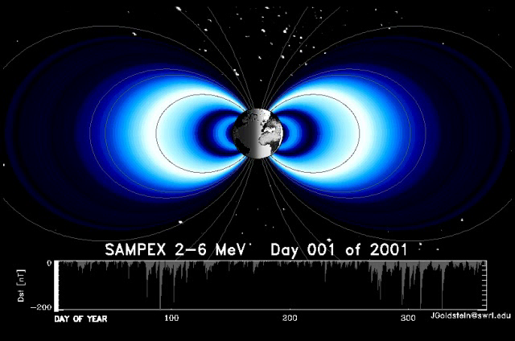
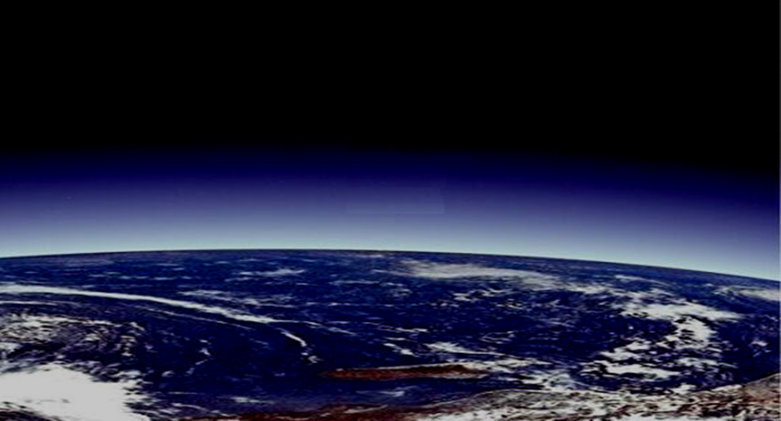
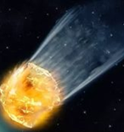
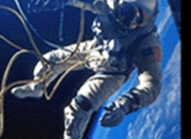
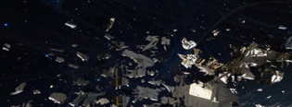
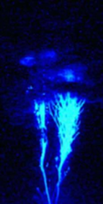

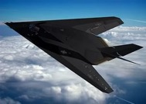

UNIVERSAT – SOCRATES for space threats monitoring
GAMMA-RAY
BURSTS
SOLAR
HIGH-ENERGY
PARTICLES
RADIATION
ASTEROIDS,
SPACE DEBRIS
TLE
RADIONUCLID
ENGINES
TGF
ELECTROMAGNETIC
TRANSIENTS

Slide 15
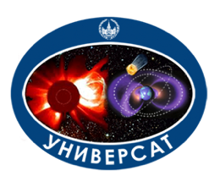
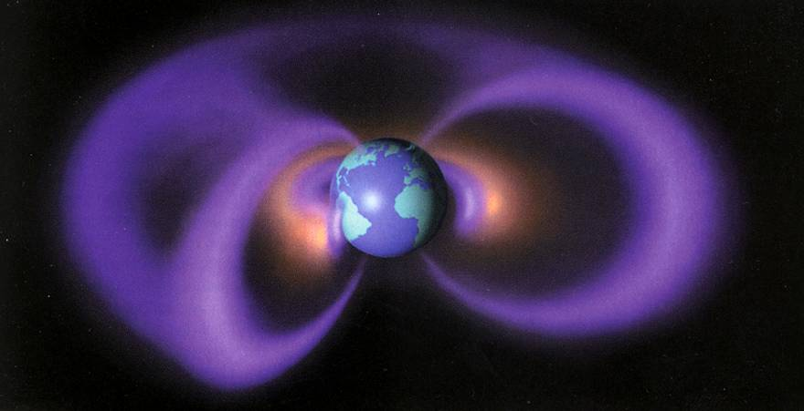

UNIVERSAT –SOCRATES CONCEPT
Extrapolation
of LEO radiation
measurements
Global Star
LEO – satellites UNIVERSAT

Slide 16
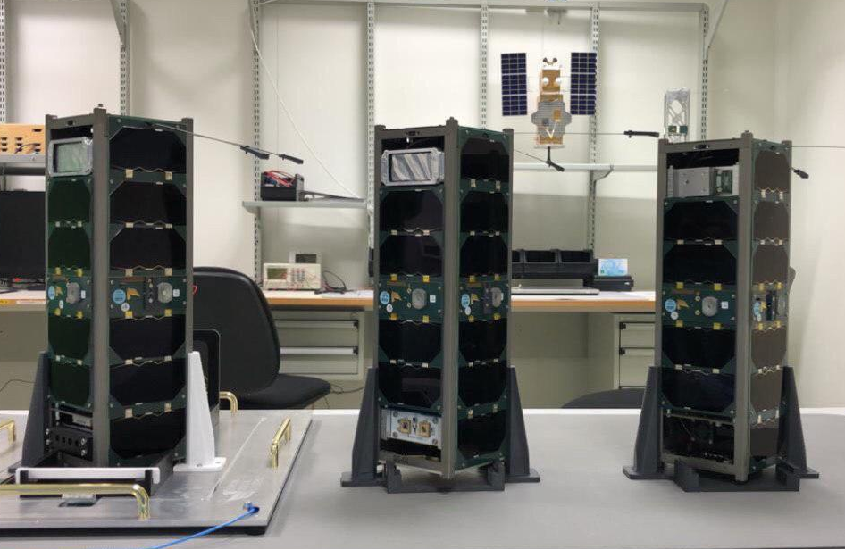
«UNIVERSAT - SOCRAT» program: the first stage
Cubesats "Socrates", "Amursat", ”VDNH-80" have been launched in piggyback payload configuration with spacecraft ”Meteor-M" №2-2 on board the "Soyuz-2.1 a"/RB "Fregat" from the cosmodrome ”Vostochny" on 5 July 2019. All SC were equipped with a radiation modules.
SC AMURSAT
SINP MSU +
AMUR U
SC SOCRAT (SINP MSU)
SC VDNH
(SINP MSU + VDNH)

Slide 17
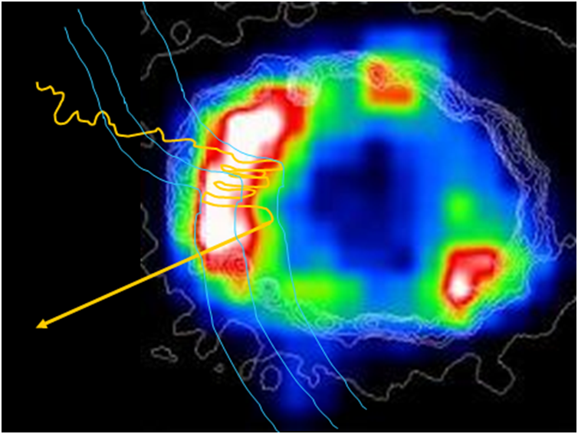
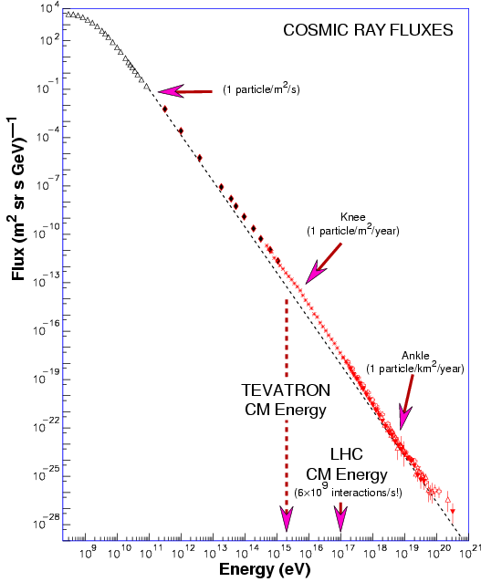
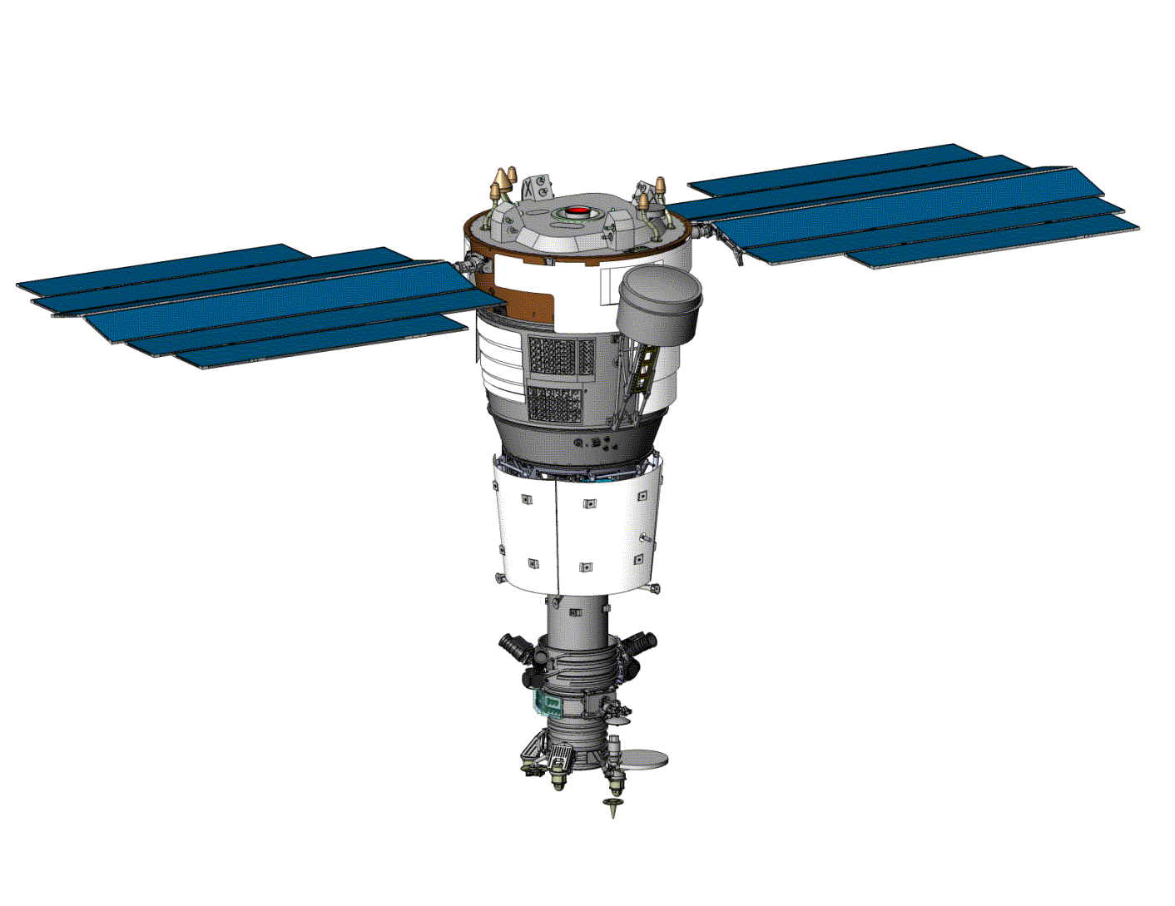
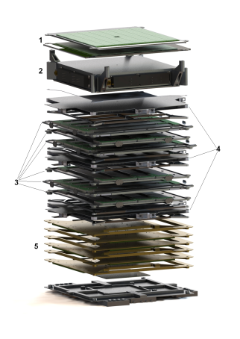
NUCLEON PROJECT (launched in 2016)
Particles acceleration
in supernovae
remnants
NUCLEON instrument
– sophisticated calorimeter
The main goal: to study chemical
composition of cosmic rays below 10¹⁵ eV

Slide 18
GO TO THE FUTURE

Slide 19
Project OLVE (Orbital Laboratory of High Energy) is directed to study
chemical composition of cosmic rays in this energy range
The only way to check standard model of generation galactic cosmic rays –
to provide information about chemical composition of particles up to 10*16 eV
Full-size calorimeter to measure energy and charge of particles/
Total mass – 12 tonn.
Life-time – more than 5 years
Super Heavy
Launcher

Slide 20
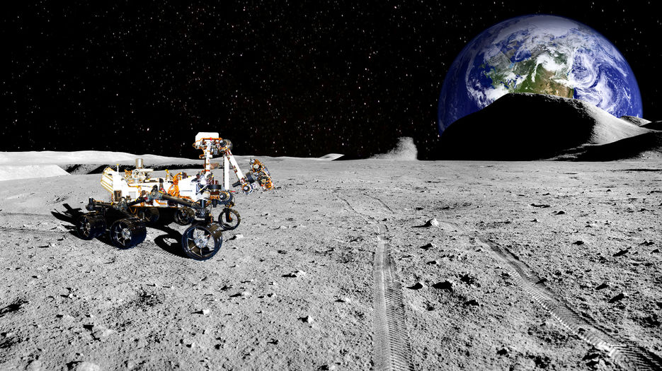
Mounting of the installation: phased and robotic
With a total weight of 10 tons
it is possible to achieve a record
geometric factor up to 300 m²
Galactic
cosmic rays
Information
modules
Neutronium’s
modules
Albedo of
Neutrons,
Gamma,
Radio

Slide 21
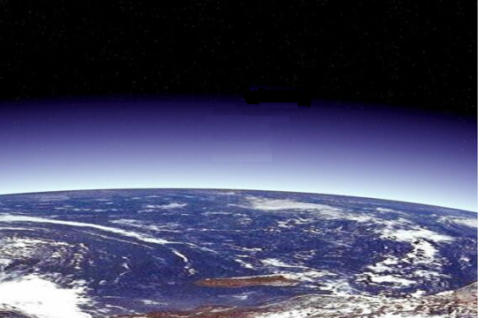
Thank you

